Slide 1
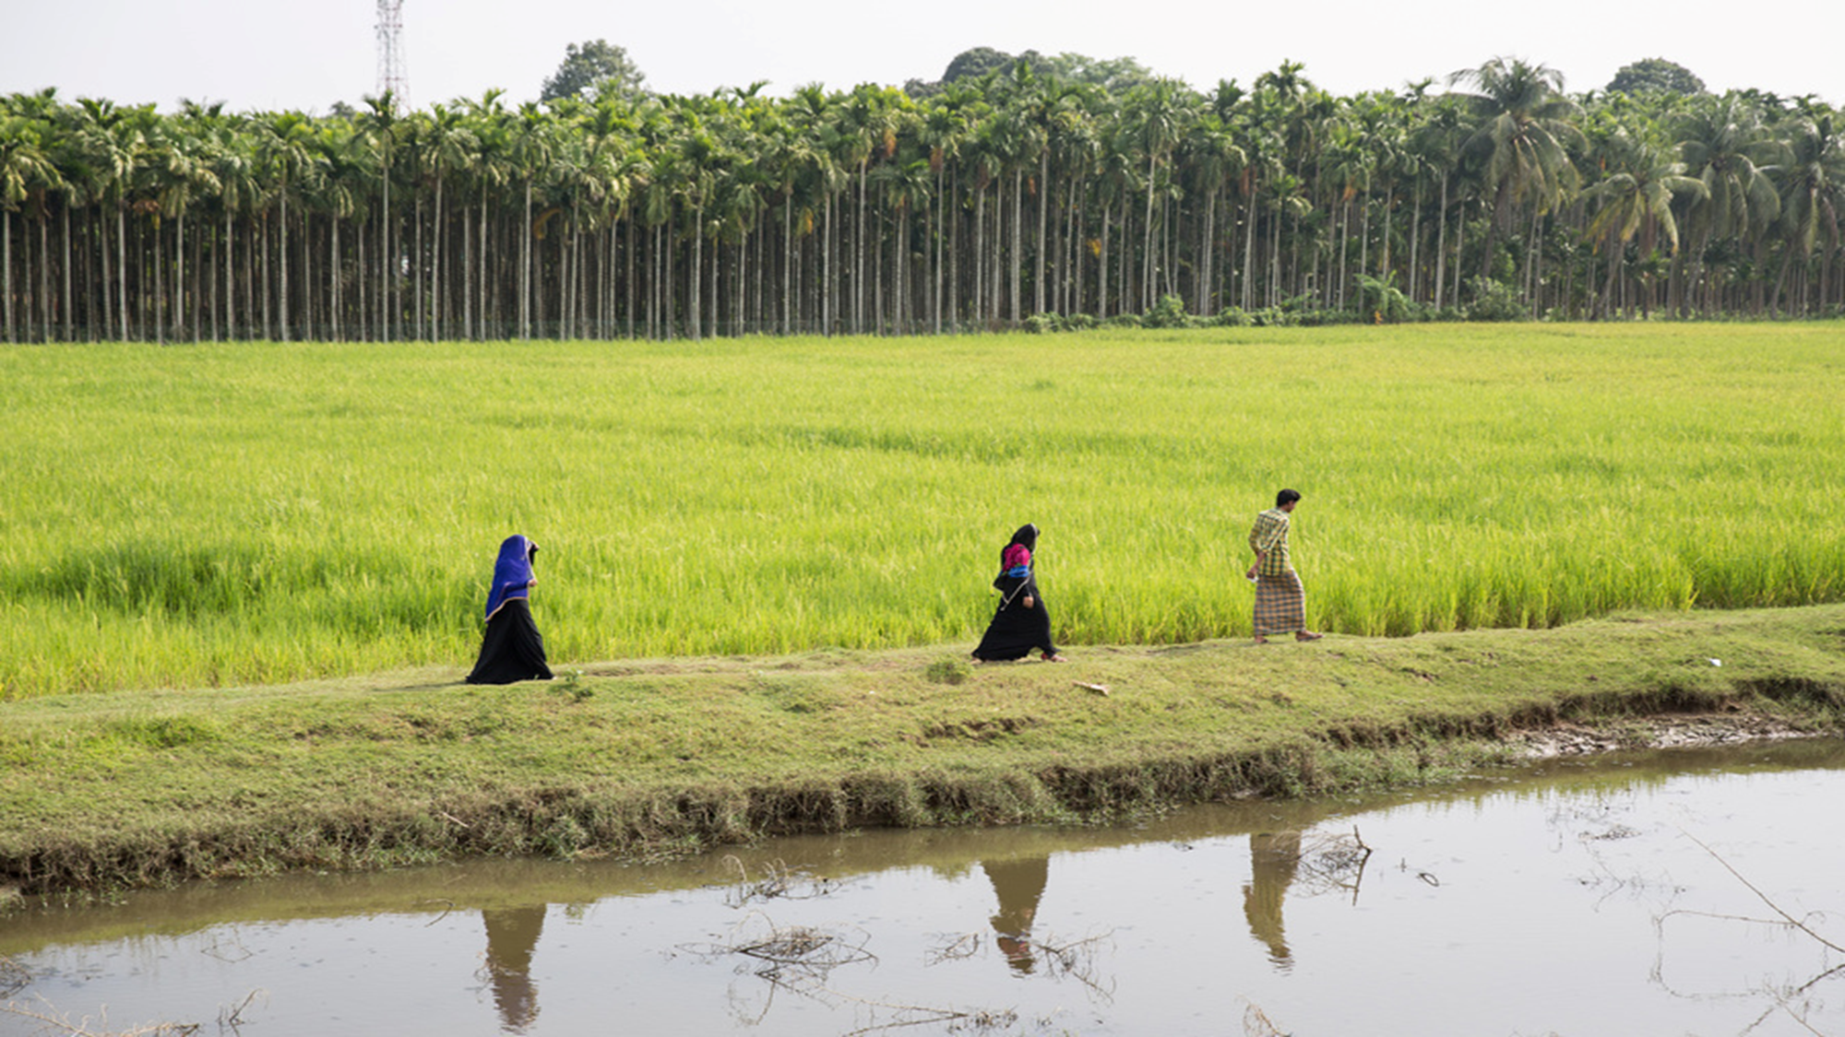


Integrating migration into country planning processes to accelerate the GCM implementation and SDGs achievement
Monday, 27 November 2023

Slide 2
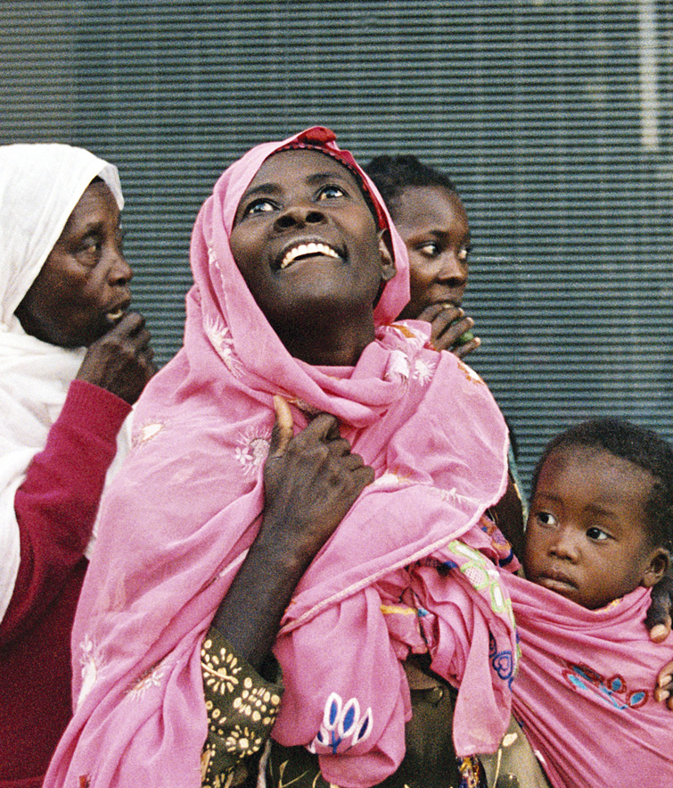

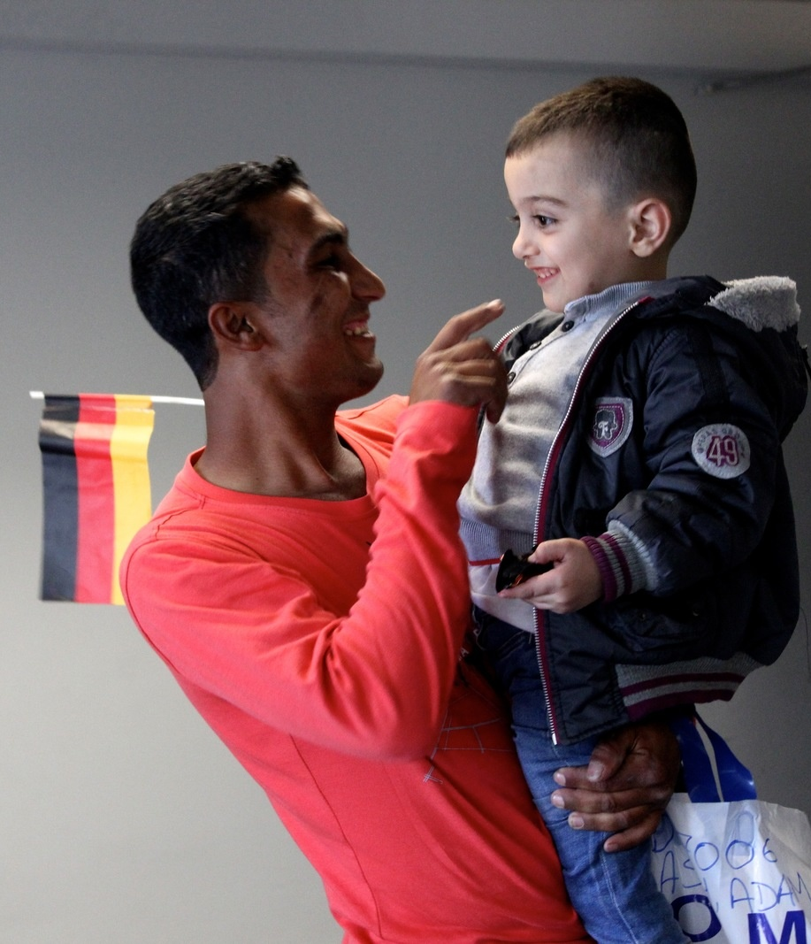
Opening Remarks

Slide 3

Training objective
  By the end of the training:
Increase knowledge and understanding of the Global Compact for Safe, Orderly and Regular Migration and/or the UN Network on Migration
Discuss ideas for establishing or strengthening partnerships with stakeholders on GCM implementation
Strengthen cohesion of UN partners in UNCT who are working on migration and create synergies amongst existing working groups and initiatives
Identify joint programming ideas for the implementation of the Cooperation Framework
Strengthen joint UNCT analysis of the migration landscape in-country to better prepare for the next update of the CCA

Slide 4
Overview of the workshop Day 1
  Day 1 and Day 2 Agenda
Session | Title
Opening session | Opening Remarks by IOM and UNICEF
Scene Setting | Migration and Asylum snapshot in Egypt
 | Global Compact on Refugees Global Compact for Safe, Orderly and Regular Migration
 | Overview of the Cooperation Framework in Egypt and progress related to its implementation
Session 1 | Coordination Mechanisms in Egypt and in the region related to Migration and Refugees
Session 2 | Migration, the GCM and the 2030 Agenda
Session 3 | Migration and the Cooperation Framework
Closing session | Key takeaways and way forward Closing Remarks by RC Egypt

Slide 5
Migration and Asylum
Snapshot in Egypt

Slide 6
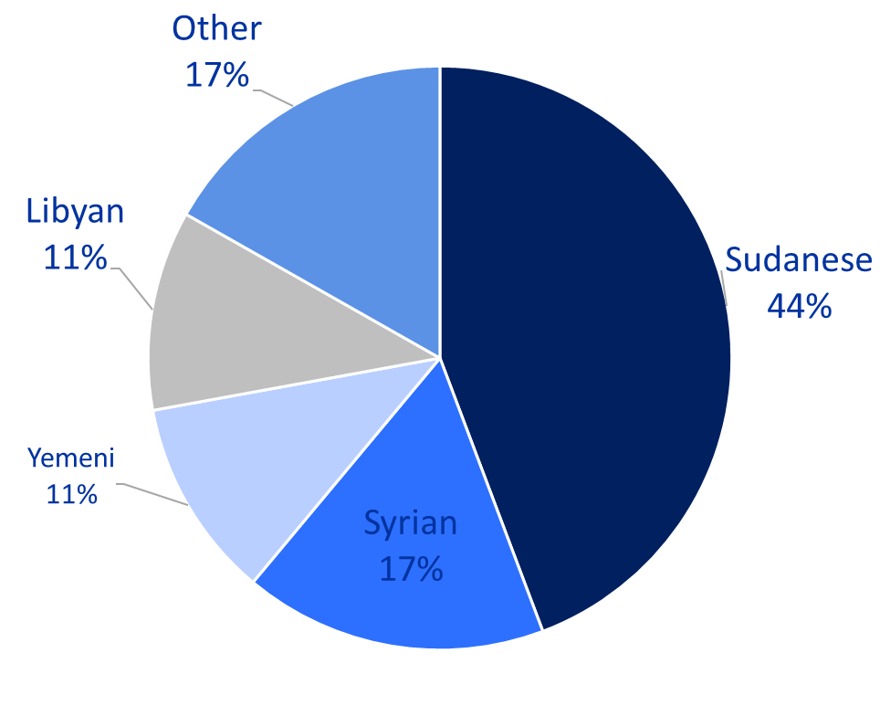
Migration snapshot in Egypt: Migrant stocks in Egypt
Egypt is a country of origin, transit and destination.
In 2022, IOM estimated that the number of migrants residing in Egypt in 2022 to be 9 million, which amounts to 8.7% of the country’s population.
80% of this population belongs to one of the main countries of origin; Sudan, Syria, Yemen and Libya.
More than 130 nationalities are represented in the remaining migrant communities, representing 1,512,582 people.
Notes:
[1] IOM, Triangulation of Migrants Stock in Egypt July 2022. (2022). Retrieved 07 November 2022, from: https://egypt.iom.int/sites/g/files/tmzbdl1021/files/documents/migration-stock-in-egypt-june-2022_v4_eng.pdf
•Common Situational Analysis on Education and Health Services for Migrants and Refugees in Egypt, Joint Platform for Migrants and Refugees, March 2022.
•Access to basic services for migrants in Egypt, IOM Egypt, January 2022.

Slide 7
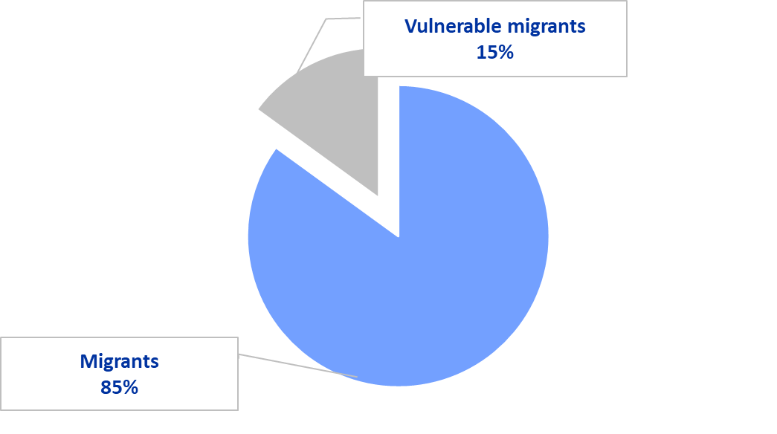
Migration snapshot in Egypt: Who is in need ?
Migrants’ vulnerabilities
• 97% are migrants and 3% are registered refugees.
15% (between 1,1 to 1,300,000) can be considered “vulnerable” migrants or persons of concern.
35.2 years old the average age of migrants
2.4% only who are 60 years old or above.
A gender-balanced population, with 49.6% females to 50.4% males.
Notes:
[1] IOM, Triangulation of Migrants Stock in Egypt July 2022. (2022). Retrieved 07 November 2022, from: https://egypt.iom.int/sites/g/files/tmzbdl1021/files/documents/migration-stock-in-egypt-june-2022_v4_eng.pdf

Slide 8
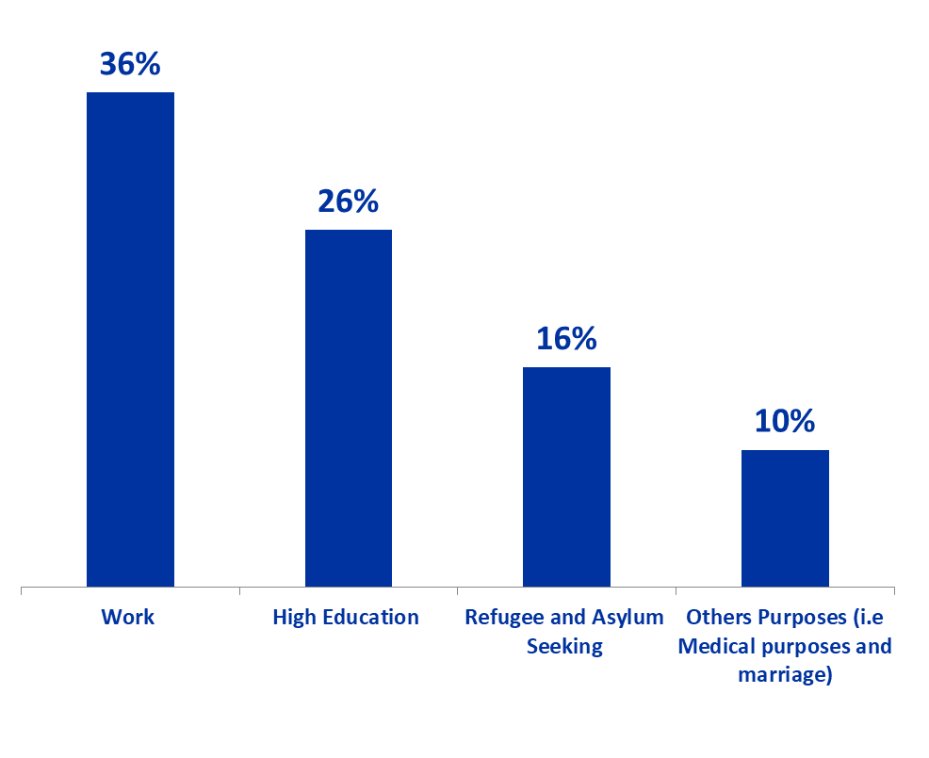
Migration snapshot in Egypt: Duration and Purpose of Stay
• 11 years is the average duration of stay in Egypt;
• 5.7 % of the population are in Egypt for 15 years or more.
• Purpose of stay
  Employment
  Education
  Applying for refugee status or asylum-seeking
  Medication (i.e Sudanese & Yemenis)
  Retirement (i.e Saudis)
  Marriage
Notes:
[1] IOM, Triangulation of Migrants Stock in Egypt July 2022. (2022). Retrieved 07 November 2022, from: https://egypt.iom.int/sites/g/files/tmzbdl1021/files/documents/migration-stock-in-egypt-june-2022_v4_eng.pdf

Slide 9
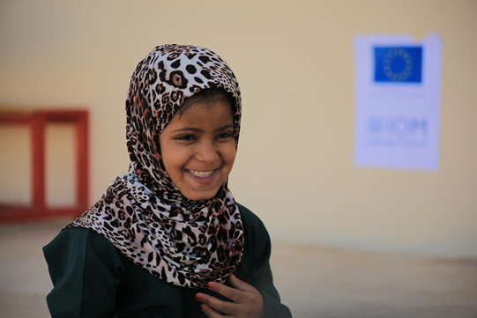
Migration snapshot in Egypt: Main Challenges Migrants Face
• Inability of migrants to present proper documentation deprives them from smooth access to education and health, and livelihood opportunities.
• Lack of financial capacity of migrants presented in the shortage of income, and the inability to provide basic fees for Education and health services, which constitutes a burden on migrants and decreases their chances of accessing the services.
• Discrimination/bullying and language barrier are among the reasons why migrants fail to get proper basic services and integrating in the society.
Notes:
[1] IOM, Triangulation of Migrants Stock in Egypt July 2022. (2022). Retrieved 07 November 2022, from: https://egypt.iom.int/sites/g/files/tmzbdl1021/files/documents/migration-stock-in-egypt-june-2022_v4_eng.pdf

Slide 10

Questions?

Slide 11
UN Workshop on Migration for UNCT Egypt:
Refugee Snapshot
UNHCR Egypt
27 November 2023

Slide 12
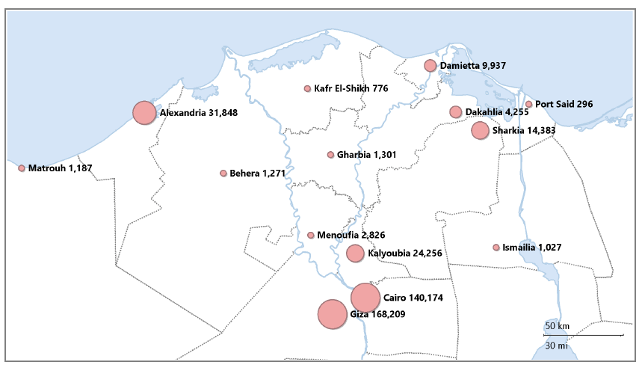
Mapping of All Populations, 31 Oct 23 (non-encampment policy)

Slide 13





Egypt Update
370k Sudanese, 8,504 TCNs (21 November)
Average of 350 arrivals per day, most arriving through Argeen and Qustol
Aswan
Presence
Awaiting Registration Clearance, undertaking border monitoring, as well as LPP, CP, GBV & CBP interventions
Waiting period for visas (in Wadi Halfa): 1-3 months, with 50+% of UNHCR registered new arrivals entering irregularly
Registration Services has increased eight-times since pre-crisis:
156,352 individuals provided with appointments (24 Nov)
107,637 (69%) individuals registered (24 Nov)
2,500+ daily average of individuals, majority new arrivals
Arrests for exits to Libya increasing, a 100% increase with a total of 852 persons as of 31/10/2023 in 2023, compared to 426 in 2022, including an increase in the number of arrested children.

Slide 14





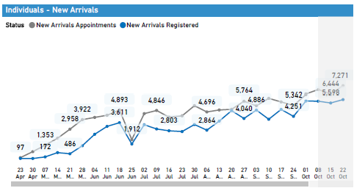
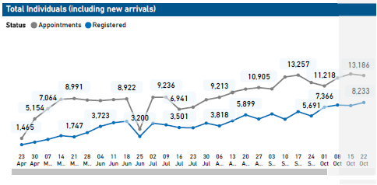
Overall Population: Gender & Registration Trends
60+ Years
2.7%
2.7%
Registered Refugee and Asylum seekers 408 K
18 - 59 Years
32.0%
25.5%
05 – 11 Years
46%
54%
15.2%
14.8%
As end of October 2023
Sudan New Arrivals:
54% 46%
0 – 4 Years
4.9%
4.5%

Slide 15
Changing Protection Environment
GoE no longer referring to the Four Freedoms Agreement, but rather referring to “bilateral arrangements” (digitized passports and visas required for entry; security clearance granted for extremely limited number). Challenges access to education.
Risk of arbitrary detention and deportation; lack of access to basic rights and services including education, communication and rental places
Visa provided decreased from 6 months to 3 months (for foreigners) under the discretionary of the immigration authorities
Refugee-like population, inc sur-place, to consider 1) Post-conflict inability to return to Sudan (UNHCR advisory), 2) Residency challenges given difficulty for passport renewal, 3) Increased social tensions, especially related to socio-economic realities
Rapidly changing context and new emerging risks. Mixed movements is a key cross-cutting issue (nexus) and coordination needed at all levels

Slide 16






Protection Strategy
Emphasis on Access to Territory & Asylum
Quality Protection Services with Outsourcing
Registration Surge / Self-Onboarding
Legal/Policy Support to Inclusion Strategy
Upscaled Role
in
Mixed Movement
Protection Coordination with Protection Information Management (PIM)

Slide 17




Mix Movement & Protection Focus
    Strengthen State-Based Protection and referrals for those in need of international protection
    Strengthen CBP/CwC to improve resilience and self-management
    Provide GoE capacity building on protection-sensitive practices
    Joint advocacy with GoE on i) Access to Territory/Asylum,
    ii) Non-Return Advisory and iii) UNHCR access to detention

Slide 18
2024 Egypt Refugee & Resilience Response Plan
Official Launch in 2024:
Egypt RRP Feb/March
Sudan RRP mid- January
Syria 3RP Feb/March
ISWG provide feedback on the a/m requirements
By 30 Nov. finalize first draft of Egypt chapter for Sudan RRP (narrative + budget+ figures)
2024 ERP High Level Workshop
IA, ER and Executive
Present to ISWG steps for ALL refugees: timeframe, indicators, strategic objectives, populations, activity log, budget guidelines for feedback
Finalization of Sudan RRP based on feedback from RB and HQ+ Second circulations with ISWG
Finalize Egypt chapter for country RRP
Start to draft country Egypt (ERP) narrative
7 Nov. Send to RB MENA Egypt figures + budget+ short narrative
(IA + IM Team)
2024 RRP Way Forward
Step Internal discussion
(Result Framework & Indicators / Pop / Fund Tracker Tool. Etc.)
Govt; Donor; NGOs, Agencies Consultations on Coordination Structure
20 Dec. finalization of 3RP Syria for Soft launch
Provide for GHO estimated figures + budget + short narrative on Syria & Sudan RRP
Feedback from countries on 3RP Syria
MSNA 2024
AUGUST
21 SEPTEMBER
1- 15 OCTOBER
15-30 OCTOBER
NOVEMBER
DECEMBER
Notes:
RSO: Regional Strategic Objectives
RCO: Resident Coordination Office

Slide 19
Questions?

Slide 20
Global Compact on Refugees
Global Compact for Safe, Orderly and Regular Migration

Slide 21
Global Compact on Refugees
GCR
Pledges of Egypt and Looking Forward
27 November 2023

Slide 22







GRF background & Pledges of Egypt
The key objectives of GRF are to:
Ease
the key pressures
on host countries
Enhance
the self-reliance
of refugees
Expand
access to third country solutions
Support
conditions in COO for return in safety and dignity
In 2019, Government of Egypt has made 3 pledges in the areas of:
Education
Health
Peacebuilding

Slide 23




Education
Continue providing refugee children and youth with access to education within national education system in line with national education strategy for 2030
New national asylum law will consolidate framework for provision of education for refugees
Pledge
Best Practices
Egypt's integration of Syrian refugee children in its public education system
Challenges and Gaps
Funding and resources
Advocacy Message
Inclusion of all refugees in the national educational system regardless of their nationalities

Slide 24




Health
Pledge
Provide refugees with same primary health care services and services in MOHP hospitals as those available to Egyptian citizens
Refugees to be covered by comprehensive health insurance
Refugees have access to primary, secondary and tertiary health services in MOHP health facilities same as Egyptian citizens
Refugees are partially included in 100 health campaigns
Refugees were/are included in Covid-19 response including vaccination – all doses
Best Practices
Challenges and Gaps
Refugees have limited access to public hospitals outside of MOHP (i.e. university hospitals)
Advocacy Message
Refugees to be fully included in all national health facilities including insurances, campaigns as well as the national data system

Slide 25



Peacebuilding (multi-stakeholder pledge)
Cooperate with international partners to provide structural and technical support to the GoE as well as ad hoc resources, to expand employment opportunities, facilitating access to work and increasing self-reliance.
Pledge
Finding durable solutions for refugees in the region, in conjunction with the search for a political solution
Strengthening social cohesion & improving welfare of people living in Egypt as part of country SDG strategy
Possible
Outcomes
Advocacy Message
Ensure the Sudanese are included in the country’s solutions strategy

Slide 26
Climate (multi-stakeholder pledge – New Pledge)
Goal: support conditions in countries of origin for return in safety and dignity), through addressing the root causes and drivers of displacement toward achieving durable solutions.
Improve the predictability of UNHCR’s engagement, working with a wide range of stakeholders, to anticipate, prepare for and respond to emergencies brought on by climate-related and other natural hazards.
Incorporate climate and environmental considerations into sectoral operational responses, work with refugees, IDPs and communities in the most climate vulnerable countries, and develop innovative sustainable energy and reforestation programmes for refugee-hosting areas.
Improve the sustainability of the end-to-end supply chain, including planning, sourcing, contents, manufacturing processes, procurement, delivery and lifecycle management of core relief items and other goods Finding durable solutions for refugees in the region, in conjunction with the search for a political solution
Strengthening social cohesion & improving welfare of people living in Egypt as part of country SDG strategy
Ensure the Sudanese are included in the country’s solutions strategy

Slide 27
Thank you

Slide 28



The Global Compact for Safe, Orderly and Regular Migration
27 November 2023
Misato Yuasa, Regional Liaison and Policy Advisor, IOM RO MENA

Slide 29

The Global Compact for Safe, Orderly and Regular Migration
  New York Declaration on Refugees and Migrants, 2016
  First "inter-governmentally negotiated" global framework on migration
  GCM adopted by UN General Assembly in 2018 (not a convention – no ratification)
  Egypt voted in favor;
  Also became a GCM Champion Country!
Notes:
Anders

Slide 30
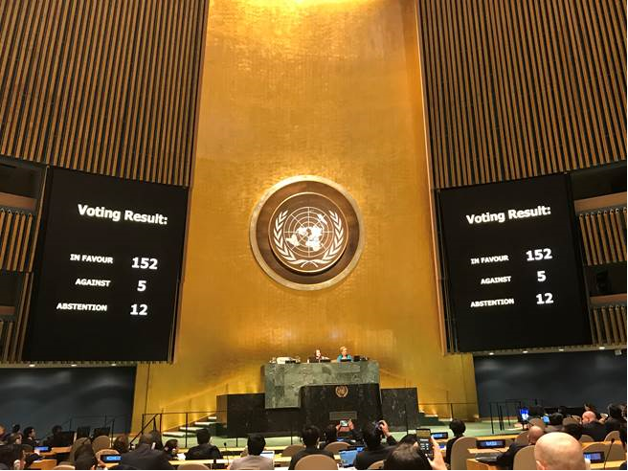
The GCM follow up and review process – all levels
Review on the progress made at the local, national, regional and global levels on the GCM implementation
Through a State-led approach
With the participation of all relevant stakeholders
International Migration Review Forum (IMRF) will take place every four years starting in 2022;
Regional Review will begin in 2020, to effectively inform each edition of the IMRF
Notes:
As many of you may have read already, in the GCM, the paragraphs 48 to 54 on the last two pages of the GCM resolution particularly speak about the Follow-up and Review process;
It speaks about the review process to be made at all leve, with the leadership of States, with the participation of all relevant stakeholders;
The former High-level Dialogue on International Migration and Development, served as the primary intergovernmental global platform for Member States to discuss and share progress on implementation; will be repurposed and renamed as “International Migration Review Forum”; which will take place every four years beginning in 2022;
Regional review on the implementation of the GCM within each region, will be beginning in 2020, alternating with discussions at the global level at a four-year interval, in order to effectively inform each edition of the International Migration Review Forum, with the participation of all relevant stakeholders; Next Slide please,

Slide 31
Preparatory process for the second GCM Regional Review
Mirroring Pledges?
Roadmap for Regional Reviews in the Arab region
Regional collaboration and state ownership
GCM Talks
Champions meetings and other initiatives
Multi-stakeholder consultations
Regional Reviews during the first half of 2024
Outcome Document to be presented at the Plenary Meeting of the General Assembly
National Consultations?

Slide 32
Second Follow-up and Review Process in the Arab region (2023-2024) – TBC
Cross-regional Dialogues and consultations by States and workstreams
Regional Review by ISCM/RCPs
Stakeholder Perception Survey (Online)
States and stakeholder consultations
(Online)
Regional Review Conference with REC (Hybrid)
Regional Review Report
November to December 2023
May/June 2024
Led by Governments of Qatar, Morocco, Egypt, KSA and Iraq (TBC)
To be finalized by September 2024
PAFOM (October 2023),
ADD (February 2024)
ARCP (April 2024)
November 2023 – April 2024
Notes:
To prepare for this first Regional Review, we have been organizing a number of preparatory events in the Arab region, together with the League of Arab States, UN ESCWA and with the members of the Regional UN Network on Migration.
The follow-up on the GCM since its adoption started since 2019, as the Regional Conference on the GCM and the Capacity-building Workshop on Migration Governance was held in 2019.
This year, Two Capacity Building Workshops were held to introduce the Guiding Template and to help Member States prepare for the Voluntary GCM Review report in June and August, and one Member States Consultation was just held last week.
Informal interactive multi-stakeholder hearing
Regional Review Report
Other cross-regional coordination efforts
- Inter-regional consultation on the role of private sector (mid-November- TBC)
- Cross-Regional Consultation with Civil Society Organizations and other Stakeholders (starting from late November, focusing on the inputs from inter-regional actors to cover the blind spots of regionally divided review processes)
A/RES/73/326 para15. Requests the President of the General Assembly to organize and to preside over one day of informal interactive multi-stakeholder hearings one day prior to each forum with all relevant stakeholders, as listed in paragraphs 4 to 7, and also requests the President of the General Assembly to invite the representative of civil society to present a summary of the hearings during the opening segment of the plenary; Next Slide please,

Slide 33
National UN Networks in the Arab region
Algeria
Bahrain
Djibouti
Iraq
Jordan
Kuwait
Lebanon
Libya
Mauritania
Morocco
Qatar
Saudi Arabia
Somalia
Sudan
Tunisia
The UAE
Yemen
Notes:
Inputs by Member States were submitted by:
Algeria (not posted)
Bahrain
Comoros
Egypt
Iraq
Jordan
Kuwait
Lebanon (not posted)
Libya
Mauritania
Morocco
Qatar
Sudan
Tunisia

Slide 34

THANK YOU
Contact:
gcmrrarabstates@iom.int

Slide 35
Session 1 – Coordination Mechanisms in Egypt
Session Objectives: by the end of this session participants should be able to understand the existing Coordination Mechanisms in Egypt related to Migration and Refugees

Slide 36


Coordination, Analysis and Policy on Migrants & Refugees in Egypt
Monday, 27 November 2023

Slide 37
Introduction and overview
Coordination mechanisms
  Inter-Agency Working Group – Refugee Coordination Model
  DPG Migration & Protection
  Mixed Migration Working Group
  Joint Platform for Migrants and Refugees
Analysis & Policy
  Common Country Analysis
  UN Sustainable Development Cooperation Framework
  Other joint products

Slide 38
Overview
Strategic Decision-Making
Structures Beyond UNCT
United Nations Country Team (UNCT)
Chair: UN Resident Coordinator
Security Management Team (SMT)
Chair: Designated Official
UN-IFIs Dialogue
Chair: WB/UNRC
UNSDCF RGs
Results Group 1
People
Chair: UNFPA
UN Security Cell
Chair: UNDSS
Development Partners Group
Chair: USAID/UNRC
Programme & Operations
Results Group 2
Prosperity
Chair: ILO
Programme Management Team
Chair: ILO
Operations Management Team
Chair: WFP
UN-INGOs Forum
Chair: Terre Des Hommes/ UNRC
Results Group 3
Planet
Chair: UNDP
Joint Platform on Migrants & Refugees
Chair: MOFA/UNRC
Mixed Migration Working Group
Chair: IOM/UNHCR
Monitoring and Evaluation
Chair: UNDP
International Norms & Standards Working Group
Chair: UNICEF
Gender Theme Group
Chair: UN Women
Results Group 4
Governance
Chair: UNICEF
Inter-Agency Working Group – Refugee Coordination
Chair: UNHCR
Results Group 5
Women & Girls
Chair: UN Women/IOM
UN Communications Group
Chair: UNIC
Youth Theme Group Chair:UNICEF/UNFPA
Joint Team on Digitalization and Innovation
Chair: UNIDO
PSEA Network
Coordinator: IOM

Slide 39
Inter-agency Working Group (IAWG) - Refugee Coordination Model
As of May 2023
INTER-AGENCY WORKING GROUP (IAWG)
INTER-SECTOR WORKING GROUP (ISWG)
PROTECTION (UNHCR)
CHILD PROTECTION (UNHCR/UNICEF)
GBV (UNHCR/UNFPA)
COMMUNICATION WITH COMMUNITIES (UNHCR)
HEALTH (UNHCR/WHO)
EDUCATION (UNHCR/UNICEF)
BASIC NEEDS AND CASH BASED INTERVENTIONS (UNHCR/IOM)
NFIs
LIVELIHOODS (UNHCR/UNDP)
FOOD SECURITY (WFP)
LOGISTICS/ICT (WFP/UNHCR)
WASH (UNICEF)
NUTRITION (UNICEF)

Slide 40
DPG Migration and Protection
As of September 2023
As of May 2023

Slide 41
Mixed Migration Working Group (MMWG)
Strategic Decision-Making
United Nations Country Team (UNCT)
Chair: UN Resident Coordinator
Security Management Team (SMT)
Chair: Designated Official
Programme & Operations
Programme Management Team
Chair: ILO
Operations Management Team
Chair: WFP
Mixed Migration Working Group
Chair: IOM/UNHCR
Monitoring and Evaluation
Chair: UNDP
International Norms & Standards Working Group
Chair: UNICEF
Gender Theme Group
Chair: UN Women
UN Communications Group
Chair: UNIC
Youth Theme Group Chair:UNICEF/UNFPA
Joint Team on Digitalization and Innovation
Chair: UNIDO

Slide 42

Joint Platform for Migrants and Refugees
Government of Egypt and United Nations Initiative
What
Who (for)
Why
A space for collaboration between the Government, the United Nations and development partners
Migrants, refugees and asylum seekers in vulnerable situations, persons in need of international protection and host communities
To enhance the protection of persons of concern through joint approaches and synergies
Evidence-based understanding and common situational analysis of persons of concern: vulnerability profile
HOW?
Assessment of institutional capacities and policy context
Mapping of existing and needed resources with development partners: financial landscaping

Slide 43
Analysis & Policy – the CCA
Common Country Analysis (2021)
  Around 20 diagnostics Papers – including one on Mixed Migration (2020)
  Joint UN product
  Regular update
Migrants & refugees in the CCA
  Mainstreamed
  Leaving No One Behind Analysis – one of six groups
  Regional Dynamics

Slide 44
Analysis & Policy – the UNSDCF
UNSDCF 2023-2027 – signed in May 2023
  Mainstreaming migrants and refugees: mentioned 30+ times, across four outcomes (People, Prosperity, Governance, Women & Girls)
  Specific focus:
    Outcome 1 (education, health, food security) and Output 1.5 (dignified assistance services to migrants, refugees and asylum seekers)
    Outcome 4, Output 4.3 (equal access to justice, effective judicial services and protection): data, national asylum law, protection services
  Reference to the Joint Platform for Migrants & Refugees
  Synergies with refugee response plans, GCM and GCR

Slide 45
Analysis & Policy – other Joint Products
Joint Platform for Migrants & Refugees
  Common Situational Assessment on Access to Education and Health Care Services – July 2022
  Basis for Joint Programme (IOM, UNHCR, UNICEF, WHO)
Joint Programme – Ukraine impact analysis
  IOM study – phone survey
Prospects, THAMM

Slide 46
Questions & Discussion

Slide 47
Coffee Break

Slide 48
Refugee System: UNHCR’s Mandate
UN General Assembly 1950 mandated the High Commissioner to:
to lead and coordinate international action for the worldwide protection of refugees and seek solutions of refugee problems
‘invite the co-operation of the various specialized agencies’ and facilitate ‘co-ordination of the efforts of private organizations concerned with the welfare of refugees’
Humanitarian response supports a Government - NOT replace the Government.
It is about responsibility and accountability
Notes:
More information: UNHCR - The mandate of the High Commissioner for Refugees and his Office

Slide 49
Refugee Response Plans
RCM
RRP
The Refugee Coordination Model (RCM) ensures accountable, inclusive, predictable and transparent coordination.
Refugee Response Plans (RRPs)
are UNHCR-led comprehensive inter-agency plans for responding to complex refugee situations;
are a key feature of the Refugee Coordination Model and provide the vehicle through which leadership and coordination of a refugee response may be exercised.
Notes:
For years UNHCR has exercised leadership and coordination responsibilities in refugee situations, in line with its mandated accountabilities. These are reflected in the Refugee Coordination Model (RCM) introduced in 2013, designed to ensure accountable, inclusive, predictable and transparent coordination in responding to refugee situations.
A Refugee Response Plan is a UNHCR-led, inter-agency planning and coordination tool for large-scale or complex refugee situations and contribute to the application of the RCM in various contexts. The Refugee Response Plan articulates the protection and solution priorities and describes the needs of refugees, host communities, and other persons of concern, states how and by whom these needs will be addressed and defines the financial requirements of all the humanitarian and development actors involved.

Slide 50
Refugee Response Plans
Regional Refugee Response Plans (RRPs) are developed at the regional level to respond to the needs of a refugee population which fled to neighbouring countries.
Regional RRPs consist of several country chapters summarizing the inter-agency response related to a specific refugee situation at the country level.
Country Refugee Response Plans (CRPs) are developed under the leadership of UNHCR to reflect the needs of an entire refugee population in a country.
In emergency situations a CRP can also be developed targeting one refugee population or covering a specific geographic area reflecting the context and response to the new emergency.
Regional
Refugee Response Plans
Country
Refugee Response Plans
Notes:
Regional Refugee Response Plans (RRPs) are developed at the regional level under the leadership of a Regional Refugee Coordinator to respond to the needs of a refugee population which fled to neighbouring countries. Since 2012, regional RRPs have been developed in multiple contexts to respond to various types of refugee crises from the onset of emergencies to more protracted situations. Regional RRPs consist of several country chapters summarizing the inter-agency response related to a specific refugee situation at the country level.
As of August 2021, by strengthening partnerships and promoting inter-agency coordination for large-scale or complex refugee situations, including for mixed movements, UNHCR coordinated six regional RRPs, covering the inter-agency response in 35 refugee-hosting countries. These included the Burundi, DRC, Ethiopia and South Sudan RRPs as well as the regional refugee and resilience plan in response to the Syria crisis (3RP), co-led with UNDP, and the regional refugee and migrant response plan for refugees and migrants from Venezuela, co-led with IOM.
While Regional Refugee Response Plans (RRPs) continue to be essential for the coordination of refugee crises with regional implications, when possible, operations are encouraged to develop Country Refugee Response Plans (CRPs), consisting of a multi-year inter-agency plan covering all refugee populations in a country. The CRPs include 1-year for budget and activities while protection strategy covers a 3- 5 years period.
As of August 2021, five Country RRPs were developed or updated for Armenia, Ethiopia, Rwanda, Sudan, and Uganda. In addition, UNHCR led the development of the Thailand Refugee Preparedness and Response Plan for the Myanmar Situation, the RRP for Central African refugees in the DRC, and Refugee Emergency Response Plans for the Ethiopian refugee influx to Sudan and for the Eritrean Refugees in Tigray, Ethiopia. In addition, UNHCR and IOM continued to co-lead the joint response plan for the Rohingya humanitarian crisis in Bangladesh.

Slide 51
Inter-agency Coordination Structure – Egypt
Refugee Coordination Model
INTER-AGENCY WORKING GROUP (IAWG)
INTER-SECTOR WORKING GROUP (ISWG)
PROTECTION (UNHCR)
CHILD PROTECTION (UNHCR/UNICEF)
GBV (UNHCR/UNFPA)
CBP/ CwC (UNHCRl TdH)
HEALTH (UNHCR/WHO)
EDUCATION (UNHCR/UNICEF)
BASIC NEEDS (CASH) (UNHCR/WFP)
LIVELIHOODS AND ECONOMIC INCLUSION (UNHCR/UNDP)
FOOD SECURITY (WFP)
WASH (UNICEF)
NUTRITION (UNICEF)

Slide 52
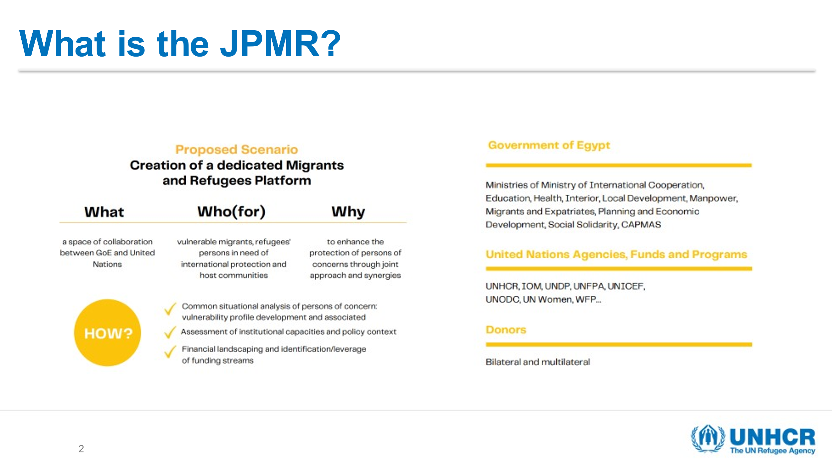

Slide 53
Thank you

Slide 54
Coordination Mechanisms at a glance
Development Partners Group
Representatives from groups which include donors, UN agencies, international/local NGOs, and/or governmental officials based in Egypt.
The Thematic Group Migration and Protection aims to enhance the coordination among Development Partners in Egypt in the field of migration and protection, by way of:
Mixed Movements WG
Members are designated relevant technical agency leads;
Joint Platform on Migration&Refugees
Co-chaired by the Ministry of Foreign Affairs and the United Nations Resident Coordinator.
MMWG is the main UN internal working group under the UNCT that is responsible for coordination and support to the Government in responding to mixed movements of migrants and forcibly displaced persons (FDPs).
The JPMR aims to bring evidence-based understanding of the needs of migrants, refugees and their host communities.
policies, principles and priorities;
procedures, and practices, as appropriate.
Co-Chaired by the IOM and UNHCR Heads of Agency;
The following UN entities are invited to be members of the Joint Platform: IOM, UNDP, UNFPA, UNHCR, UNICEF, UNODC, UN-Women, WFP and other relevant government and UN agencies;
The overall objectives are:
It aims at contributing to durable solutions through sustainable financing and delivery modalities, supporting the implementation of Egypt’s Vision 2030 and the SDGs
It constitutes a setting where a strategic discussion to identify and address the needs of migrants and refugees takes place, along with mobilization additional resources for migrants and refugees in Egypt.
2) cooperation
3) collaboration; and
4) alignment on:
1) consultation
2) strengthening systems to prevent, mitigate and response to smuggling and trafficking; and
1) ensuring consistent coordination and cooperation within the UN system in support of the Government of Egypt, on mixed movements responses;
3) addressing gaps in the protection and assistance provided to FDPs and migrants within the context of mixed movements.

Slide 55
UN Network on Migration: then what do they do?
Ensure close collaboration with other existing UN system coordination mechanisms addressing migration-related issues, seeking synergies and avoiding duplication
Provide leadership to mobilize coordinated and collaborative action on migration by the UN system, including by speaking with one voice
Engage with external partners and other relevant stakeholders at global, regional and national levels
Members of the UN system who wish to be a part of it Within that Network
And for whom migration is of relevance to their mandates
Support coherent action by the UN system at country, regional and global levels in support of GCM implementation
Act as a source of ideas, tools, reliable data and information, analysis, and policy guidance on migration issues
An Executive Committee can be established, comprised of entities with clear mandates, technical expertise and capacity in migration-related fields
Ensure Network actions promote the application of relevant international and regional norms and standards
Establish and provide support to the capacity building mechanism
Report to the Secretary-General as required on the implementation of the GCM, the activities of the UN system

Slide 56
LUNCH

Slide 57

Session 2: Migration, the GCM & the 2030 Agenda
By the end of the session participants should be able to:
- Understand migration as a cross-cutting issue in the SDGs
- Explain the linkage between the GCM and the 2030 Agenda
Notes:
Key points
With introductions complete, the facilitators will now begin the first session of the training, which focuses on migration, the GCM and the 2030 Agenda
The specific learning objectives for the session are:
By the end of the session participants should:
Be able to explain how migration is a cross-cutting issue, fundamental to the achievement of the 2030 Agenda
Be familiar with the linkage between the GCM and the 2030 Agenda

Slide 58
An introduction to the training

Slide 59
Pre-training survey results
12 total responses;
Participants from 13 different agencies;
64% Senior Technical Staff, 36% other
  58% have worked for the UN for more than 10 years;
  33% have 1-5 years of working experience with UN
Diversity of primary roles:
  5 people answered Programme/Project Management;
  3 answered Programme/Project development;
  1 representation/liaison with government; 1 Research & Data; 1 M&E
Who’s in the room?
Notes:
Ayman - tbc

Slide 60
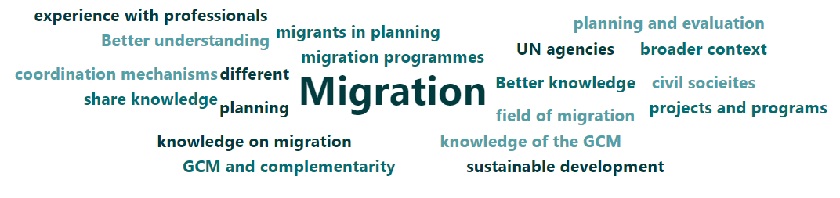
67% have never undertaken training on migration governance; (only 33% confirmed)
33% have never received training on the UN Development System Cooperation Framework;
67% have not taken part in the process leading up to the development of the CF while 33% have ;
Diverse range of expectations for the training:
Who’s in the room?
Notes:
Ayman - tbc

Slide 61
Findings from Pre-Training Survey (cont.)
Expectations from Responders include:
To learn more about different migration programmes and their impact
Better understanding of the UN Network on migration; better knowledge of the GCM, as well as of how to implement it, incl. jointly with other UN agencies.
Integrating migration into the planning and programming
More knowledge on GCM and complementarity with other coordination mechanisms and how can agencies, government and civil societies work together
Connect and share knowledge, experience with professionals, experts, and peers in the field of migration and sustainable development
Who’s in the room?
Notes:
Ayman - tbc

Slide 62
Icebreaker Exercise
  Write 1 WORD that crosses your mind when you think about migration and migrants
    They can be related to your personal experience/ study/ work/ family/ etc.
  Be prepared to explain to the colleagues 1) your name, 2) agency, 3) which word you chose and 4) the brief reason why
Notes:
Nedjla

Slide 63
Migration Governance
Defining Migration Governance:
“The combined frameworks of legal norms, laws and regulations, policies and traditions as well as organizational structures (sub-national, national, regional and international) and the relevant processes that shape and regulate States’ approaches with regard to migration in all its forms, addressing rights and responsibilities and promoting international cooperation.”
Source: www.migrationdataportal.org

Slide 64

The Global Compact for Safe, Orderly and
Regular Migration
First comprehensive UN framework adopted through inter-governmental negotiations to enhance international cooperation in global migration governance.
Notes:
Key points
The Global Compact for Safe, Orderly and Regular Migration:
The GCM is the first comprehensive UN framework adopted through inter-governmental negotiations to enhance international cooperation in global migration governance.
It is based on a collective realization that no single government can effectively govern migration alone - whether fully realizing the potential of global mobility or protecting people from the most pernicious aspects of migration - without cooperation, whether bilaterally, regionally, or globally.
By creating this cooperative framework on international migration, States have developed a common terminology for discussing key migration issues and a blueprint for comprehensive, rights-based migration policies.
While not legally binding, the GCM’s guiding principles, objectives and actions find their root in established obligations and principles, underpinned by the Universal Declaration of Human Rights, the 2030 Agenda for Sustainable Development, and international law.
The GCM's approach to improving migration governance
The GCM's approach to improving migration governance is anchored in its vision, guiding principles and its 360-degree view of migration (explored in more detail below).
Note that the Governments of both Georgia and Armenia adopted the GCM in Marrakech in December 2018

Slide 65

GCM Vision
Collective commitment to improving cooperation on international migration
To unite rather than divide
Common understanding, shared responsibilities & unity of purpose regarding migration
Making migration work for all
(para 8 & 9).
Question to participants:
Do you know what the GCM Guiding Principles Are?
Please put suggestions in the chat...
Notes:
Key points
Vision of the GCM
The GCM's vision is based on a collective commitment to improving cooperation on international migration, and on the recognized need for the challenges and opportunities of international migration to unite us, rather than divide us (paras 8-9).
The Compact sets out a common understanding, shared responsibilities and unity of purpose regarding migration, with a view to making migration work for all (para 9).
Interactivity: (if time allows)
Question to participants:
Do you know what the GCM Guiding Principles Are?
Please put suggestions in the chat...
Facilitator to summarise the inputs and use this as a stepping stone to the next slide, which provides an overview of the principles

Slide 66

GCM Guiding Principles
Notes:
Key points
Guiding principles of the GCM
The GCM is based on a set of cross-cutting, interdependent guiding principles that should inform the implementation of any GCM objective. These are (para 15):
People-centred
International cooperation
National sovereignty
Rule of law and due process
Sustainable development
Human rights
Gender-responsive
Child-sensitive
Whole-of-government approach
Whole-of-society approach
Refer to human rights-based approach (utilizing OHCHR Human Rights Marker as guidance), child-sensitive approach (following UNICEF guidance), and gender -responsive approach (per UN-WOMEN Guidelines) being developed (publication dates to be confirmed).Each of these sets of guidelines is to be referenced and made accessible to participants to encourage familiarity and engagement with these tools (as far as possible)
While migration policy is part of migration governance, and the GCM is a useful tool for ensuring comprehensive migration governance, for this to be fully realized requires following the above referenced guiding principles (including WOG, WHS approaches) and ensuring adequate capacity and ensuring adequate data is utilized throughout, including for continuous monitoring, review and adjustments (to avoid static approaches)

Slide 67
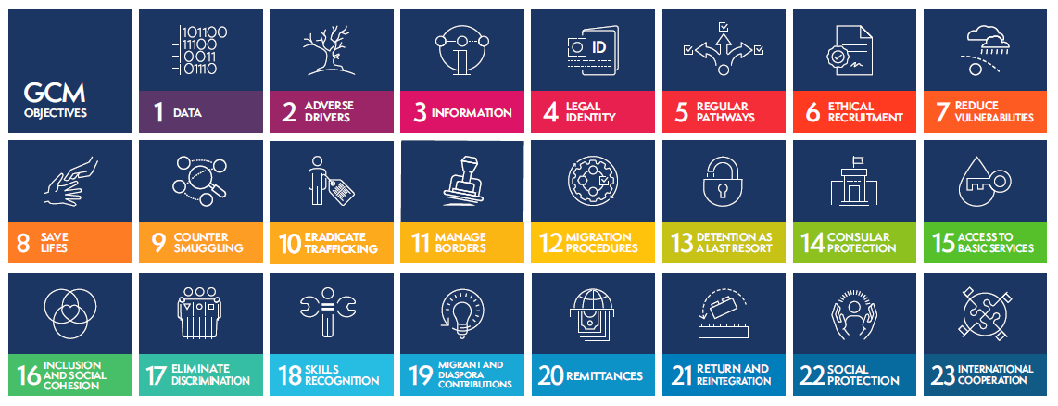
GCM Objectives
Notes:
Key points
The GCM defines 23 objectives covering all aspects of migration (“360-degree” approach – see below) with an array of possible actions, drawn from best practice, that States may choose to utilise to implement their national migration policies.
Explain the broad spectrum of the objectives, and indicate that the slide displayed will be provided as a handout
Interactivity: (if time allows)
Question to participants:
Can you think of examples from your country contexts where these objectives are either:
Posing a challenge to development
Being addressed to support development
Raise hand to share thoughts...
Facilitator to summarise the inputs and use this as a stepping stone to the next slide, which provides an overview of the principles

Slide 68

GCM’s 360-degree view of migration
Recognises that a comprehensive approach is needed to…
  Optimise the benefits of migration
  Address migration risks and challenges
Notes:
Key points
The GCM's 360-degree view of international migration recognizes that a comprehensive approach is needed to
optimize the benefits of migration
while addressing its risks and challenges.
This comprehensive approach is reflected in the 23 objectives of the GCM, which collectively aim to cover all relevant aspects of migration.
While different GCM objectives focus on various aspects of migration, from access to services for migrants to border governance and available migration pathways, taken together they represent a comprehensive 360-degree vision of migration.
Accordingly, GCM objectives should not be considered in isolation but rather all 23 objectives should be implemented together. The 360-degree approach makes clear that focusing on combatting smuggling without also working on protection will not work; that focusing on remittances without delivering on decent work will not work; that focusing on pathways without attention to narratives and inclusion will not work; that no approach to migration governance will work if it does not seek to understand who is moving and why; and that without international cooperation, all efforts will be limited.

Slide 69


The 2030 Agenda: an overview
Progress is being made in many places, but, overall, action to meet the Goals is not yet advancing at the speed or scale required.
The COVID-19 pandemic and its impact on all 17 SDGs has shown that what began as a health crisis has quickly become a human and socio-economic crisis.
Notes:
Key points
The session begins by providing reference to the 2030 Agenda, recalling that it informs the work of the UN Development System
Reference that interventions with a migration link are also heavily informed by the 2030 Agenda
Recall that we are now well into the Decade for Action (the push for the achievement of the Goals!)
Explain the impact of the COVID-19 Pandemic across the goals, and also highlight the clear relevance to migration
Interactivity: (if time allows)
Question to participants:
Ask participants if they are able to make any other connections between COVID-19 and migration, including its impact on development
Raise hand to share thoughts...
Facilitator to summarise the inputs before moving to the next slide

Slide 70

Migration & Sustainable Development
The relationship between migration & development is complex and context-specific.
It is also a two-way relationship:
Migration impacts development
Development impacts migration
Migration is a multi-faceted, non-linear and complex phenomenon, which requires an integral approach:
All sectoral areas
All levels of governance
The 2030 Agenda provides the lens through which we can analyze this relationship.
Notes:
Key points
For the first time in global development policy, the 2030 Agenda recognizes the positive contribution of migrants to inclusive growth and sustainable development (para 29).
The 2030 Agenda incorporates the issues of migration and mobility in other significant ways, in particular by:
Recognizing that international migration is a multi-dimensional reality of great relevance for countries of origin, transit and destination — one that requires coherent and comprehensive responses at all levels (para 29)
Calling for the empowerment of vulnerable groups (including refugees, internally displaced persons and migrants) (para 23)
Highlighting the impact of humanitarian crises and forced displacement on development (para 14)
Committing to the eradication of forced labour and human trafficking (para 27)
COVID-19 is one such example of the cross-cutting and multi-directional relevance of migration to sustainable development. Responses, including to the immediate and medium-term socio-economic effects can benefit greatly from taking into consideration migration and migrants. See UNNM Guidance Note referenced in the Introductory Session. (as already referenced above)
The relationship between migration and development is complex and context specific. It is also a two-way relationship, with migration impacting development and development impacting migration
Migration is multi-faceted, non-linear and complex, requiring and integrated approach that links in with all sectoral areas and all levels of governance (horizontal and vertical linkages)
The 2030 Agenda also commits States and other stakeholders to cooperating internationally to ensure safe, orderly and regular migration involving full respect for human rights and for the humane treatment of migrants (regardless of migration status), of refugees and of displaced persons (para 29).

Slide 71
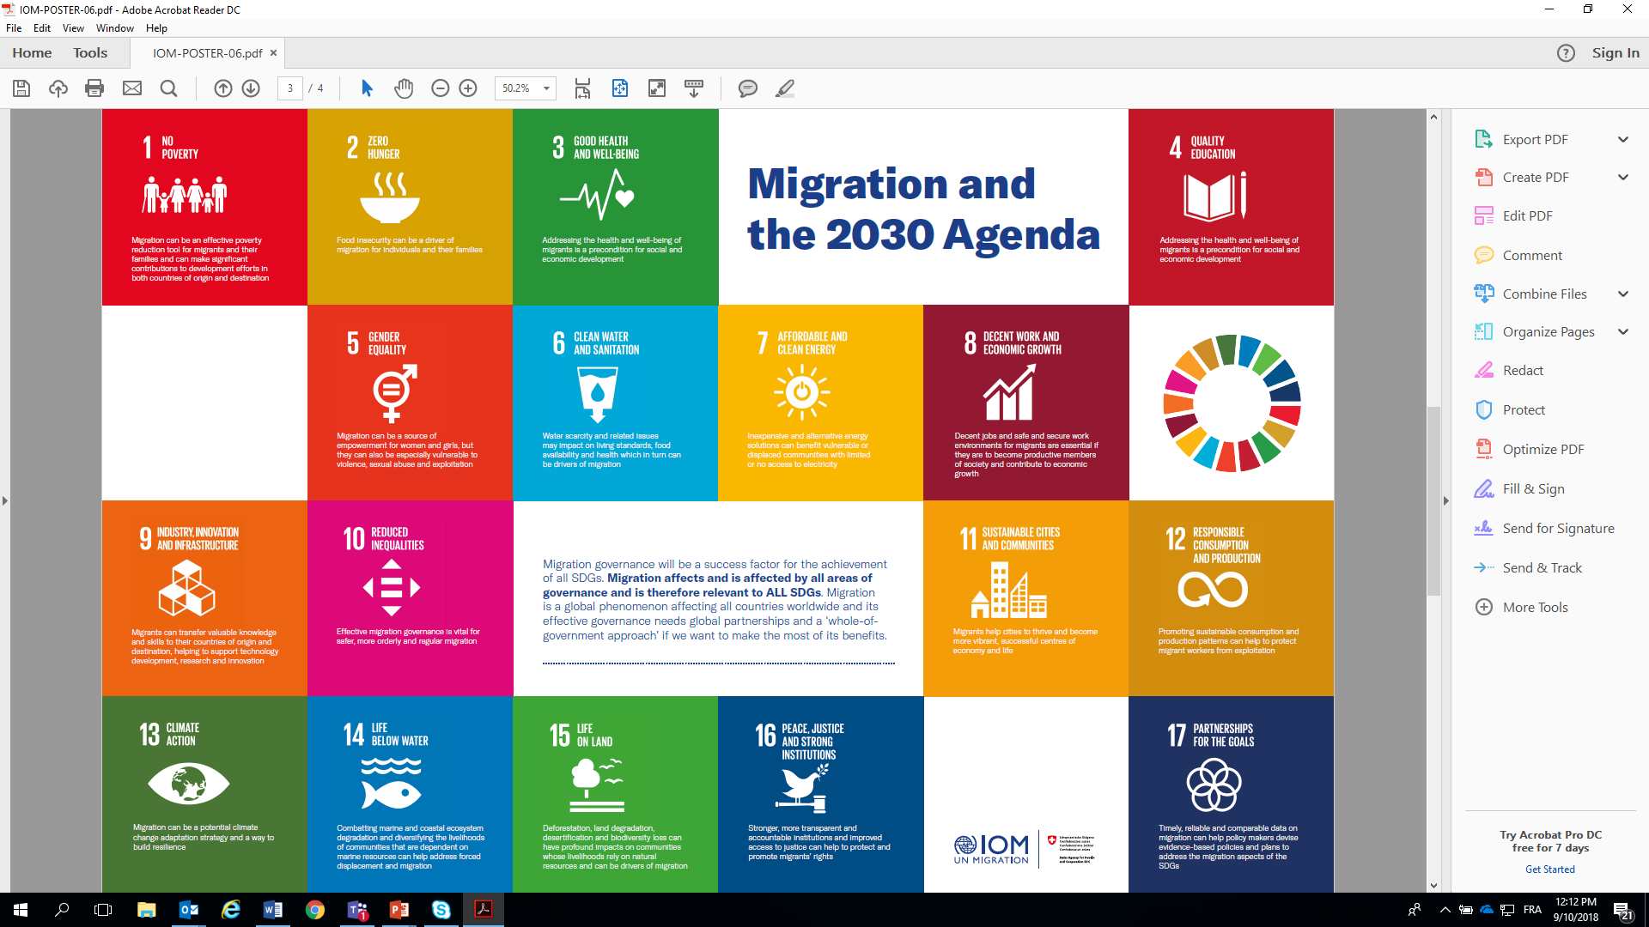
Migration & the SDGs
Notes:
Key points:
Among core connections are the following (these are all referenced in the 2030 Agenda):
Positive contribution of migrants to inclusive growth and sustainable development
(UPDATE FOR COUNTRY CONTEXT)
Migration as a multi-dimensional reality relevant to all countries
Need to empower vulnerable groups (including migrants)
Impact of forced displacement on development
(UPDATE FOR COUNTRY CONTEXT)
Need to eradicate forced labour and human trafficking
(UPDATE FOR COUNTRY CONTEXT)
Need for international cooperation to ensure safe, orderly and regular migration, involving full respect for human rights and the humane treatment of migrants
Recent inclusion of Georgia in the Schengen Zone and the resultant impact on safe, orderly and regular migration, for example
Readmission agreements between Armenia and Iran, India and the Philippines, for example, as well as within the European Union
Beyond this, migration links to all SDGs, as shown in the visual

Slide 72

SDG target 10.7
“10.7 Facilitate orderly, safe, regular and responsible migration and mobility of people, including through the implementation of planned and well-managed migration policies”
Notes:
Key points:
Before delivering the key messages on "References to migration in the 2030 Agenda," it might be helpful to review the main references to migration in the 2030 Agenda and how these are formulated. See below:
Paragraph 14: We are meeting at a time of immense challenges to sustainable development. Billions of our citizens continue to live in poverty and are denied a life of dignity. There are rising inequalities within and among countries. There are enormous disparities of opportunity, wealth and power. Gender inequality remains a key challenge. Unemployment, particularly youth unemployment, is a major concern. Global health threats, more frequent and intense natural disasters, spiralling conflict, violent extremism, terrorism and related humanitarian crises and forced displacement of people threaten to reverse much of the development progress made in recent decades.
Paragraph 23: People who are vulnerable must be empowered. Those whose needs are reflected in the Agenda include all children, youth, persons with disabilities (of whom more than 80% live in poverty), people living with HIV/AIDS, older persons, indigenous peoples, refugees and internally displaced persons and migrants. We resolve to take further effective measures and actions, in conformity with international law, to remove obstacles and constraints, strengthen support and meet the special needs of people living in areas affected by complex humanitarian emergencies and in areas affected by terrorism.
Paragraph 27: We will seek to build strong economic foundations for all our countries. Sustained, inclusive and sustainable economic growth is essential for prosperity. This will only be possible if wealth is shared and income inequality is addressed. We will work to build dynamic, sustainable, innovative and people-centred economies, promoting youth employment and women’s economic empowerment, in particular, and decent work for all. We will eradicate forced labour and human trafficking and end child labour in all its forms.
Paragraph 29: We recognize the positive contribution of migrants for inclusive growth and sustainable development. We also recognize that international migration is a multi-dimensional reality of major relevance for the development of countries of origin, transit and destination, which requires coherent and comprehensive responses. We will cooperate internationally to ensure safe, orderly and regular migration involving full respect for human rights and the humane treatment of migrants regardless of migration status, of refugees and of displaced persons. Such cooperation should also strengthen the resilience of communities hosting refugees, particularly in developing countries. We underline the right of migrants to return to their country of citizenship and recall that States must ensure that their returning nationals are duly received.
The importance of migrants' ability to fulfil their development potential
The 2030 Agenda cannot be achieved without due consideration of migration, for meaningful implementation of the SDGs hinges upon protecting and empowering migrants (among other vulnerable groups) to fulfil their development potential in dignity and equality and in a healthy environment
Migrants' fulfilment of such potential benefits individuals, communities and countries throughout the world.
Beyond making a positive contribution to the economic dimension of sustainable development, migrants also make important, non-quantifiable contributions that enhance the social dimension of sustainable development.
For example, through social remittances – defined as " the flows of ideas, knowledge, behaviours and social capital transmitted by migrants to their families, friends and communities in their home countries" – migrants can use their linguistic and cultural links to make distinct contributions and to be agents of change.
See below link to document containing examples of how each of the SDGs and many of its targets are relevant for migrants and mobility and can be ultimately translated into migration-specific interventions: Migration and the 2030 Agenda: A Guide for Practitioners, IOM, 2018
It is important for facilitators to be familiar with the contents of this guide and to be able to draw on relevant SDGs & targets to the country-context, including in line with priorities.
SDG target 10.7
There are both direct and in-direct references to migration in the 2030 Agenda
This commitment is reflected in SDG target 10.7 of the 2030 Agenda, which calls on Member States to "facilitate orderly, safe, and responsible migration and mobility of people, including through the implementation of planned and well-managed migration policies.“
(UPDATE FOR COUNTRY CONTEXT)

Slide 73






Direct Connections between
migration and the SDGs
Inclusion in the SDGs | Migration Theme | Key Targets
Direct references | Student Mobility | 4.B
 | Human Trafficking & Exploitation | 5.2; 8.7; 16.2
 | Labour Migration & Employment | 8.5, 8.7, 8.8
 | Migration Governance | 10.7
 | Remittances | 10.C
 | Migration Data | 17.18
Notes:
Key points:
The direct connections between migration and the SDGs can be seen as follows:
Student mobility (target 4B)
Human Trafficking and exploitation (targets 5.2; 8.7; 16.2)
Labour migration and employment (8.5, 8.7, 8.8)
Migration governance (10.7)
Remittances (10.C)
Migration data (17.18)
e.g. (UPDATE FOR COUNTRY CONTEXT)
Interactivity: (if time allows)
Question to participants:
Consider asking participants to share more information on this initiative and how it helps improve data on migration Raise hand to share thoughts...
Facilitator to contextualise the inputs before moving to the next slide
This slide and the previous content has exemplified the direct connections. However, there are innumerable other cross-cutting linkages. These are shown in the next slide

Slide 74
Cross-Cutting Connections between
Migration and the SDGs
The 2030 Agenda also contains targets that relate indirectly to migration. In these, migration is a cross-cutting theme and implementation should include migration.
Migrants should be included in all targets relating to disaster risk reduction and management, including early warning systems Migration should be recognized as a potential climate change adaptation (CCA) strategy and way to build resilience Education awareness-raising efforts on climate change should include the mobility dimensions of climate change
Inclusion in the SDGs | Theme | Key Targets
Indirect entry points | Poverty and Growth | 1.1; 1.2; 1.4; 1a; 1b, 2.3, 8.1, 8.2, 8.3 10.1
 | Social Protection | 1.3, 3.8, 10.4
 | Health | 3.1, 3.2, 3.3, 3.4, 3.5, 3.7, 3.8; 3c, 3d, 5.6
 | Climate change | 1.5; 2.4, 3d; 11.5; 11b; 13.1; 13.2; 13.3; 13a; 13b, 14.2, 14.7, 15.3
 | Education | 4.1, 4.2, 4.3, 4.4; 4.5, 4a
 | Gender | 3.7, 5.2; 5.3, 5.4, 5.6, 5a
 | Children | 5.2; 8.7; 16.2
 | Cities | 11.1; 11.3, 11a
 | Citizenship and Identity | 16.9, 10.2, 10.3, 16b
Notes:
Key points:
The 2030 Agenda also contains targets that relate indirectly to migration. In these, migration is a cross-cutting theme and implementation should include migration.
Some examples include poverty and growth, social protection, health, climate change, education, gender, among others
Refer to the targets indicated on the screen
(PROVIDE EXAMPLES BASED ON COUNTRY CONTEXT)

Slide 75

The 2030 Agenda’s Promise
“We are determined to take the bold and transformative steps which are urgently needed to shift the world onto a sustainable and resilient path. As we embark on this collective journey, we pledge that no one will be left behind”
Preamble of the 2030 Agenda
Notes:
Key points:
The promise to leave no one behind
The GCM is rooted and anchored in the 2030 Agenda.
It is rooted in the 2030 Agenda's promise to leave no one behind, and related to this promise, the Agenda's explicit focus on investing in and empowering a number of vulnerable groups: children, youth, persons with disabilities, people living with HIV/AIDS, older persons, indigenous peoples, refugees and internally displaced persons and migrants (para. 23).
The GCM’s gender-responsive guiding principle articulates the commitment to supporting the achievement of SDG 5 on gender equality and women’s empowerment
(UPDATE FOR COUNTRY CONTEXT)

Slide 76
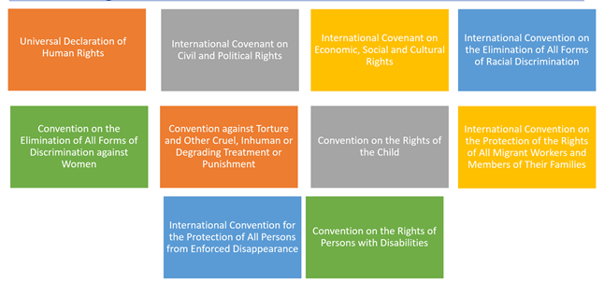
Human Rights Frameworks on which the GCM rests
Notes:
Key points:
The migration-related elements of the SDGs and the GCM rest on international human rights frameworks, including:
The Universal Declaration on Human Rights
International Covenants on Civil & Political Rights and on Economic, Social & Cultural Rights
International Contention on the Elimination of All forms of Racial Discrimination
Convention on the Elimination of All forms of Discrimination against Women
Convention against Torture and other Cruel, Inhuman or Degrading Treatment or Punishment
Convention on the Rights of the Child
International Convention on the Protection of the Rights of All Migrant Workers and Members of their Families
International Convention for the Protection of All Persons from Enforced Disappearance
Convention of the Rights of Persons with Disabilities

Slide 77
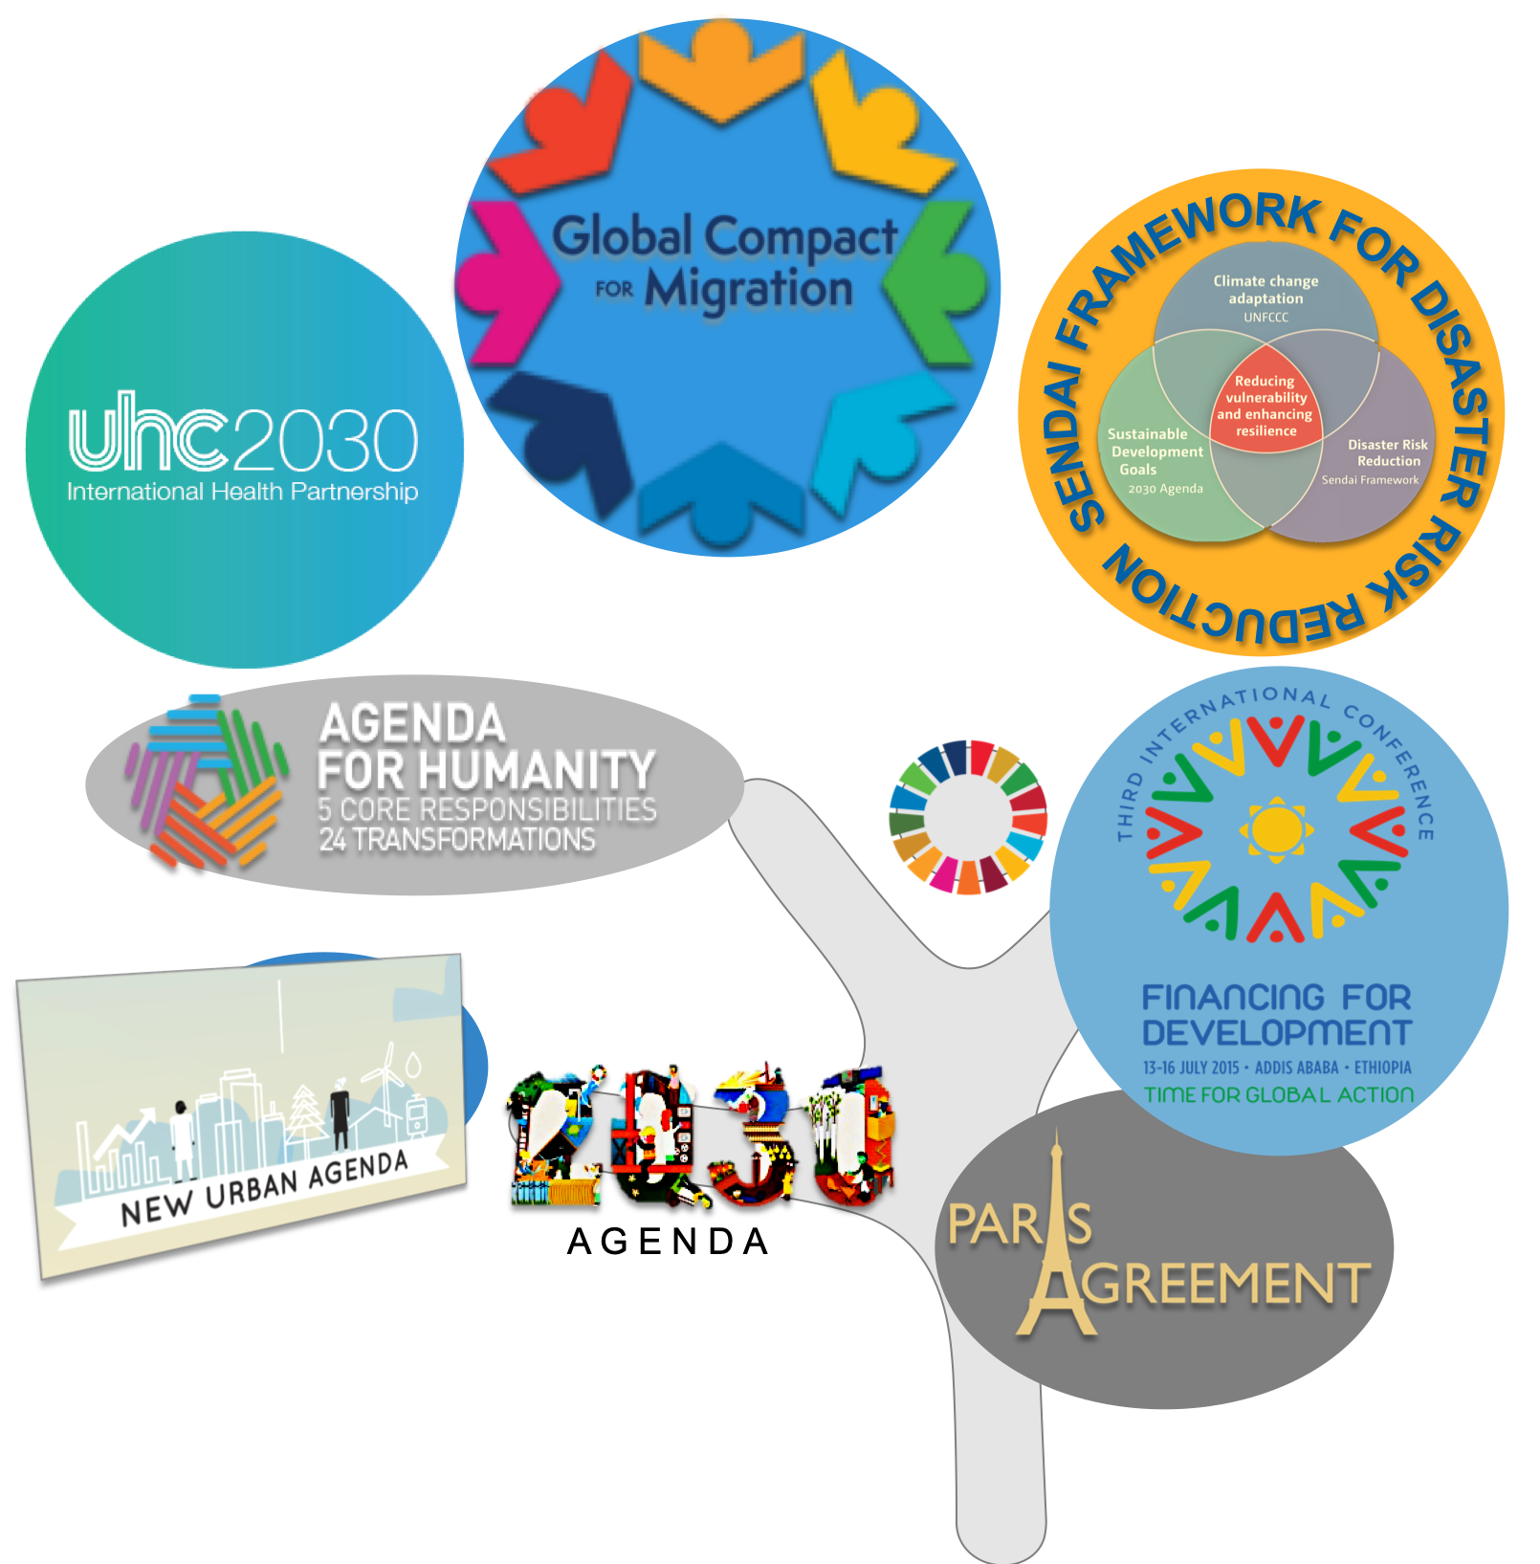
Towards Policy Coherence
Binding:
United Nations Convention against Transnational Organized Crime, including:
  - Protocol to Prevent, Suppress and Punish Trafficking in Persons Especially Women & Children
  - the Protocol against the Smuggling of Migrants by Land, Sea and Air
Slavery Convention and the Supplementary Convention on the Abolition of Slavery, the Slave Trade, and Institutions and Practices Similar to Slavery
United Nations Framework Convention on Climate Change
United Nations Convention to Combat Desertification
International Labour Organization conventions on promoting decent work and labour migration (inc. Nos 97, 143, 181 & 189)
Non-binding:
2030 Agenda for Sustainable Development
Paris Agreement (on climate change)
Addis Ababa Action Agenda (on financing for development)
Sendai Framework for Disaster Risk Reduction
New Urban Agenda
Notes:
Policy coherence is critical to the successful implementation of the GCM.
The core international human rights treaties, there are a number of other relevant international instrutments.
These include:
United Nations Convention against Transnational Organized Crime and its supplementary trafficking and smuggling protocols
Slavery Convention and the Supplementary Convention on the Abolition of Slavery, the Slave Trade, and Institutions and Practices Similar to Slavery
United Nations Framework Convention on Climate Change
United Nations Convention to Combat Desertification
Paris Agreement on Climate Change
International Labour Organization Conventions promoting decent work and labour migration
Addis Ababa Action Agenda (on financing for development)
Sendai Framework for Disaster Risk Reduction
New Urban Agenda
Elaborate on these, and draw linkages to country context

Slide 78

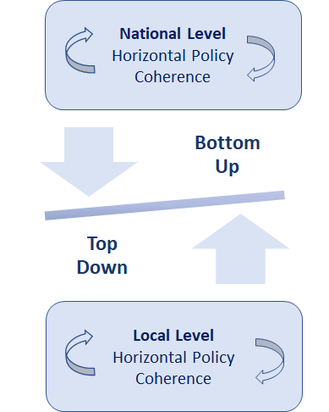

Policy Coherence: vertical and horizontal connections
The concept of policy coherence:
“An approach and policy tool that supports the integration of the economic, social, environmental and governance dimensions of sustainable development across all stages of policy making” - source: www.oecd.org
- Policy coherence & the 2030 Agenda:
SDG target 17.4 - “Enhance policy coherence for sustainable development”
- Policy coherence includes vertical coherence (between levels of governance) and horizontal policy coherence (between sectors of governance). Vertical and horizontal policy coherence are complementary.

Slide 79
  Examining the relevance of the SDGs to migrants, mobility, and the rights of people on the move:
  Are migrants and people on the move among those who are being left behind in your country?
  How and why?
Questions
and
Group Reflection
Notes:
Ask for any questions or reflections from the presentation.
Then, ask participants to consider the following question:
Are migrants among those who are at risk to be left behind in your country? How and why?
Additional Guiding questions (for Facilitator use/reference, pending the available time)
How could the movement of people affect the SDGs?
How could the achievement of the SDGs affect mobility patterns?
How could the achievement of the SDGs (or lack thereof) affect the human rights of migrants?
What risks to achieving this goal exist when migration and migrants’ rights are not mainstreamed/ integrated?

Slide 80
Activity instructions
  Breakout Group discussion (30 minutes)
  Divide into five (5) groups
  Each group will discuss one SDG (please see SDGs and guiding questions on the next slide)
  Designate one speaker for the group who will present a short (2-3 min max) presentation highlighting one example from the group discussion.
  Note: please see the presentation template to formulate the group speaker’s intervention. The presentation should not be a summary of everything the group discussed, but rather one example, answering all three questions, they feel would be interesting to the group.
  Plenary discussion (15 minutes)
  Each group will present one example from their breakout discussion in the plenary.

Slide 81




Break out Groups and Questions
Within your group, examine the assigned SDG: (one SDG per group)
GROUP 1 : SDG 3
GROUP 2 : SDG 4
GROUP 3: SDG 5
GROUP 4: SDG 13
GROUP 5: SDG 16
GUIDING QUESTIONS:
How can mobility affect the achievement of this goal? (What is the link between this SDG and migration?)
Which GCM objectives are most relevant to achieving this goal?
How do the guiding principles of GCM apply to this SDG?
  Please see the following tool: https://www.migrationdataportal.org/sdgs?node=0;

Slide 82
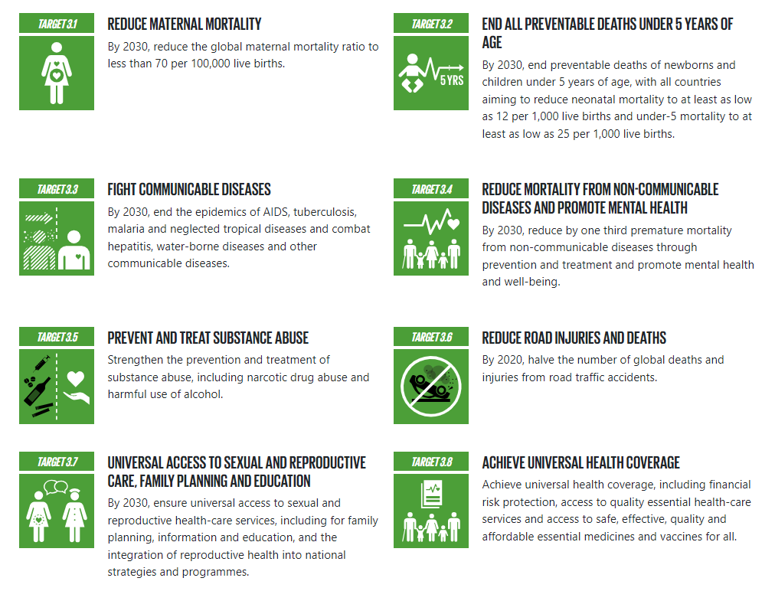
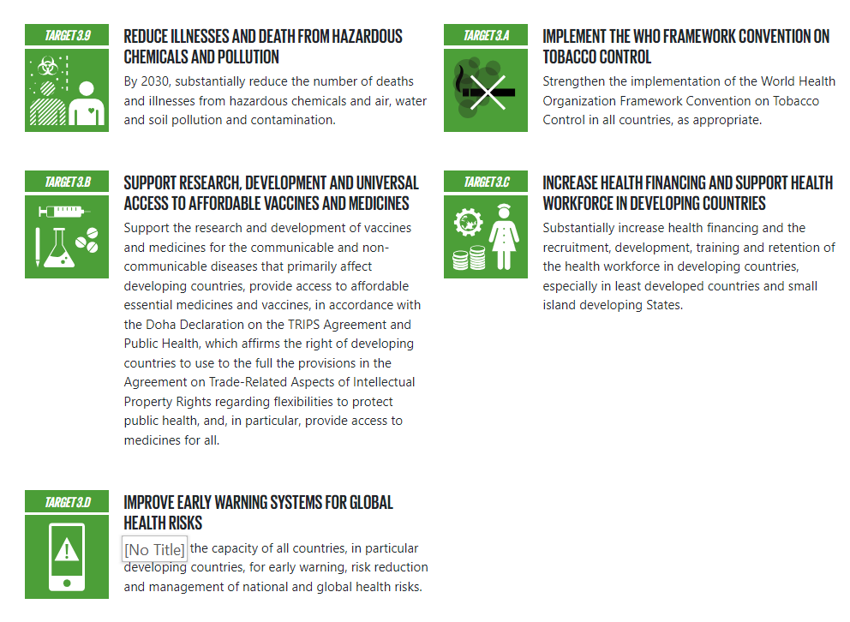
SDG 3: Ensure healthy lives and promote well-being for all at all ages
Source: https://www.globalgoals.org/goals/

Slide 83
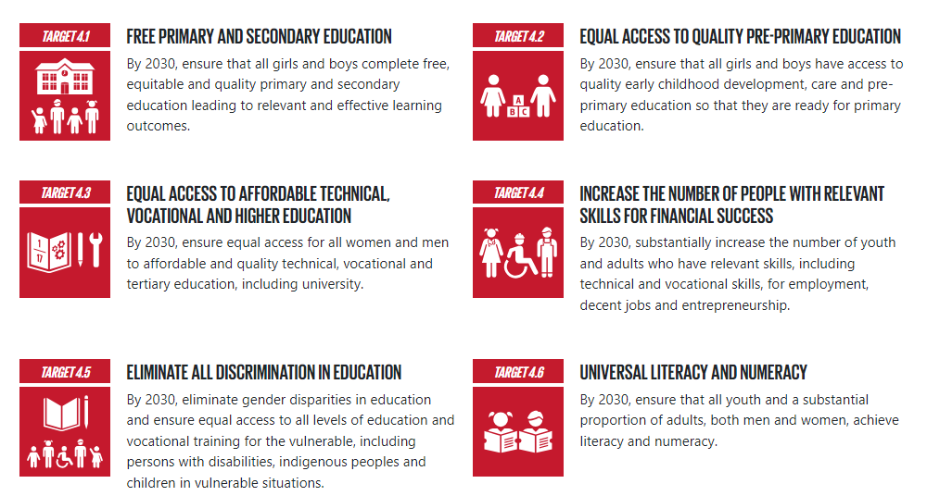
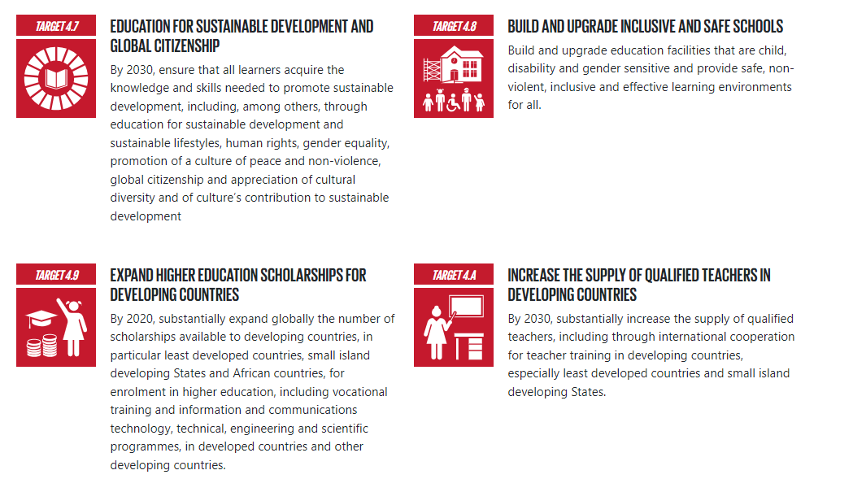
SDG 4: Ensure inclusive and equitable quality education and promote lifelong learning opportunities for all
Source: https://www.globalgoals.org/goals/

Slide 84
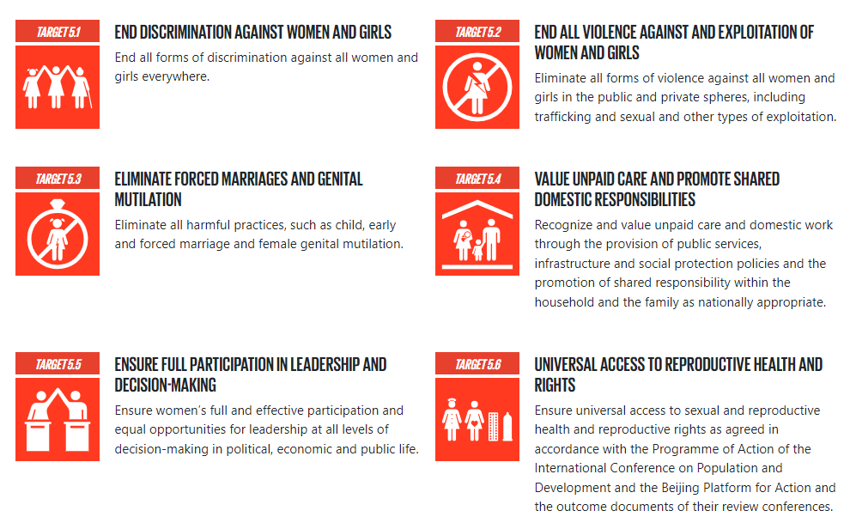
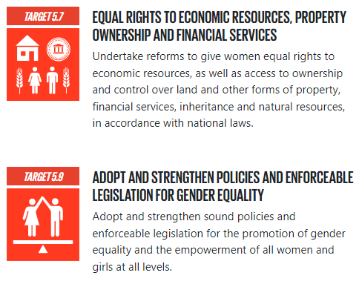

SDG 5: Achieve gender equality and empower all women and girls
Source: https://www.globalgoals.org/goals/

Slide 85
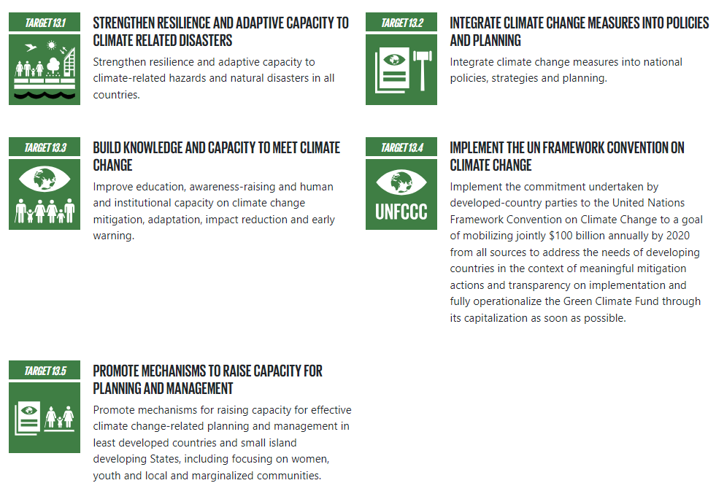
SDG 13: Take urgent action to combat climate change and its impacts
Source: https://www.globalgoals.org/goals/

Slide 86
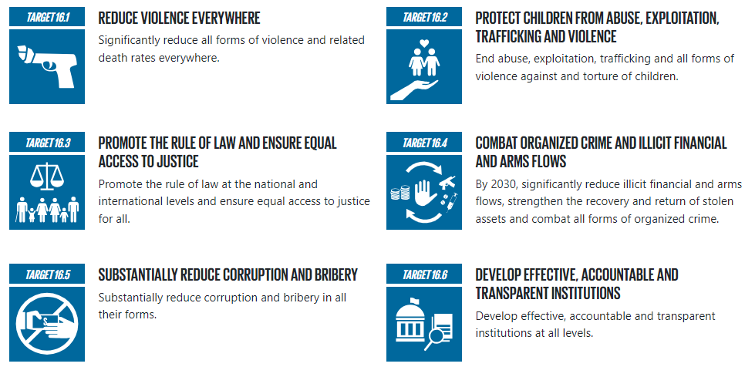
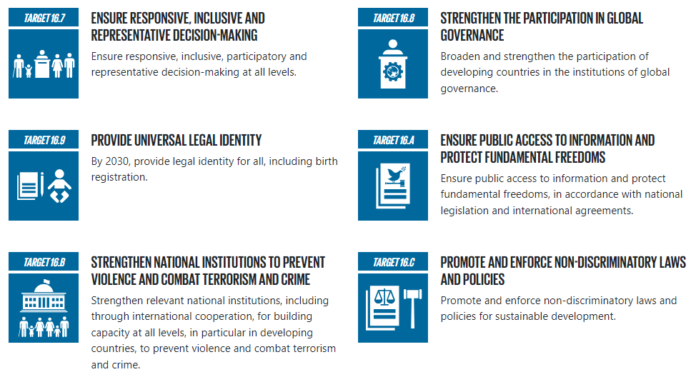
SDG 16: Promote peaceful and inclusive societies for sustainable development, provide access to justice for all and build effective, accountable and inclusive institutions at all levels
Source: https://www.globalgoals.org/goals/​

Slide 87
  Examining the relevance of the SDGs to migrants, mobility, and the rights of people on the move:
  The speaker from each Group will present one example from their discussion, answering all three questions.
Presentations and Discussion
Note: please see the presentation template to formulate the group speaker’s intervention.

Slide 88
Coffee Break

Slide 89
United Nations Network on Migration
UNNMArabRegion@iom.int
gcmrrarabstates@iom.int
www.migrationnetwork.un.org

Slide 90
Session 3 – Migration and the Cooperation Framework (CF)
Session Objectives: by the end of this session, participants should be able to: Strengthen analysis of the migration landscape in-country and discuss how migration can be further mainstreamed into the implementation of the CF priorities

Slide 91
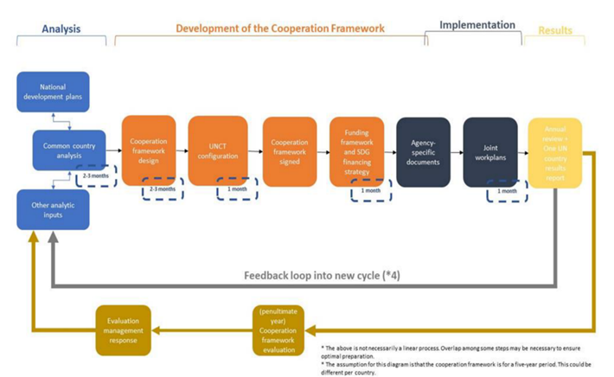
The Cooperation Framework (a recap)
Stages:
Analysis (includes the CCA)
Development of CF (includes designing, signing & funding the CF & reviewing UNCT configuration)
Implementation
Monitoring & evaluation

Slide 92
Integrating migration into the CF
Design phase:
The CCA will provide a basis for the integration of migration into CF
Development of CF includes the following basic elements:
  Determining strategic priorities (and for our purposes, linkage to migration)
  Identifying the high-level change(s) the UN system intends to contribute during through the CF
  Identifying the solutions needed for high-level change to happen (how can migrants/ migration support this)
  Identifying partners and stakeholders necessary for change
  Identify and make explicit the key assumptions underpinning the identified solutions, and major risks that may affect whether the solutions will be effective

Slide 93
Strategic prioritization
Focuses on:
  Examining the most pressing national development priorities, bottlenecks and entry points
  Matching potential solutions to these priorities with the UN system's various mandates and sectoral priorities
  Looking at the UN system's comparative advantage and complementarity with other stakeholders
  Identifying ways that migrants and migration can contribute to the achievement of desired results
Recalling national development priorities for Egypt:
  Quality services for all, social cohesion and an enhanced youth and child focused human capital.
  Inclusive, competitive, diversified, environmentally sustainable and knowledge economy.
  Sustainable natural resource management for food security and climate resilience.
  Transparency, good governance and rule of law.

Slide 94

Migration: an opportunity to accelerate SDGs
When engaged & empowered, migrants can support positive development outcomes in their countries of origin, transit and destination, as recognized in the GCM
Using the GCM as a framework for effective migration governance, the UN system is encouraged to integrate migration into CFs to harness important elements of and opportunities for sustainable development (e.g., diaspora engagement for development)
Integrating migrants and migration into CFs helps support principle of LNOB and allows for increased understanding of how development interventions affect migration dynamics
Integrating migration into CFs also supports policy coherence, connecting with other aspects across the HDPN including environmental degradation and climate change, natural disasters, conflict, violence, and displacement
Well governed migration
can contribute to positive development outcomes and accelerate the achievement of the 2030 Agenda
Notes:
To change photo, just right click photo and choose ”Change Picture”

Slide 95
Group Activity
Integrating migration into the Cooperation Framework
Objective: to review/explore alignment between the UN’s migration-related priorities in Egypt (Working Groups/Coordination mechanisms) and the CF priorities, with the aim of strengthening alignment for coherent UN support for national development priorities.
Instructions
Breakout groups (45 minutes)
Divide into five (5) groups – Different from the first breakout group
Based on the country-context of Egypt, answer the provided guiding questions
Plenary exchange (30 min)
Return to plenary
One speaker from each group highlights and 2 suggested actions for the group’s further review/discussion

Slide 96
Group Activity
Integrating migration into the Cooperation Framework
Objective: to review/explore alignment between the UN’s migration-related priorities in Egypt (Working Groups/Coordination mechanisms) and the CF priorities, with the aim of strengthening alignment for coherent UN support for national development priorities.
Guiding Questions:
  Question 1: How are migrants/people on the move impacted by this outcome? How can migrants/people on the move help contribute to achieving this outcome?
  Question 2: How to integrate migration into projects that your organization implements (if not already being implemented)? If implemented already, share context, highlight any bottlenecks and address areas for improvement
Question 3: Reflecting on previous discussions (SDG-GCM linkages, partnership, data, etc.) identify two concrete actions/activities the UNCT can take to ensure that migrants/people on the move are effectively included in the implementation of the CF. What are the potential points of Entry in the Egyptian context?When/where possible, reference key national documents (i.e., National Strategies) and how the GCM (either Guiding Principles or Objectives) can be used to support or inform these actions

Slide 97
Group Activity
Cooperation Framework Outcomes
Case study: Your group has been formed to help ensure that the new Cooperation Framework in your country is effectively implemented.
You have been advised that the outcome areas of the new Cooperation Framework are:
Outcome 1: By 2027, strengthened human capital through equal access to quality services, social protection and social justice ensured for all people.
Outcome 2: By 2027, enhanced people-centred inclusive and environmentally sustainable economic development driven by industrialization, productivity growth, decent jobs, digitalization and integrating the informal economy.
Outcome 3: By 2027, enhanced climate resilience and efficiency of natural resource management for all people in a sustainable environment.
Outcome 4: By 2027, people have improved, safe and equal access to information, protection, justice and a peaceful and inclusive society through transparent, accountable, participatory, effective and efficient governance based on the rule of law and international norms and standards.
Outcome 5: By 2027, women and girls realise their rights in the social, health and livelihood spheres, as laid out in the Egyptian Constitution, and their leadership and empowerment are guaranteed in a society free of all forms of discrimination and violence against women and girls.

Slide 98
  Integrating migration into the CF:
  The speaker from each group will present
  Group 1: (3-5 min)
  Group 2: (3-5 min)
  Group 3: (3-5 min)
  Group 4: (3-5 min)
  Group 5: (3-5 min)
  Open floor for further reactions and discussion
Presentations and Discussion
Notes:
Facilitator

Slide 99
Key takeaways and way forward
Key takeaways: All participants
Action Points for the group:
What (topics)? | Who (wish to lead)? | (By) When? | Which (platform)? | What (kind of support is needed)?

Slide 100
Overview of the workshop Day 2
  Day 1 and Day 2 Agenda
Session | Title
Opening session | Opening Remarks
Session 4 | Informal Consultations with Stakeholders American University in Cairo (AUC) Egyptian Red Crescent Society (ERC) Coalition of Refugee Led organizations Participatory Development Solutions- El Mahrousa PDS Save the Children St Andrews Refugee Services Terre des Hommes
Closing session | Wrap-up and Closing

Slide 101
Closing Remarks

Slide 102
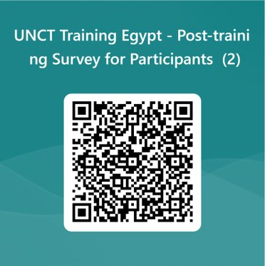
Thank you

Slide 103
Session 4 – Informal Consultation with Stakeholders
Session Objectives: Discuss ideas for establishing or strengthening partnerships with stakeholders on GCM implementation and good migration governance

Slide 104
Stakeholder Consultation
Dr. Maysa Ayoub (American University in Cairo (AUC)
Mr. Mohamed Mahgoub (Refugee Led Organizations)
Dr. Rasha Elmasry (Egyptian Red Crescent Society (ERC)
Dr. Hany Ibrahim (Participatory Development Solutions- ElMahrousa PDS)
Ms. Omneya Ghamry (Save the Children )
Mr. Ibrahim Abou Senna (St Andrews Refugee Services)
Ms. Laure Baudin (Terre des Hommes)

Slide 105
Guiding Questions
• Please introduce yourself by indicating your role and a brief description of the work of your organization in relation to migration
In your opinion, what is the best way for stakeholders to contribute better to implement the Global Compact for Safe, Orderly and Regular Migration/good migration governance in Egypt?
Please indicate the top areas in your country where support is needed to implement the Global Compact for Safe, Orderly and Regular Migration/good migration governance?
What are the main gaps/challenges you have identified which hinders/hindered the implementation of the Global compact for Safe, Orderly and Regular Migration/good migration governance?
Please describe some examples of good practices and lessons learned on the implementation of the Global Compact for Safe, Orderly and Regular Migration/good migration governance.
Do you have any recommendations for how the UN and stakeholders can work better together in the Egyptian context?

Slide 106
United Nations Network on Migration
UNNMArabRegion@iom.int
gcmrrarabstates@iom.int
www.migrationnetwork.un.org

