Slide 1
INTERNATIONAL MIGRATION REVIEW FORUM
ROUNDTABLE 1
How to enhance voluntary, safe and regular migration, and ensure access to decent work?
Contributions to the Background Note
Co-organized by UNDP and ILO

Slide 2
The Global Compact for Safe, Orderly and Regular Migration (GCM) was adopted in 2018 and aims to make migration work for all.
Notes:
The Global Compact for Safe, Orderly and Regular Migration is the first-ever intergovernmentally agreed UN framework on a cooperative approach to international migration, to ensure that migration works for all, recognizing that no single government can effectively govern migration alone.

Slide 3
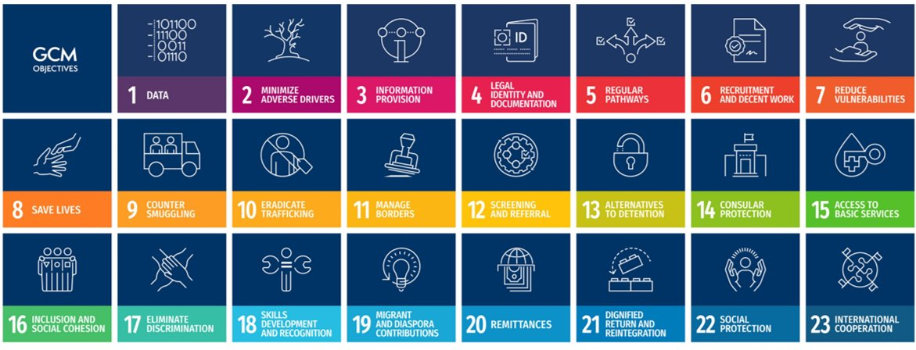
Notes:
The GCM defines 23 objectives covering all aspects of migration with an array of possible actions that States may use to implement their national migration policies. While not legally binding, the GCM’s guiding principles, objectives and actions are grounded in established obligations and principles, underpinned by the Universal Declaration of Human Rights, the 2030 Agenda for Sustainable Development, and international law.

Slide 4
The first IMRF will take place on 10-13 May 2022 in New York.
Notes:
The International Migration Review Forum is the primary intergovernmental global platform to discuss and share progress on the implementation of all aspects of the Global Compact, with the participation of all relevant stakeholders. The first International Migration Review Forum will take place in New York from 10 to 13 May 2022 and will result in an intergovernmentally agreed Progress Declaration.
4 round tables will take place during the IMRF to offer space to Member States and other relevant stakeholders to discuss and share progress on the implementation of all 23 objectives of the Global Compact.

Slide 5
ROUNDTABLE 1
The GCM objectives under discussion are:
Notes:
Round table 1 will offer a space for discussion on five related objectives of the GCM. First of all, nobody should feel compelled to leave their country of origin due to circumstances and factors beyond their control, including the negative impacts of climate change; people should have access to more options for safe avenues to migrate regularly in accordance with relevant considerations; migration should take place through transparent and user-friendly procedures, with referral mechanisms for categories of migrants in situations of vulnerability; the rights and dignity of all migrants, including migrant workers, regardless of migration status, should be protected at all stages of migration; and migrants should be able to enjoy decent work and develop their skills to empower them to maximize their contributions to countries of origin and destination alike.

Slide 6
What are the key priorities that should shape discussions and best highlight the issues covered by this Roundtable??
What emerging trends, progress and innovations, related to the GCM objectives under review, do you think should be highlighted?
What emerging and priority challenges related to the objectives would you like to see the Roundtable address?
What actions by Governments and/or other actors are helping to achieve the 5 objectives of RT 1?
Discussion questions

Slide 7
How can you contribute to the preparation of Roundtable 1?
Please provide your inputs at:
https://migrationnetwork.un.org/hub/discussion-space/imrf2022
Notes:
To support the discussion in the Round Table, we need your ideas and inputs. A background note to set the agenda and main topics for the Round Table is currently being prepared by ILO and UNDP on behalf of the UN Network on Migration. By contributing and sharing your ideas in the Discussion Space web page, you can help shape the Round Table, raising the profile of your priorities. You can respond to the guiding questions, interact with other participants, and share your experiences and insights
We look forward to your participation and contribution!

