Slide 1





1
Workstream
Measuring progress:
GCM indicators
WELCOME
To facilitate a structured discussion, please note that all participants, with the exception of panellists, are automatically muted.
If you wish to speak from the floor, please click on the ”raise hand” button.
Once approved by the moderator, you are able to unmute yourself and turn on your video by clicking on the microphone and camera buttons (bottom left of the screen).
This session will start
at 2:30 PM CET
If you face any technical difficulty, please reach out directly to the technical support operator in the chat.

Slide 2

Measuring progress:
GCM indicators
1
Workstream
UN DESA
IOM GMDAC
Global Consultation for Member States
6 February 2024, Online

Slide 3
Paragraph 70 of the International Migration Review Forum Progress Declaration
1
Workstream
Member States ‘request the Secretary-General, in his next biennial report, to propose, for the consideration of Member States, a limited set of indicators, drawing on the global indicator framework for the Sustainable Development Goals and targets of the 2030 Agenda as contained in General Assembly resolution 71/313 of 6 July 2017 and other relevant frameworks, to assist Member States, upon their request, in conducting inclusive reviews of progress related to the implementation of the Global Compact, as well as to include a comprehensive strategy for improving disaggregated migration data at the local, national, regional and global levels.’

Slide 4
Deliverables
1
Workstream
2023
Conduct a mapping of relevant approaches to measuring the governance of migration in general and with a specific focus on the Global Compact for Safe, Orderly and Regular Migration Develop a discussion note with a proposal for a limited set of indicators, building on existing indicators and data collection processes, including SDG indicators and the work of the UN Expert Group on Migration Statistics Conduct consultations with Member States and a wide range of relevant stakeholders on the limited set of indicators
2024
Develop a comprehensive strategy for improving disaggregated migration data Conduct a technical consultation on the draft comprehensive strategy for improving disaggregated migration data

Slide 5




Overview of the process for identifying the preliminary proposal of the limited set of indicators ​(January-June 2023)
1
Workstream
Canvassing questionnaire
Mapping 1: Indicator frameworks
Mapping 2:
Indicators based on Mapping 1
Preliminary proposal for a limited set of indicators
STEP 1
STEP 2
STEP 3
STEP 4
Notes:
Here, we could mention consultation mechanisms internal to the workstream (such as survey and roundtables)

Slide 6

Progress on deliverable 2:
Preliminary proposal of a limited set of indicators
1
Workstream
Finalized in June 2023
20 core indicators chosen for their relevance to GCM objectives and for fulfilling many criteria in Mapping 2
41 additional indicators
Extensive consultations with members of the workstream to develop the proposal

Slide 7
Overview of the process for identifying the revised proposal of the limited set of indicators ​(July-December 2023)
1
Workstream
5 regional consultations
Survey on the preliminary proposal
Revised proposal for a limited set of indicators
STEP 1
STEP 2
STEP 3
Notes:
Here, we could mention consultation mechanisms internal to the workstream (such as survey and roundtables)

Slide 8

Progress on deliverable 3:
Consultations with Member States and stakeholders
1
Workstream
5 regional consultations
Over 800 participants attended one or more of the five regional consultations:
  253 for the regional consultation for Africa (24 July)
  139 for the regional consultation for Arab States (25 July)
  117 for the regional consultation for Asia and the Pacific (26 July)
  197 for the regional consultation for Latin America and the Caribbean (27 July)
  114 for the regional consultation for Europe and Northern America (28 July)

Slide 9

Progress on deliverable 3:
Survey on the preliminary proposal for a limited set of indicators
1
Workstream
48 total responses of which 18 by Government entities from all regions
Respondents agreed that the core and additional indicators included in the proposal:
  Were relevant to the scope of the objectives of the GCM.
  Adequately reflected the guiding principles of the GCM.
  Built on existing reporting requirements and mandates, including the SDG indicator framework.

Slide 10

Progress on deliverable 2:
Revised proposal of a limited set of indicators
1
Workstream
Finalized in December 2023
26 core and 76 additional indicators
Key background information and statistics were added to the proposal (NEW)
Extensive consultations with members of the workstream to develop the proposal

Slide 11
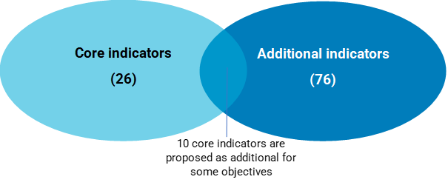
Core and additional indicators in the revised proposal
(December 2023)
Core indicators:
2 per GCM objective
10 are SDG, 15 MGI and 1 IDAC
Additional indicators:
2 to 12 per GCM objective
Many are multipurpose
18 are new and do not have an agreed methodology

Slide 12
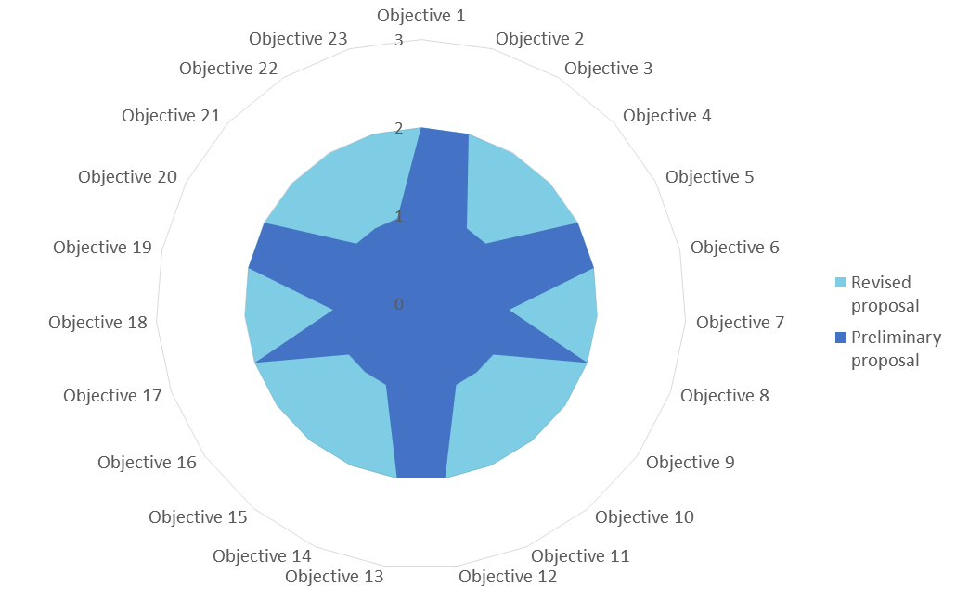
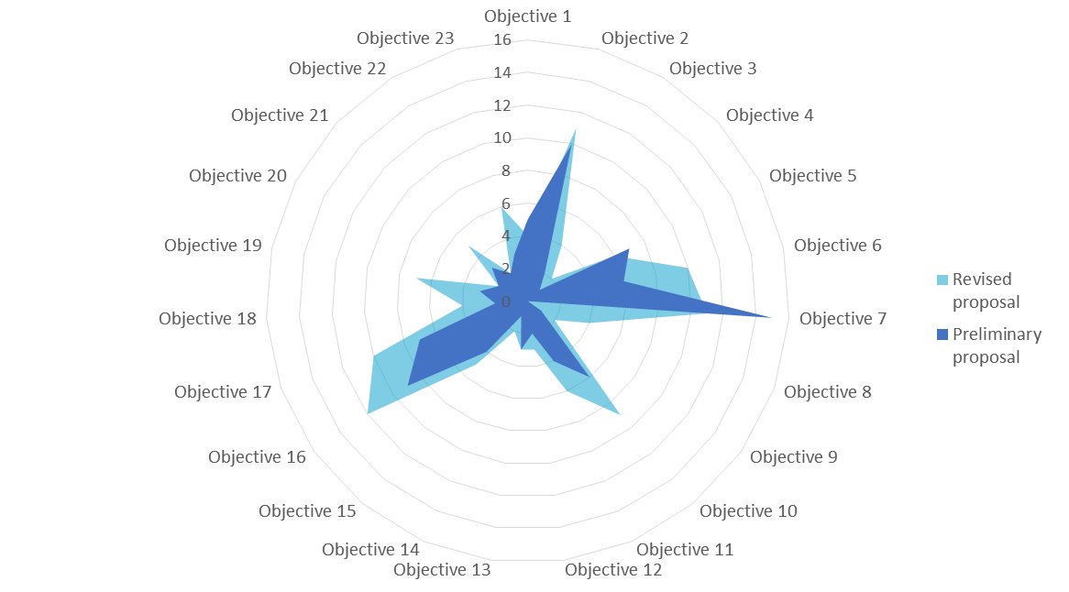
Number of core and additional indicators by GCM objective (preliminary vs. revised proposal)
1
Workstream
Core
Additional

Slide 13
Key background information and statistics
1
Workstream
Key background statistics:
1. Number/proportion of international migrants in the total resident population, by sex and age
2. Number of international migrants in the total population by country or area of origin, by sex
3. Annual number of immigrants, by sex
4. Annual number of emigrants, by sex
5. Total net migration over a given year
6. Number of international migrant workers, by sex
7. Annual number of internationally mobile tertiary-level students
8. Volume of remittance (in United States dollars) inflows
9. Volume of remittance (in United States dollars) outflows
10. Volume of remittances (in United States dollars) as a proportion of total GDP

Slide 14
Key background information and statistics (cont.)
1
Workstream
Conventions and international legal instruments:
1949 ILO Convention concerning Migration for Employment (Revised 1949) (No. 97)
1954 Convention relating to the Status of Stateless Persons
1965 Convention on the Elimination of All Forms of Racial Discrimination
1966 International Covenant on Civil and Political Rights
1966 International Covenant on Economic, Social and Cultural Rights
1975 ILO Convention concerning Migrations in Abusive Conditions and the Promotion of Equality of Opportunity and Treatment of Migrant Workers (Supplementary Provisions) (No. 143)
1979 Convention on the Elimination of All Forms of Discrimination against Women
1984 Convention against Torture and Other Cruel, Inhuman or Degrading Treatment or Punishment
1989 Convention on the Rights of the Child
1990 International Convention on the Protection of the Rights of All Migrant Workers and Members of Their Families
2000 Protocol to Prevent, Suppress and Punish Trafficking in Persons, Especially Women and Children
2000 Protocol against the Smuggling of Migrants by Land, Sea and Air
2006 International Convention for the Protection of All Persons from Enforced Disappearance
2007 Convention on the Rights of Persons with Disabilities
2011 ILO Convention concerning Decent Work for Domestic Workers (No. 189)
2019 ILO Violence and Harassment Convention, 2019 (No. 190)

Slide 15
Overview of the process for identifying the final proposal of the limited set of indicators (December 2023-March 2024)
1
Workstream
Survey on the revised proposal
In Progress
2 global consultations
(Member States & Stakeholders)
In Progress
Final proposal for a limited set of indicators submitted for the consideration of the Executive Committee of the UN Migration Network
STEP 1
STEP 2
STEP 3
Notes:
& Here, we could mention consultation mechanisms internal to the workstream (such as survey and roundtables)

Slide 16

Progress on deliverable 3:
Survey on the revised proposal for a limited set of indicators
1
Workstream
Open to Member States and stakeholders
Deadline 11 February 2024
Password: GCM23HubNetwork!

Slide 17
Presentation of the revised indicators and interactive discussions
1
Workstream

Slide 18
Guiding questions
1
Workstream
Is the proposed limited set of indicators for the GCM suitable in terms of its relevance, scope, coverage, balance and ability to compare progress over time and across different countries and regions?
Does the proposal align well with other global frameworks, such as the SDGs, while also reflecting migration dynamics?
Among the suggested indicators, which ones should be retained as core and additional for effective monitoring of the GCM?
How do these proposed indicators compare against the indicators currently in use in countries?

Slide 19





Panel 1
1
Workstream

Slide 20
Core indicators
1
Workstream
GCM objective | Core Indicators | Framework
2 | Whether or not the Government has a national disaster risk reduction strategy with specific provisions for addressing the displacement impacts of disasters | SDG 10.7.2 (Domain 5, sub-category 4)
2 | Proportion of informal employment in total employment, by sector and sex | SDG 8.3.1
5 | Whether or not the Government has a national policy or strategy for regular migration pathways, including labour migration | SDG 10.7.2 (Domain 2, sub-category 2)
5 | Visa or residency categories for which family reunification is possible | MGI
6 | Level of national compliance with labour rights (freedom of association and collective bargaining) based on ILO textual sources and national legislation, by sex and migrant status | SDG 8.8.2
6 | Recruitment cost borne by employee as a proportion of monthly income earned in country of destination | SDG 10.7.1
12 | Whether or not the Government has migration information and awareness-raising campaigns | SDG 10.7.2 (Domain 6, sub-category 4)
12 | Whether or not the country has a clear and transparent set of rules and regulations pertaining to migration (e.g. available to the public, easy to consult, easy to understand) | MGI
18 | Whether or not the Government facilitates the recognition of skills and qualifications acquired abroad | SDG 10.7.2 (Domain 4, sub-category 3)
18 | Whether or not the country participates in international schemes with common qualification frameworks (e.g. the European Qualifications Framework) | MGI

Slide 21






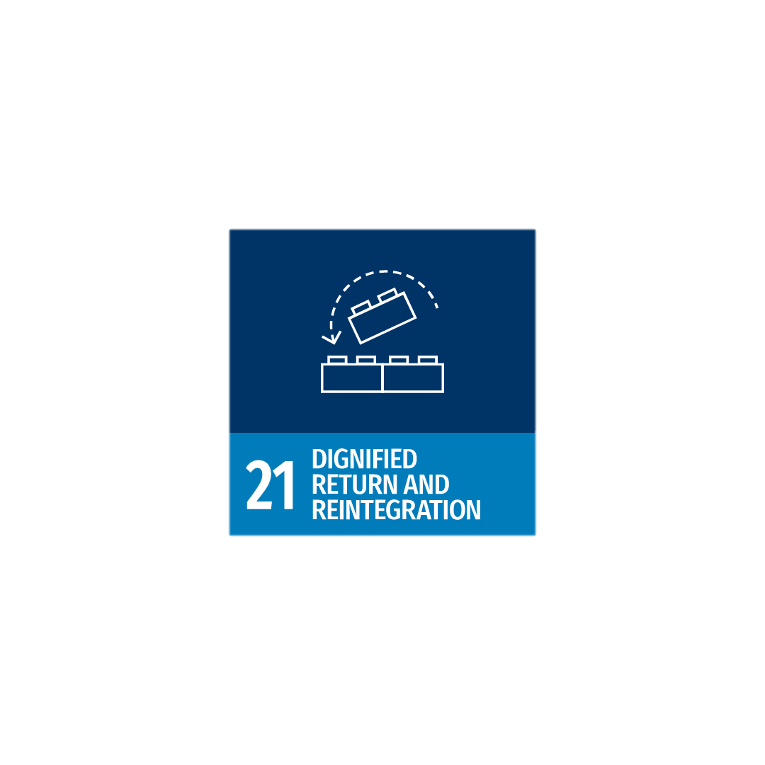
Panel 2
1
Workstream

Slide 22
Core indicators
1
Workstream
GCM objective | Core Indicators | Framework
4 | Proportion of children under 5 years of age whose births have been registered with a civil authority, by age | SDG 16.9.1
4 | Possibility for migrants who reside in the country without proof of legal identity to access civil registration services | MGI
8 | Number of people who died or disappeared in the process of migration towards an international destination | SDG 10.7.3
8 | Whether or not the country has systems in place, including formal cooperation agreements/arrangements with other countries, to trace and identify missing migrants within the national territory | MGI
9 | Whether or not the Government has formal strategies to address trafficking in persons and migrant smuggling | SDG 10.7.2 (Domain 6, sub-category 5, b)
9 | Whether or not the country has formal cooperation agreements/arrangements with other countries to prevent and counter the smuggling of migrants | MGI
10 | Number of victims of human trafficking per 100,000 population, by sex, age and form of exploitation | SDG 16.2.2
10 | Whether or not the Government has formal strategies to address trafficking in persons | SDG 10.7.2 (Domain 6, sub-category 5, a)

Slide 23
Core indicators
1
Workstream
GCM objective | Core Indicators | Framework
11 | Whether or not the Government has a system to monitor visa overstays | SDG 10.7.2 (Domain 6, sub-category 1)
11 | Specific and regular training of border staff (e.g. specific training, as well as languages, gender and cultural aspects) | MGI
13 | Estimated number of persons in immigration detention due to irregular migration status in a given year | IDAC
13 | Whether or not the country has a policy or strategy to ensure that migrant detention is only used as a measure of last resort for adults, and work towards non-custodial alternatives to detention (ATDs) | MGI
21 | Existence of a formal government programme or dedicated policy that focuses on facilitating the reintegration of returning nationals | MGI
21 | Whether or not the Government has an agreement for cooperation with other countries on return and readmission | SDG 10.7.2 (Domain 3, sub-category 4)

Slide 24






Panel 3
1
Workstream

Slide 25
Core indicators
1
Workstream
GCM objective | Core Indicators | Framework
14 | Whether or not the Government has specific measures to provide assistance to citizens residing abroad in countries in crisis or post-crisis situations | SDG 10.7.2 (Domain 5, sub-category 3)
14 | Existence of institutions to assist nationals residing abroad (embassies or consulates, labour attachés, ministries/offices of diaspora) | MGI
15 | Whether or not the Government provides non-nationals equal access to essential and/or emergency health care | SDG 10.7.2 (Domain 1, sub-category 1)
15 | Whether or not the Government provides non-nationals equal access to public education | SDG 10.7.2 (Domain 1, sub-category 2)
16 | Whether or not the Government has a national policy or strategy to promote the inclusion or integration of immigrants | SDG 10.7.2 (Domain 2, sub-category 3)
16 | Whether or not the Government has formal mechanisms to engage civil society and the private sector in the formulation and implementation of migration policy | SDG 10.7.2 (Domain 3, sub-category 5)

Slide 26
Core indicators
1
Workstream
GCM objective | Core Indicators | Framework
19 | Extent to which the Government takes measures to maximize the positive development impact of migration and the socioeconomic well-being of migrants | SDG 10.7.2 (Domain 4)
19 | Whether or not the country formally engages members of diaspora and expatriate communities in agenda setting and implementation of development policy | MGI
20 | Remittance costs as a proportion of the amount remitted | SDG 10.c.1
20 | Whether or not the country has programmes to promote financial inclusion of migrants and their families, particularly when they are remittance senders and/or receivers | MGI
22 | Whether or not the Government provides non-nationals equal access to social security | SDG 10.7.2 (Domain 1, sub-category 4)
22 | Whether or not the Government facilitates the portability of social security benefits | SDG 10.7.2 (Domain 4, sub-category 2)

Slide 27





Panel 4
1
Workstream

Slide 28
Core indicators
1
Workstream
GCM objective | Core Indicators | Framework
1 | Whether or not the Government has a mechanism to ensure that migration policy is informed by data, appropriately disaggregated | SDG 10.7.2 (Domain 2, sub-category 5)
1 | Whether or not there are questions on migration in the national census | MGI
3 | Whether or not the Government has migration information and awareness-raising campaigns | 10.7.2 (Domain 6, sub-category 4)
3 | Whether or not the Government has a website clearly outlining visa options | MGI
7 | Whether or not the Government provides non-nationals equal access to justice | SDG 10.7.2 (Domain 1, sub-category 5)
7 | Whether or not the Government has provisions for unaccompanied minors or separated children | SDG 10.7.2 (Domain 6, sub-category 3)
17 | Proportion of population reporting having personally felt discriminated against or harassed in the previous 12 months on the basis of a ground of discrimination prohibited under international human rights law | SDG 10.3.1 & 16.b.1
17 | Whether or not the country has a policy or strategy to combat hate crimes, violence, xenophobia and discrimination against migrants | MGI
23 | Extent to which the Government has measures to foster cooperation among countries and encourage stakeholder inclusion and participation in migration policy | SDG 10.7.2 (Domain 3)
23 | Number of countries with mechanisms in place to enhance policy coherence of sustainable development | SDG 17.14.1

Slide 29
United Nations Network on Migration
17 Route des Morillons, P.O. Box 17
1218 Grand-Saconnex, Switzerland
unmignet@iom.int
www.migrationnetwork.un.org

