Slide 1
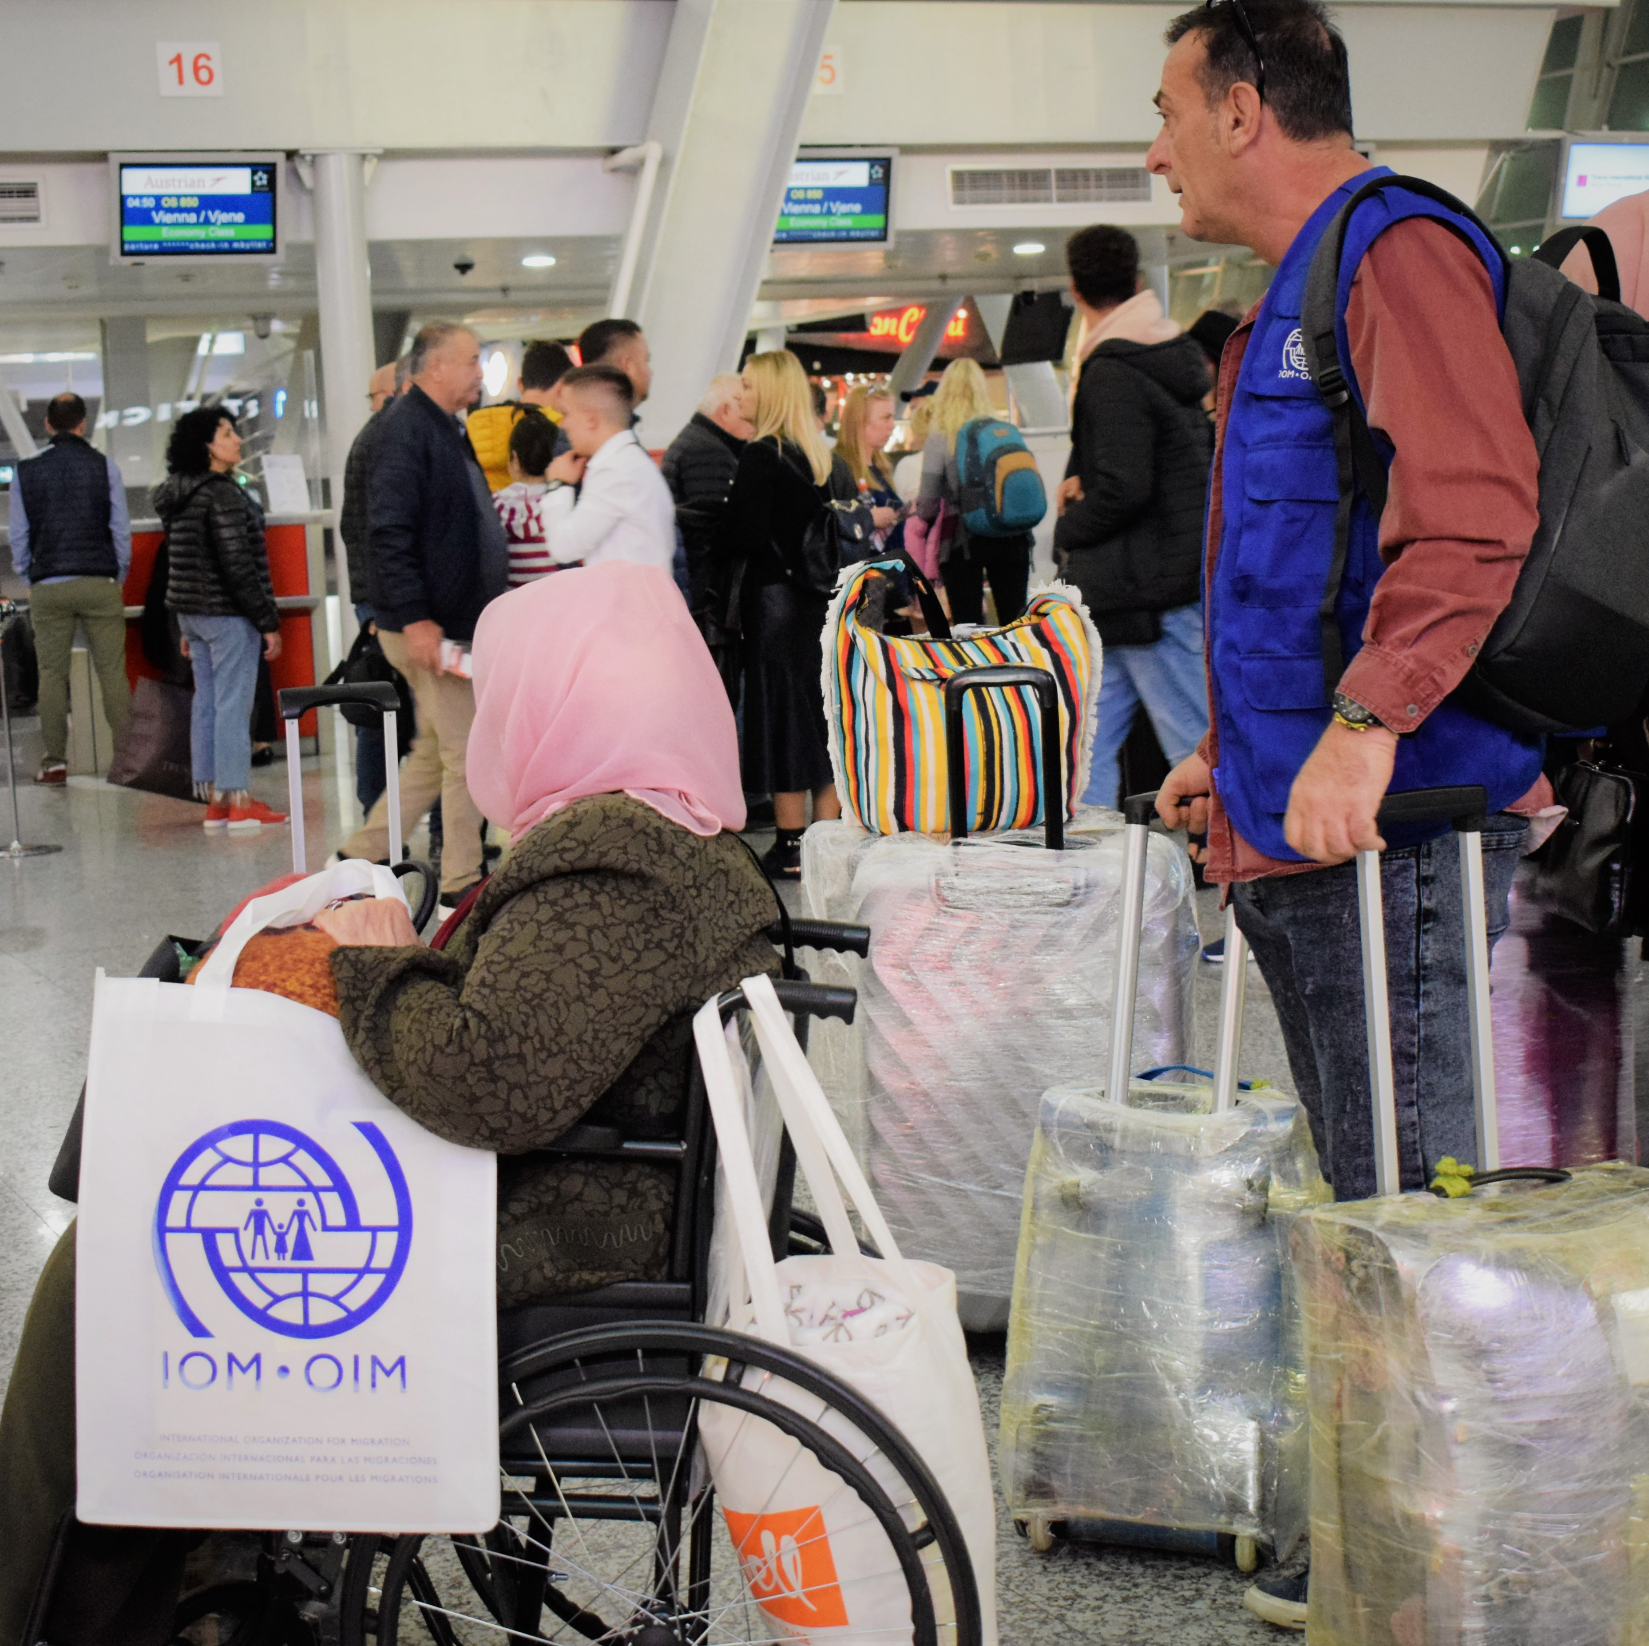
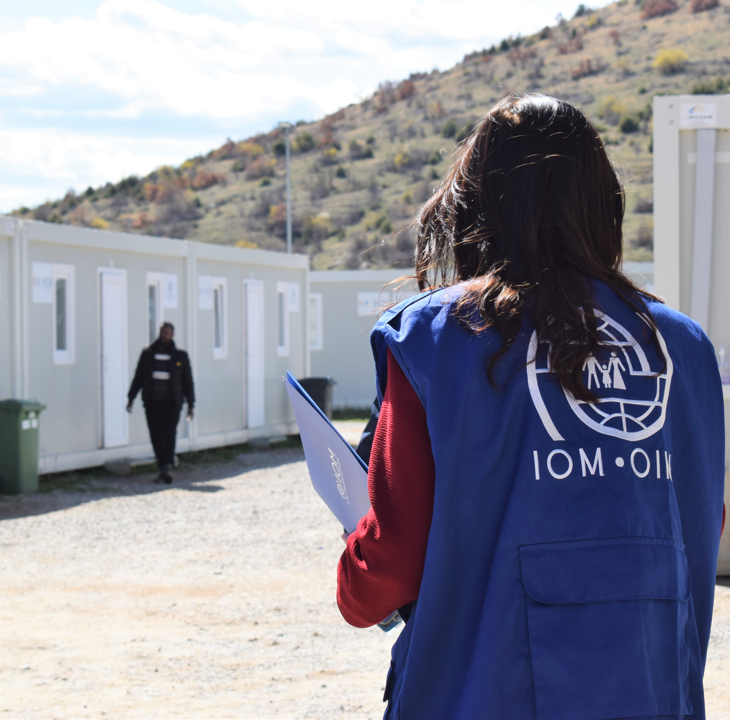
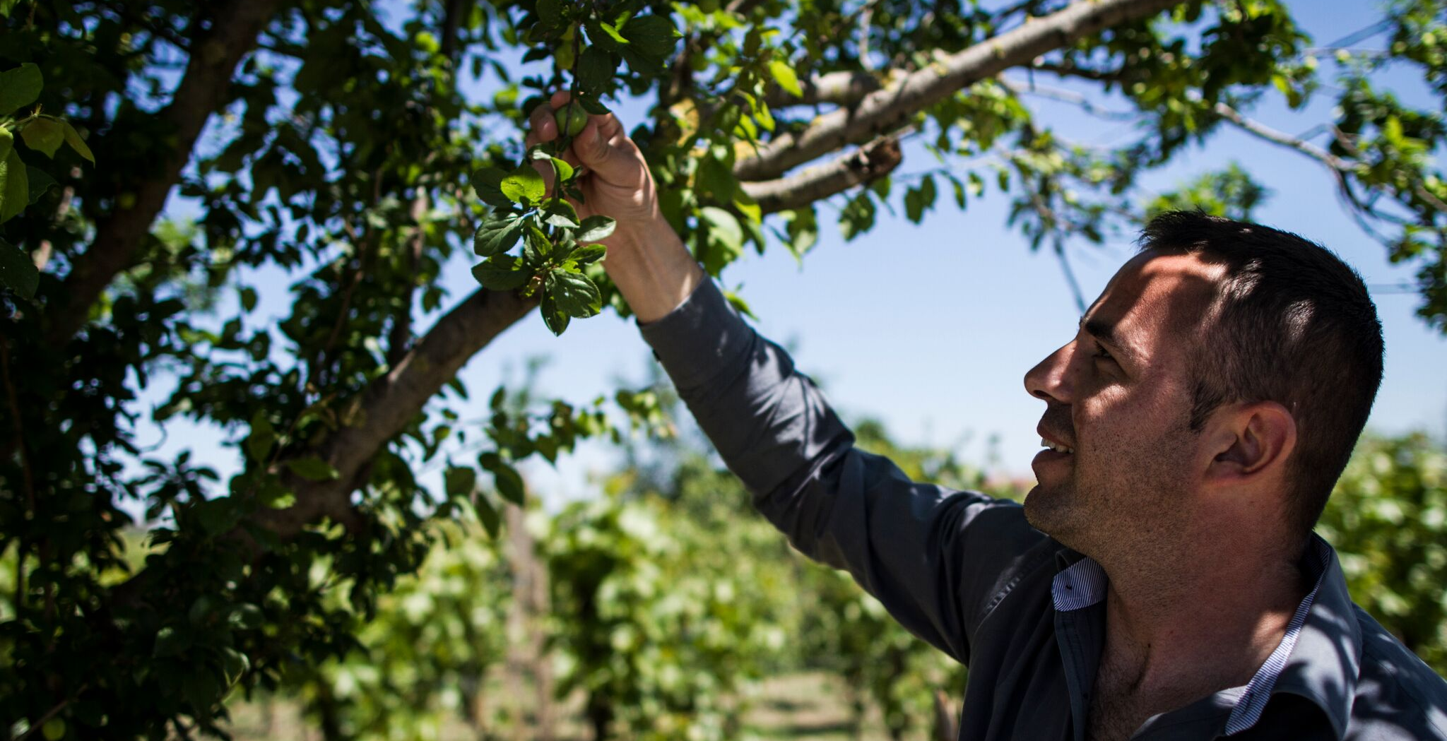
Workshop on the Global Compact for Migration (GCM) and synergies with other frameworks
10 May 2023

Slide 2
Overview briefing
10 May 2023
Opening session | Official opening (30 mins)
Session 1 | Global Compact for Safe, Orderly and Regular Migration (60 mins) Amr Taha, Sr. Regional Policy and Liaison IOM Regional Vienna
Session 2 | GCM resources for stakeholders and way forward(60 mins) Amr Taha, Sr. Regional Policy and Liaison IOM Regional Vienna Kerry-Lynn Maze, Sr. Knowledge Management Coordinator, Global Migration Data Analysis Centre
Closing session | Wrap up and official close (30 mins)

Slide 3
Opening remarks
Fiona McCluney, UN Resident Coordinator
Alma Jani, IOM Head of Office
Silvana Banushi, General Director, MoI
Notes:
Name and title of Government representatives to be included

Slide 4
Session 1: Global Compact for Safe, Orderly and Regular Migration (GCM)

Slide 5
The Global Compact for Safe, Orderly and Regular Migration
First comprehensive UN framework adopted through inter-governmental negotiations to enhance international cooperation in global migration governance.
Notes:
Key points
The Global Compact for Safe, Orderly and Regular Migration:
The GCM is the first comprehensive UN framework adopted through inter-governmental negotiations to enhance international cooperation in global migration governance.
It is based on a collective realization that no single government can effectively govern migration alone - whether fully realizing the potential of global mobility or protecting people from the most pernicious aspects of migration - without cooperation, whether bilaterally, regionally, or globally.
By creating this cooperative framework on international migration, States have developed a common terminology for discussing key migration issues and a blueprint for comprehensive, rights-based migration policies.
While not legally binding, the GCM’s guiding principles, objectives and actions find their root in established obligations and principles, underpinned by the Universal Declaration of Human Rights, the 2030 Agenda for Sustainable Development, and international law.
The GCM's approach to improving migration governance is anchored in its vision, guiding principles and its 360-degree view of migration (explored in more detail below).
Note that the Governments of Albania adopted the GCM in Marrakech in December 2018 –and was represented by the President H.E. Mr. Ilir Meta the President of Albania

Slide 6
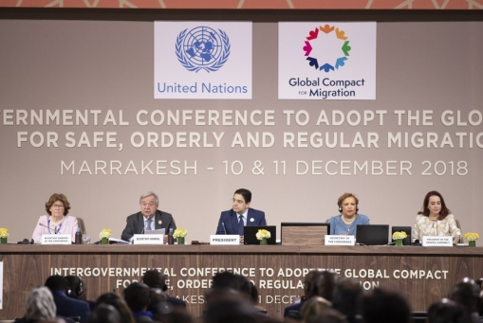
GCM Vision
Collective commitment to improving cooperation on international migration
To unite rather than divide
Common understanding, shared responsibilities & unity of purpose regarding migration
Making migration work for all
(GCM para 8 and 9)
Notes:
Key points
Vision of the GCM
The GCM's vision is based on a collective commitment to improving cooperation on international migration, and on the recognized need for the challenges and opportunities of international migration to unite us, rather than divide us (paras 8-9).
The Compact sets out a common understanding, shared responsibilities and unity of purpose regarding migration, with a view to making migration work for all (para 9).
Interactivity: (if time allows)
Question to participants:
Do you know what the GCM Guiding Principles Are?
Please put suggestions in the chat...
Facilitator to summarise the inputs and use this as a stepping stone to the next slide, which provides an overview of the principles

Slide 7
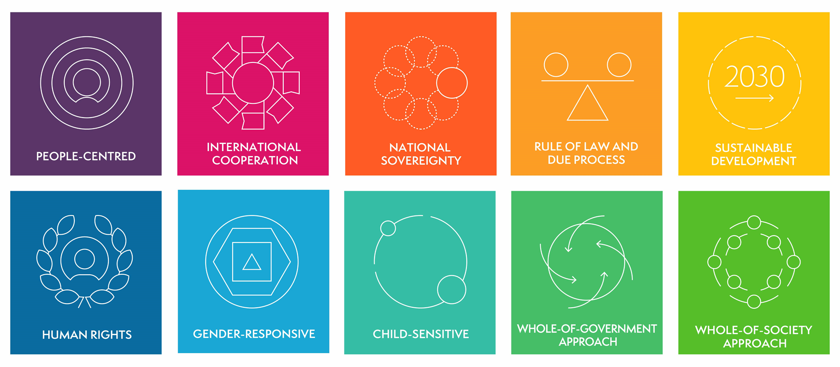
GCM Guiding Principles
Notes:
Key points
Guiding principles of the GCM
The GCM is based on a set of cross-cutting, interdependent guiding principles that should inform the implementation of any GCM objective. These are (para 15):
People-centred
International cooperation
National sovereignty
Rule of law and due process
Sustainable development
Human rights
Gender-responsive
Child-sensitive
Whole-of-government approach
Whole-of-society approach
whole-of-society approach requires government actors to create enabling environments that are inclusive, safe and sustainable, not only during consultations with relevant stakeholders but throughout all processes related to GCM implementation and review. Such environments are not only aligned with the GCM's age-, gender-, disability- and diversity-sensitive principles, but they are much more likely to meaningfully include and amplify the voices of those who often face significant structural barriers to participation, such as migrants and migrant-led organizations. Migration is a transversal phenomenon relevant to all levels of government, as well as a wide range of policy domains, and so a whole-of-society approach helps ensure that cross-societal and cross-governmental collaboration occurs. For example, when States take a whole-of-society approach to providing accurate and timely information at all stages of migration (Objective 3), they are compelled to organize multilingual, gender-responsive and evidence-based campaigns and awareness-raising activities in partnership with a wide range of governmental and civil society actors, including local authorities, consular and diplomatic missions, employers’ and workers’ organizations, diaspora organizations and academia (GCM, para. 19 (e)).
Refer to human rights-based approach (utilizing OHCHR Human Rights Marker as guidance), child-sensitive approach (following UNICEF guidance), and gender -responsive approach (per UN-WOMEN Guidelines) being developed (publication dates to be confirmed).Each of these sets of guidelines is to be referenced and made accessible to participants to encourage familiarity and engagement with these tools (as far as possible)
While migration policy is part of migration governance, and the GCM is a useful tool for ensuring comprehensive migration governance, for this to be fully realized requires following the above referenced guiding principles (including WOG, WHS approaches) and ensuring adequate capacity and ensuring adequate data is utilized throughout, including for continuous monitoring, review and adjustments (to avoid static approaches)

Slide 8
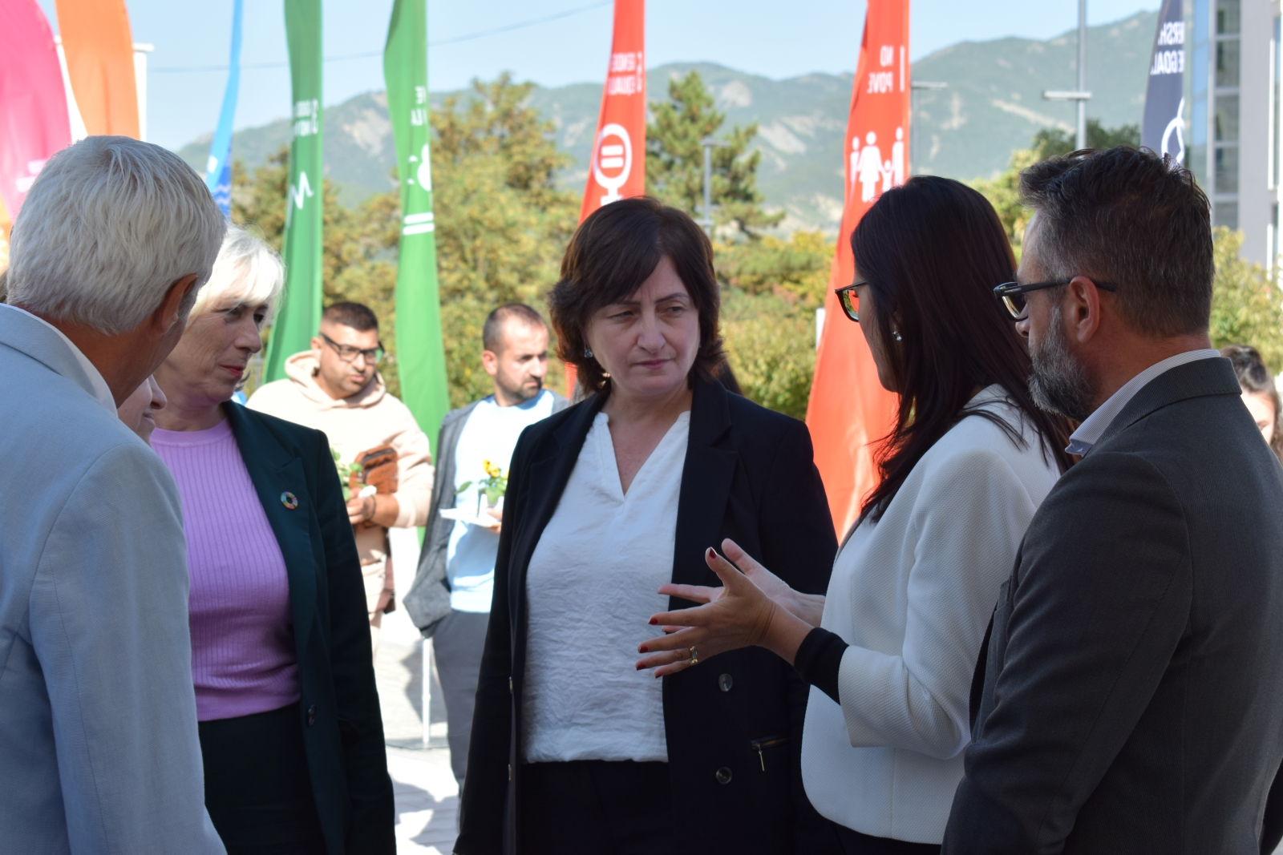
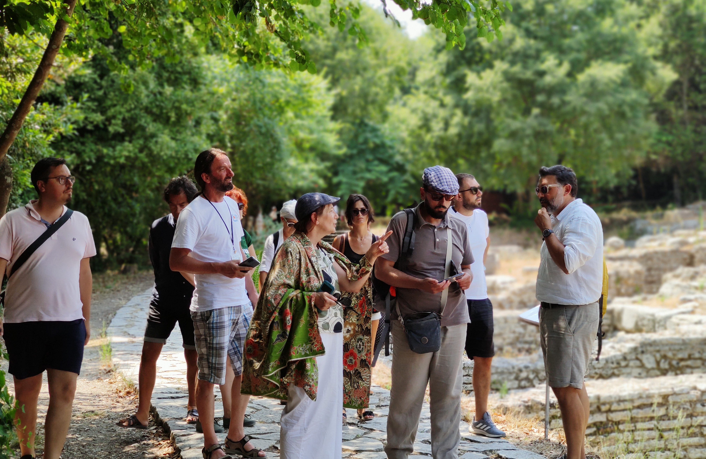
Partnerships the 2030 Agenda & the GCM Implementation of the GCM is dependent on partnership between/ among:
Migrants
Civil society
Migrant and diaspora organizations
Local authorities and communities
The private sector
Parliamentarians
National Human Rights Institutions
International Red Cross and Red Crescent Movement
Academia
Media
Other relevant stakeholders
Innovative and non-traditional partnerships are
central to success
Notes:
Stakeholders as defined in GCM para 44.
*Photo 1. IOM reps., UN RC and local government representatives in a joint public event during the UN Week 2022 in Permet, Albania, with all the UN agencies.
**Photo 2. Field trip with Albanian diaspora representatives as part of the IOM diaspora program.

Slide 9
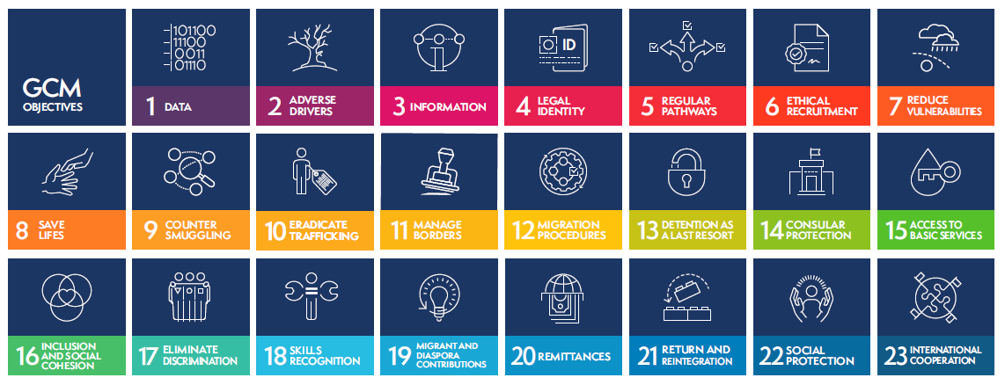
GCM Objectives
Notes:
Key points
The GCM defines 23 objectives covering all aspects of migration (“360-degree” approach – see below) with an array of possible actions, drawn from best practice, that States may choose to utilise to implement their national migration policies.
Explain the broad spectrum of the objectives, and indicate that the slide displayed will be provided as a handout
Interactivity: (if time allows)
Question to participants:
Can you think of examples from your country contexts where these objectives are either:
Posing a challenge to development
Being addressed to support development
Raise hand to share thoughts...
Facilitator to summarise the inputs and use this as a stepping stone to the next slide, which provides an overview of the principles

Slide 10
GCM’s 360-degree view of migration
Recognizes that a comprehensive approach is needed to…
Optimize the benefits of migration
Address migration risks and challenges
Notes:
Key points
The GCM's 360-degree view of international migration recognizes that a comprehensive approach is needed to
optimize the benefits of migration
while addressing its risks and challenges.
This comprehensive approach is reflected in the 23 objectives of the GCM, which collectively aim to cover all relevant aspects of migration.
While different GCM objectives focus on various aspects of migration, from access to services for migrants to border governance and available migration pathways, taken together they represent a comprehensive 360-degree vision of migration.
Accordingly, GCM objectives should not be considered in isolation but rather all 23 objectives should be implemented together. The 360-degree approach makes clear that focusing on combatting smuggling without also working on protection will not work; that focusing on remittances without delivering on decent work will not work; that focusing on pathways without attention to narratives and inclusion will not work; that no approach to migration governance will work if it does not seek to understand who is moving and why; and that without international cooperation, all efforts will be limited.
*Photo of Albanian returnees supported through the IOM reintegration program

Slide 11
The 2030 Agenda: an overview
Progress is being made in many places, but, overall, action to meet the Goals is not yet advancing at the speed or scale required.
The COVID-19 pandemic and its impact on all 17 SDGs has shown that what began as a health crisis has quickly become a human and socio-economic crisis.
Notes:
Key points
-The session begins by providing reference to the 2030 Agenda, recalling that it informs the work of the UN Development System
-Reference that interventions with a migration link are also heavily informed by the 2030 Agenda
-Recall that we are now well into the Decade for Action (the push for the achievement of the Goals!)
-Explain the impact of the COVID-19 Pandemic across the goals, and also highlight the clear relevance to migration
Interactivity: (if time allows)
Question to participants:
Ask participants if they are able to make any other connections between COVID-19 and migration, including its impact on development
Raise hand to share thoughts...
Facilitator to summarise the inputs before moving to the next slide

Slide 12
Migration & Sustainable Development
The relationship between migration & development is complex and context-specific.
It is also a two-way relationship:
Migration impacts development
Development impacts migration
Migration is a multi-faceted, non-linear and complex phenomenon, which requires an integral approach:
All sectoral areas
All levels of governance
Notes:
Key points
For the first time in global development policy, the 2030 Agenda recognizes the positive contribution of migrants to inclusive growth and sustainable development (para 29).
The 2030 Agenda incorporates the issues of migration and mobility in other significant ways, in particular by:
Recognizing that international migration is a multi-dimensional reality of great relevance for countries of origin, transit and destination — one that requires coherent and comprehensive responses at all levels (para 29)
Calling for the empowerment of vulnerable groups (including refugees, internally displaced persons and migrants) (para 23)
Highlighting the impact of humanitarian crises and forced displacement on development (para 14)
Committing to the eradication of forced labour and human trafficking (para 27)
COVID-19 is one such example of the cross-cutting and multi-directional relevance of migration to sustainable development. Responses, including to the immediate and medium-term socio-economic effects can benefit greatly from taking into consideration migration and migrants. See UNNM Guidance Note referenced in the Introductory Session. (as already referenced above)
The relationship between migration and development is complex and context specific. It is also a two-way relationship, with migration impacting development and development impacting migration
Migration is multi-faceted, non-linear and complex, requiring and integrated approach that links in with all sectoral areas and all levels of governance (horizontal and vertical linkages)
The 2030 Agenda also commits States and other stakeholders to cooperating internationally to ensure safe, orderly and regular migration involving full respect for human rights and for the humane treatment of migrants (regardless of migration status), of refugees and of displaced persons (para 29).

Slide 13
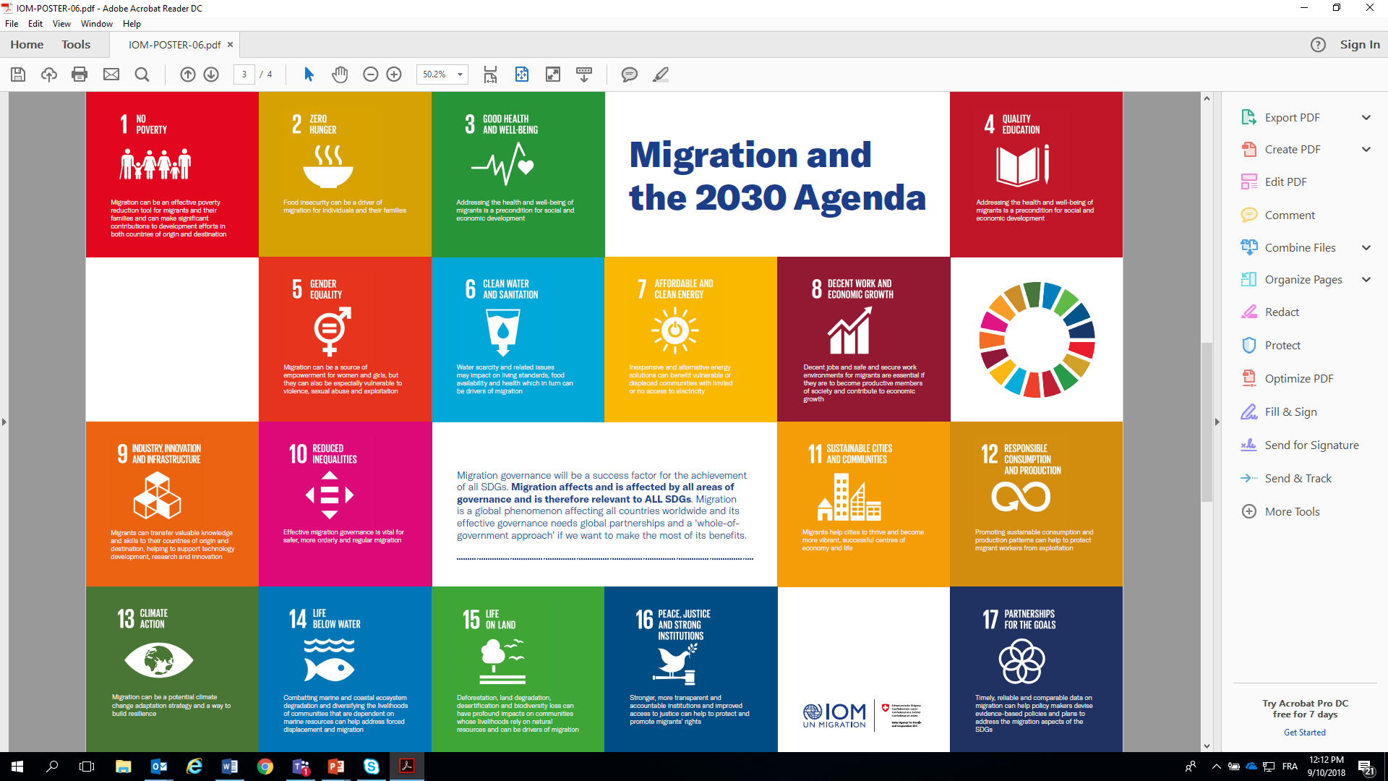
Migration & the SDGs
Notes:
Key points:
Among core connections are the following (these are all referenced in the 2030 Agenda):
Positive contribution of migrants to inclusive growth and sustainable development
Migration as a multi-dimensional reality relevant to all countries
Need to empower vulnerable groups (including migrants)
Impact of forced displacement on development
Need to eradicate forced labour and human trafficking
Need for international cooperation to ensure safe, orderly and regular migration, involving full respect for human rights and the humane treatment of migrants
Recent inclusion of Georgia in the Schengen Zone and the resultant impact on safe, orderly and regular migration, for example
Readmission agreements as well as within the European Union
Beyond this, migration links to all SDGs, as shown in the visual

Slide 14
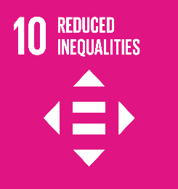
Direct Connections between
migration and the SDGs
Inclusion in the SDGs | Migration Theme | Key Targets
Direct references | Student Mobility | 4.B
 | Human Trafficking & Exploitation | 5.2; 8.7; 16.2
 | Labour Migration & Employment | 8.5, 8.7, 8.8
 | Migration Governance | 10.7
 | Remittances | 10.C
 | Migration Data | 17.18
Notes:
Key points:
The direct connections between migration and the SDGs can be seen as follows:
Student mobility (target 4B)
Human Trafficking and exploitation (targets 5.2; 8.7; 16.2)
Labour migration and employment (8.5, 8.7, 8.8)
Migration governance (10.7)
Remittances (10.C)
Migration data (17.18)
e.g. (UPDATE FOR COUNTRY CONTEXT)
Interactivity: (if time allows)
Question to participants:
Consider asking participants to share more information on this initiative and how it helps improve data on migration Raise hand to share thoughts...
Facilitator to contextualise the inputs before moving to the next slide
This slide and the previous content has exemplified the direct connections. However, there are innumerable other cross-cutting linkages. These are shown in the next slide

Slide 15
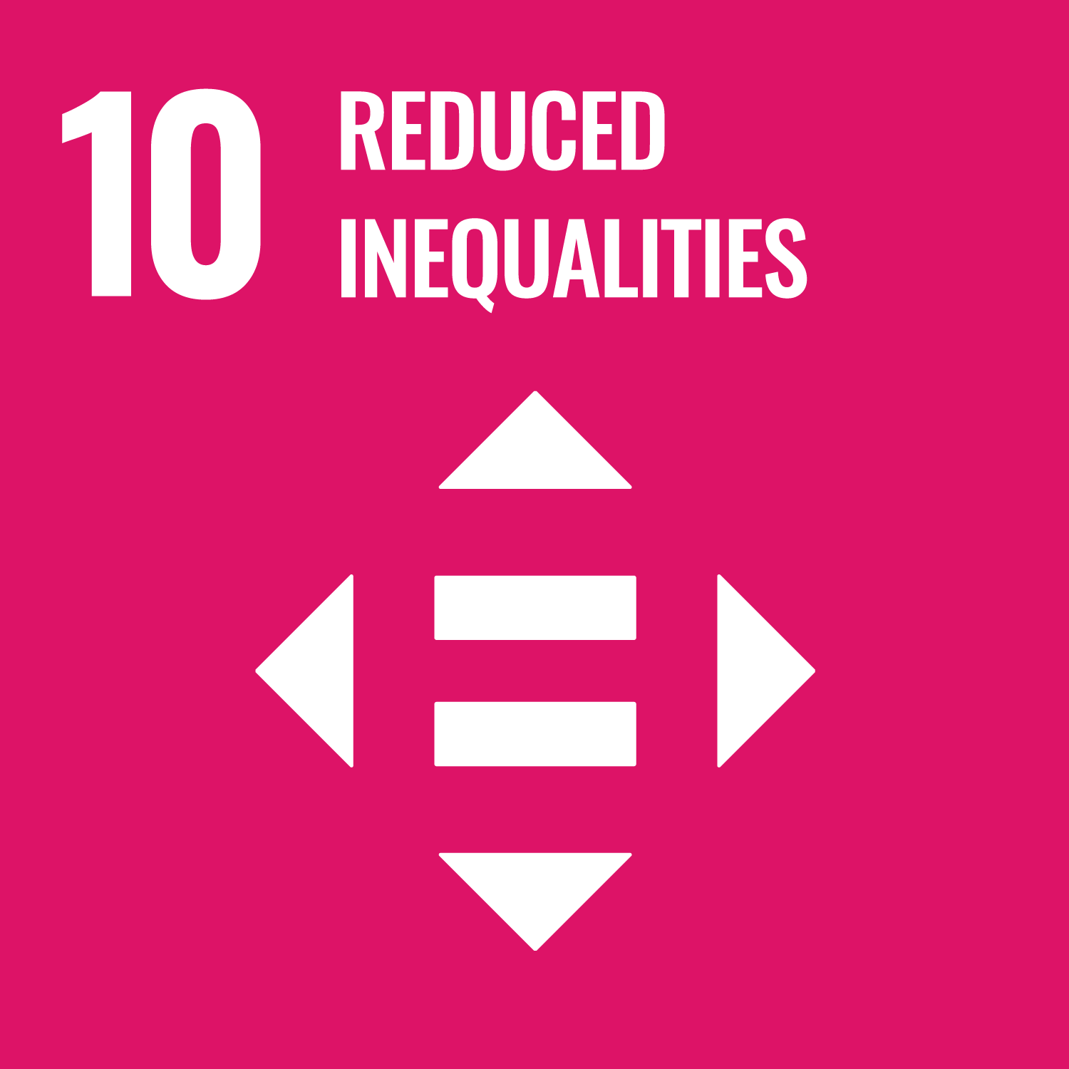
SDG target 10.7
“10.7 Facilitate orderly, safe, regular and responsible migration and mobility of people, including through the implementation of planned and well-managed migration policies”
Notes:
Key points:
Before delivering the key messages on "References to migration in the 2030 Agenda," it might be helpful to review the main references to migration in the 2030 Agenda and how these are formulated. See below:
Paragraph 14: We are meeting at a time of immense challenges to sustainable development. Billions of our citizens continue to live in poverty and are denied a life of dignity. There are rising inequalities within and among countries. There are enormous disparities of opportunity, wealth and power. Gender inequality remains a key challenge. Unemployment, particularly youth unemployment, is a major concern. Global health threats, more frequent and intense natural disasters, spiralling conflict, violent extremism, terrorism and related humanitarian crises and forced displacement of people threaten to reverse much of the development progress made in recent decades.
Paragraph 23: People who are vulnerable must be empowered. Those whose needs are reflected in the Agenda include all children, youth, persons with disabilities (of whom more than 80% live in poverty), people living with HIV/AIDS, older persons, indigenous peoples, refugees and internally displaced persons and migrants. We resolve to take further effective measures and actions, in conformity with international law, to remove obstacles and constraints, strengthen support and meet the special needs of people living in areas affected by complex humanitarian emergencies and in areas affected by terrorism.
Paragraph 27: We will seek to build strong economic foundations for all our countries. Sustained, inclusive and sustainable economic growth is essential for prosperity. This will only be possible if wealth is shared and income inequality is addressed. We will work to build dynamic, sustainable, innovative and people-centred economies, promoting youth employment and women’s economic empowerment, in particular, and decent work for all. We will eradicate forced labour and human trafficking and end child labour in all its forms.
Paragraph 29: We recognize the positive contribution of migrants for inclusive growth and sustainable development. We also recognize that international migration is a multi-dimensional reality of major relevance for the development of countries of origin, transit and destination, which requires coherent and comprehensive responses. We will cooperate internationally to ensure safe, orderly and regular migration involving full respect for human rights and the humane treatment of migrants regardless of migration status, of refugees and of displaced persons. Such cooperation should also strengthen the resilience of communities hosting refugees, particularly in developing countries. We underline the right of migrants to return to their country of citizenship and recall that States must ensure that their returning nationals are duly received.
The importance of migrants' ability to fulfil their development potential
The 2030 Agenda cannot be achieved without due consideration of migration, for meaningful implementation of the SDGs hinges upon protecting and empowering migrants (among other vulnerable groups) to fulfil their development potential in dignity and equality and in a healthy environment
Migrants' fulfilment of such potential benefits individuals, communities and countries throughout the world.
Beyond making a positive contribution to the economic dimension of sustainable development, migrants also make important, non-quantifiable contributions that enhance the social dimension of sustainable development.
For example, through social remittances – defined as " the flows of ideas, knowledge, behaviours and social capital transmitted by migrants to their families, friends and communities in their home countries" – migrants can use their linguistic and cultural links to make distinct contributions and to be agents of change.
See below link to document containing examples of how each of the SDGs and many of its targets are relevant for migrants and mobility and can be ultimately translated into migration-specific interventions: Migration and the 2030 Agenda: A Guide for Practitioners, IOM, 2018
It is important for facilitators to be familiar with the contents of this guide and to be able to draw on relevant SDGs & targets to the country-context, including in line with priorities.
SDG target 10.7
There are both direct and in-direct references to migration in the 2030 Agenda
This commitment is reflected in SDG target 10.7 of the 2030 Agenda, which calls on Member States to "facilitate orderly, safe, and responsible migration and mobility of people, including through the implementation of planned and well-managed migration policies.“

Slide 16
Cross-Cutting Connections between
Migration and the SDGs
The 2030 Agenda also contains targets that relate indirectly to migration. In these, migration is a cross-cutting theme and implementation should include migration.
Migrants should be included in all targets relating to disaster risk reduction and management, including early warning systems Migration should be recognized as a potential climate change adaptation (CCA) strategy and way to build resilience Education awareness-raising efforts on climate change should include the mobility dimensions of climate change
Inclusion in the SDGs | Theme | Key Targets
Indirect entry points | Poverty and Growth | 1.1; 1.2; 1.4; 1a; 1b, 2.3, 8.1, 8.2, 8.3 10.1
 | Social Protection | 1.3, 3.8, 10.4
 | Health | 3.1, 3.2, 3.3, 3.4, 3.5, 3.7, 3.8; 3c, 3d, 5.6
 | Climate change | 1.5; 2.4, 3d; 11.5; 11b; 13.1; 13.2; 13.3; 13a; 13b, 14.2, 14.7, 15.3
 | Education | 4.1, 4.2, 4.3, 4.4; 4.5, 4a
 | Gender | 3.7, 5.2; 5.3, 5.4, 5.6, 5a
 | Children | 5.2; 8.7; 16.2
 | Cities | 11.1; 11.3, 11a
 | Citizenship and Identity | 16.9, 10.2, 10.3, 16b
Notes:
Key points:
The 2030 Agenda also contains targets that relate indirectly to migration. In these, migration is a cross-cutting theme and implementation should include migration.
Some examples include poverty and growth, social protection, health, climate change, education, gender, among others
Refer to the targets indicated on the screen
(PROVIDE EXAMPLES BASED ON COUNTRY CONTEXT)

Slide 17
The 2030 Agenda’s Promise
“We are determined to take the bold and transformative steps which are urgently needed to shift the world onto a sustainable and resilient path. As we embark on this collective journey, we pledge that no one will be left behind”
Preamble of the 2030 Agenda
Notes:
Key points:
The promise to leave no one behind
The GCM is rooted and anchored in the 2030 Agenda.
It is rooted in the 2030 Agenda's promise to leave no one behind, and related to this promise, the Agenda's explicit focus on investing in and empowering a number of vulnerable groups: children, youth, persons with disabilities, people living with HIV/AIDS, older persons, indigenous peoples, refugees and internally displaced persons and migrants (para. 23).
The GCM’s gender-responsive guiding principle articulates the commitment to supporting the achievement of SDG 5 on gender equality and women’s empowerment
(UPDATE FOR COUNTRY CONTEXT)

Slide 18
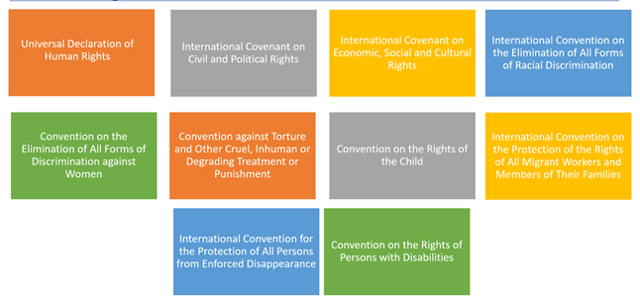
Human Rights Frameworks on which the GCM rests
Notes:
Key points:
The migration-related elements of the SDGs and the GCM rest on international human rights frameworks, including:
The Universal Declaration on Human Rights
International Covenants on Civil & Political Rights and on Economic, Social & Cultural Rights
International Contention on the Elimination of All forms of Racial Discrimination
Convention on the Elimination of All forms of Discrimination against Women
Convention against Torture and other Cruel, Inhuman or Degrading Treatment or Punishment
Convention on the Rights of the Child
International Convention on the Protection of the Rights of All Migrant Workers and Members of their Families
International Convention for the Protection of All Persons from Enforced Disappearance
Convention of the Rights of Persons with Disabilities

Slide 19
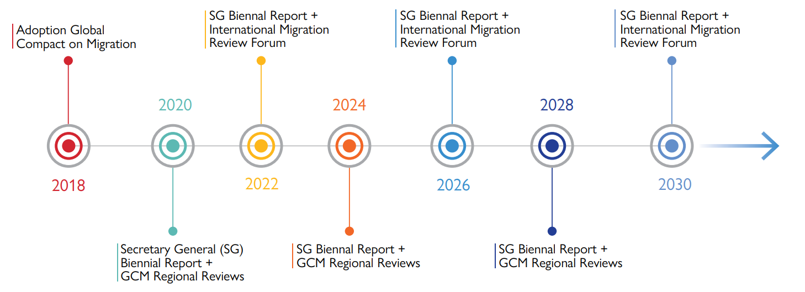
GCM Review (timeline)
Notes:
Important to note that for the IMRF, stakeholders can only participate if they are registered through ECSCO

Slide 20
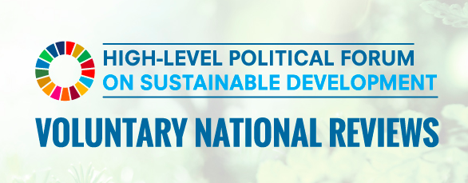
Voluntary National Reviews (VNRs) & Migration
VNRs submitted to the High-level Political Forum (HLPF) can:
Help draw attention to the situation of migrants
Emphasise the link between migration and the SDGs
Highlight areas where migration has affected SDG progress
Ensure that migration-related indicators are reflected in VNR
Identify other areas of progress towards SDGs linked to migration
Notes:
A recap:
Regular reviews of progress on 2030 Agenda implementation: country-led & country-driven
Presented by governments during the annual High-level Political Forum on Sustainable Development (HLPF) in New York
Sharing of experiences, challenges & lessons learned
Strengthen governments' policies & institutions
Mobilize multi-stakeholder support for SDG implementation

Slide 21
GCM Monitoring & Review
“We will review the progress made at local, national, regional and global levels in implementing the Global Compact in the framework of the United Nations through a State-led approach and with the participation of all relevant stakeholders” (GCM, para. 48 )
Regional reviews
Next: 2024
Global review: International Migration Review Forum (IMRF)
Next 2026
National reviews of GCM implementation
Regular, voluntary reviews the status of implementation of the GCM at national level are encouraged and should inform Regional Reviews and the IMRF.

Slide 22
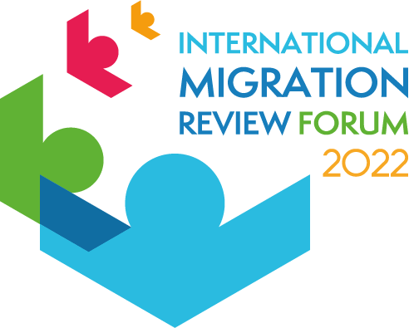
International Migration Review Forum (IMRF)
Primary inter-governmental platform for Member States to discuss & share on GCM progress, including as it relates to the 2030 Agenda for Sustainable Development, preceded by a multi-stakeholder consultation
Will convene every four years, started in May 2022
Includes interaction with and participation of all relevant stakeholders
Each IMRF to result in a Progress Declaration agreed upon by governments
Notes:
The GCM review (IMRF) is complimentary to the VNR (and HLPF)
Recall: GCM is rooted in the 2030 Agenda & supports SDG acceleration & attainment

Slide 23
International Migration Review Forum (IMRF)
National and Regional Reviews
Each IMRF should be meaningfully informed by both national and regional reviews
National reviews conducted by governments should regularly and inclusively examine progress on GCM implementation and inform future planning and activities
Regional reviews, take place every four years, alternating with the IMRF
Visit the UN Network on Migration website for guidance, templates and related documents to support the preparation of national and regional reviews, as well as the IMRF: https://migrationnetwork.un.org/

Slide 24
Break

Slide 25
Session 2: GCM Resources, Good practices & Way Forward

Slide 26
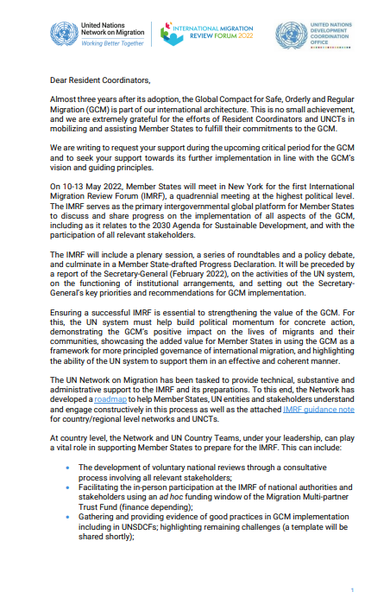
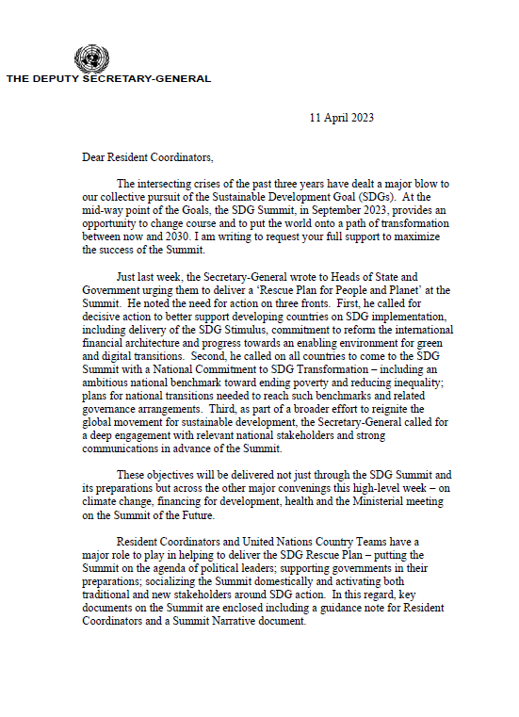
Letter to Resident Coordinators
FROM: Assistant SG + IOM DG ( 4 Nov. 2021)
FROM: Deputy SG ( 11 April 2023)
Notes:
Letter to RC
4Nov.2021: Ass. SG + IOM DG calling on RCs support, ahead of the IMRF
11 April. 2023: Deputy SG calling on RCs support ahead of the SDG Summit (planned in September 2023)

Slide 27
UN Network on Migration
The UN Network on Migration
GCM
UN system support for the implementation, follow up and review of GCM adopted in December 2018.
Network
Consists of 39 entities of the UN system who wish to be a part of it and for whom migration is of relevance to their mandate
The United Nations system is committed to supporting the implementation, follow-up and review of the Global Compact for Safe, Orderly and Regular Migration (GCM).
To this end, the United Nations establishes a Network on Migration to ensure effective, timely and coordinated system-wide support to Member States
UNNM country and regional experience
Rolled out on global, regional and national level
The Country Network in Albania was established in 2021, co-chaired by IOM and UNRC.
IOM’s Role
IOM as Coordinator and Secretariat

Slide 28
Resources to support stakeholders to implement the GCM and achieve the SDGs
UN Network on Migration - https://migrationnetwork.un.org/
Strengthening the UN System in Implementing the GCM (training) - https://migrationnetwork.un.org/network-support/un-system
Supporting Member States and Stakeholders in implementing the GCM (Guide + Booklet) - https://migrationnetwork.un.org/network-support/member-states-and-stakesholders-system
Migration Network Hub - https://migrationnetwork.un.org/hub
Migration Multi-partner Trust Fund - https://migrationnetwork.un.org/mptf
Notes:
Option to share screen and give a live demonstration of particular tools

Slide 29
Implementing the GCM: Training to Stakeholders
No one-size-fits-all approach to GCM implementation
Training: Leveraging the technical experience and guidance of UN partners to integrate migration into planning processes.
Training Sessions (to be tailored to national context)
Migration, GCM and 2030 Agenda
Migration and the CCA
Migration and the CF
Migration Governance in Practice
Strategic briefing
Available on:

Slide 30
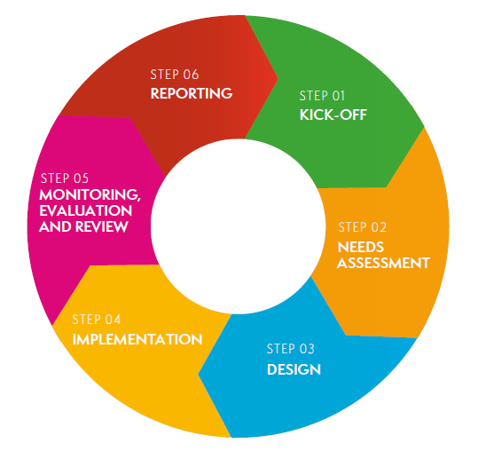
Implementing the GCM: Guidance for Governments & Stakeholders
No one-size-fits-all approach to GCM implementation
Guide: proposes a six-step process to support GCM implementation that responds to the country context
Each Step provides:
Guiding questions
Concrete actions
Tools and resources
Checklist for action
Companion Booklet: outlines all 23 GCM Objectives, with examples of practical application and links to the SDGs
Available on:

Slide 31
Migration Multi-Partner Trust Fund (Migration MPTF)
“Start-up” fund of the capacity building mechanism of the GCM and 1st UN inter-agency pooled funding instrument focusing on migration.
Has its own steering committee with representatives of Member States, donors, stakeholders & UN entities
Requires that all proposals have the endorsement of the relevant national government.
Strongly encourages the participation of government institutions and stakeholders both at the design and implementation phases.

Slide 32
Migration Network Hub
Notes:
The Hub is a virtual “meeting space” where governments, stakeholders and experts can access and share migration-related information and services. It provides curated content, analysis and information on a variety of topics.
The Hub aims to support UN Member States in the implementation, follow-up and review of the Global Compact for Migration by serving as a repository of existing evidence, practices and initiatives, and facilitating access to knowledge sharing via online discussions, an expert database, knowledge platform and training and guidance.

Slide 33
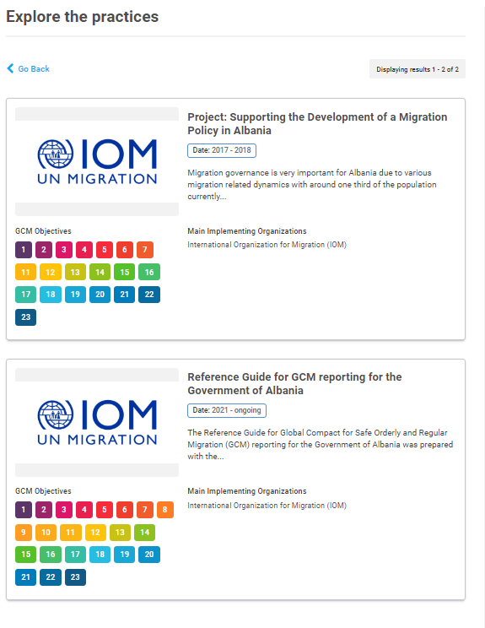
Repository of Practices
Notes:
The Repository of Practices showcases replicable practices to inspire those working to implement the Global Compact for Migration from global, national, regional and local levels.

Slide 34
Way Forward

Slide 35
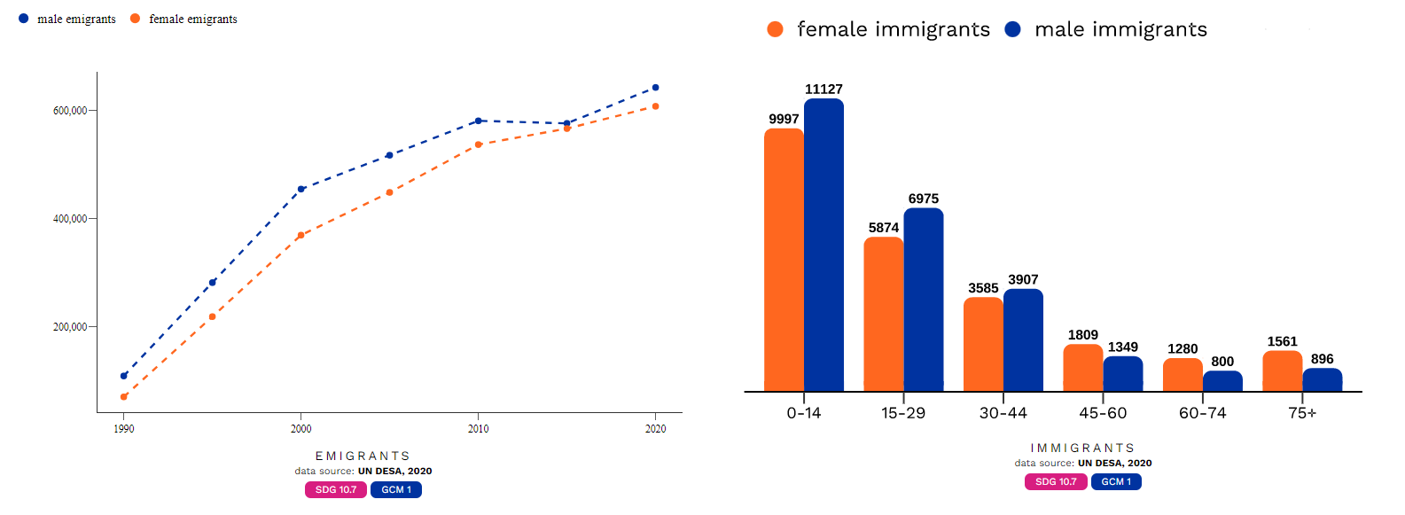
Key migration trends from and to Albania
Notes:
1,250,451 of people from Albania live in other countries, which represents 43.4% of Albania's population. 51.4% of emigrants are male, and 48.6% of emigrants are female.
49,160 of international immigrants live in Albania, which represents 1.7% of Albania's population. 51%% of immigrants are male, and 49%% of immigrants are female.

Slide 36
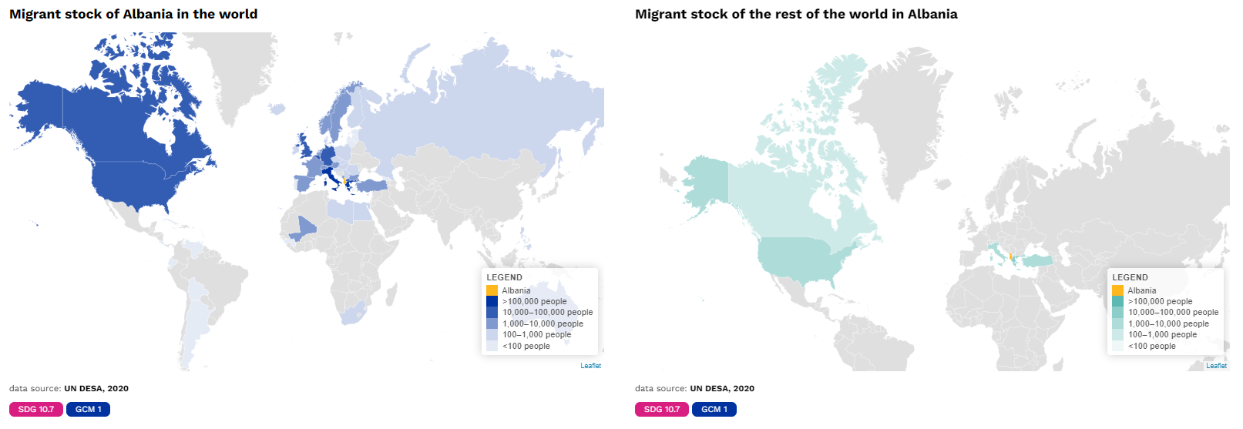
Key Migration Channels

Slide 37
Key Population Trends

Slide 38
Economic Outlook – GDP Albania

Slide 39
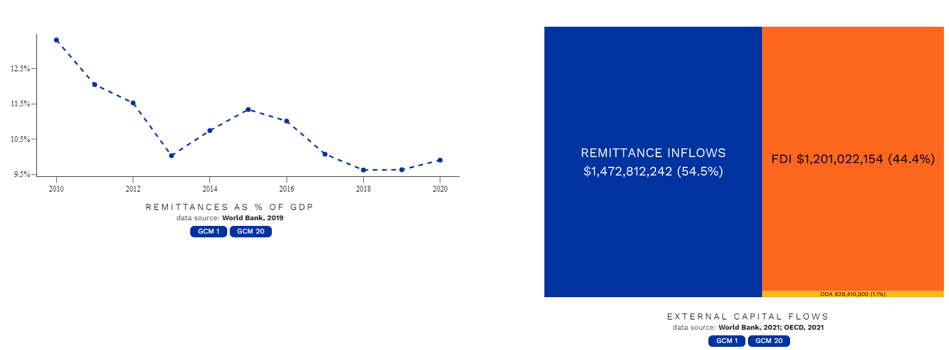
Economic Outlook – Remittances Albania

Slide 40
Leveraging the GCM to support the 2030 Agenda for Sustainable Development
Rooted in the 2030 Agenda (10.7), and with Sustainable Development as one of its Guiding Principles, the GCM presents a roadmap to facilitate safe, orderly and regular migration.
The Progress Declaration of the first International Migration Review Forum (IMRF) calls for strengthening the linkages between the GCM and the 2030 Agenda

Slide 41
Albania’s engagement in the GCM
2018: Voted in favour of the adoption of the GCM
2020: GCM Regional Review for UNECE
2021: UN Network in Albania
2022: Reference Guide for GCM reporting
2022: IMRF
2023: GCM Pledge: “New National Strategy on Migration of the Republic of Albania to be fully rooted in the GCM
….

Slide 42
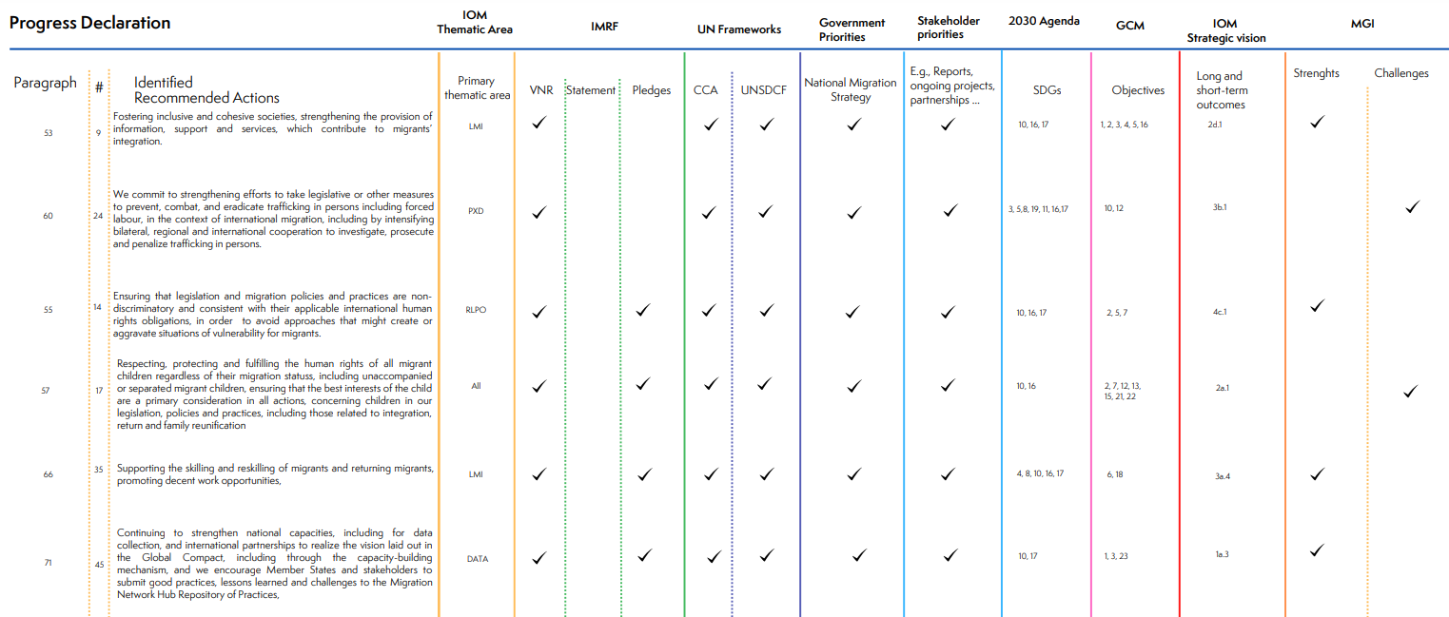
Snapshot: Synergies with other frameworks
Notes:
As you advance the implementation of the GCM, and the Progress Declaration, you are also advancing other international and national frameworks.

Slide 43
Synergies with national frameworks
National Strategy on Migration and Action Plan 2023-2027
National Strategy for Development and European Integration 2022-2030
The inter-sectorial Strategy of Integrated Border Management 2021-2027 and Action Plan
National Strategy for Diaspora 2021-2025
National Strategy of Social Protection, 2020–2023
Strategy Against Organized Crime and Serious Crime 2021–2025 and Action Plan
National Action Plan for the Fight Against Human Trafficking 2021-2023
National Strategy on Youth 2022-2029

Slide 44
Way Forward – GCM Regional Review 2024
Notes:
First GCM Review cycle concluded

Slide 45
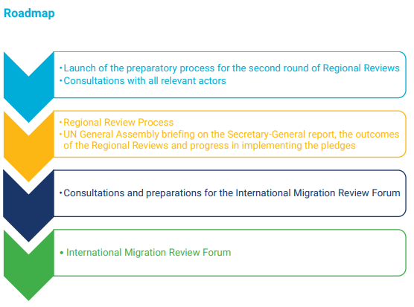
Way Forward – GCM Regional Review 2024
Regional priorities and gaps
Opportunities for strengthening regional and cross-regional cooperation on migration.
How to further integrate the GCM objectives and guiding principles in existing frameworks
Regional progress and challenges
Recommended actions set out in the IMRF Progress Declaration

Slide 46
Way Forward – GCM Regional Review 2024
GCM talks
Global and regional consultations and peer-learning exchanges
Migration Network Hub:
Easy-to-use platform to provide inputs
consult all information related to the Regional Reviews
Regular communications products and updates by UN Network Secretariat and Regional Network
GCM Pledges Dashboard
Notes:
No VNRs to not, the way we prepare is DIALOGUE.
Government and stakeholders are encouraged to host a GCM TALKS

Slide 47
Closing remarks

