Slide 1
Session 2 – Migration and the Common Country Analysis (CCA)
Session Objective: by the end of this session participants should be able to: - Identify where to look for migration data and evidence

Slide 2
The CCA: an overview
Draws on national data, diverse perspectives and UN-wide intellectual resources
Delves into risk, vulnerability & human rights
No longer a one-off event but is on on-going exercise with regular updates
Allows the UN to be more responsive to emerging needs & changing conditions in the country
Six Core Principles:
Reaching the most vulnerable and marginalized
Realizing human rights
Advancing gender equality & women's empowerment
Deepening resilience
Ensuring sustainability
Upholding accountability

Slide 3
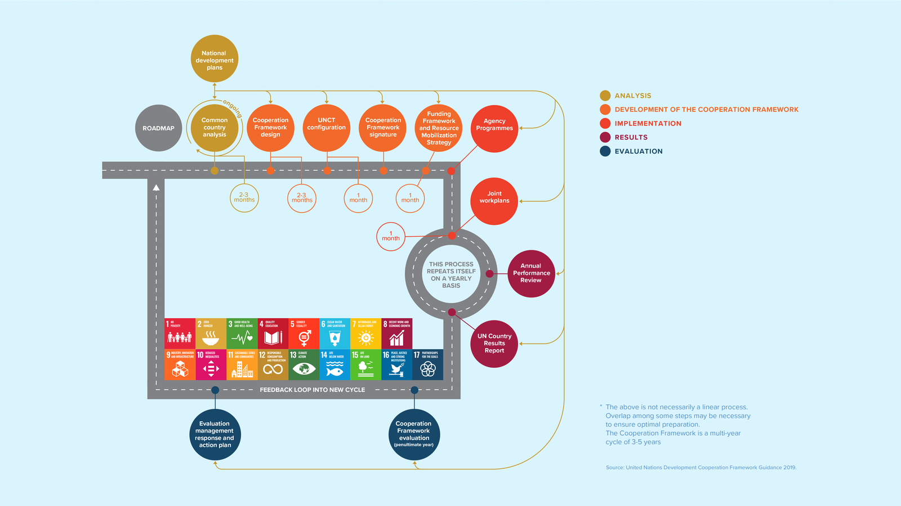
Contextualising the CF and the CCA

Slide 4
The CCA and the CF in Country x
Provide input on CCA and CF status
(to be delivered by RCO in Country x)

Slide 5
The CCA and the CF in Country x
Provide input on CCA and CF timelines
(to be delivered by RCO in Country x)

Slide 6
The CCA and the CF in Country x
Provide input on core elements of the CCA and CF priorities etc
(to be delivered by RCO in Country x)

Slide 7
Incorporating migrants and migration into the CCA
The core considerations in CCAs towards meeting international commitments on norm and standards all link to migration: Migrants, migration and related data should be considered in each
Populations at risk of being left behind
Social development and exclusion
Economic transformation & financial landscape analysis
Environment and climate change analysis
Governance and political analysis
Multidimensional risk analysis
H-D-P linkages
Populations at risk of being left behind: add country context here​
Economic analysis: add country context here
​
Other: add country context here
Which of the 5 factors of the LNOB analysis is particularly relevant for people on the move in this country context?
Discrimination │ Governance │ Socio-economic status │ Geography │ Vulnerability to shocks

Slide 8
Leave No One Behind Analysis
Which of the 5 factors of the LNOB analysis is particularly relevant for people on the move in Country Name?
1) Discrimination
2) Governance
3) Socio-economic status
4) Geography
5) Vulnerability and shocks
Group Activity
1) Click on the Easy Retro link
2) Add your examples for each factor
Insert Easy Retro link here

Slide 9
Migration, data & the CCA
Core considerations for the identification of migration-related data and research during CCA development :
Take stock - what data is available, what are the gaps (what do we know and not know) - example from country context (i.e. migration profile)
Examine available data according to demographic characteristics (inc. nationality, age, sex, other)
Use diverse (yet reliable) data sources (NSOs, government administrative data, NHRI, international organizations) - example from country context (i.e. census data, demographic health survey, etc)
Work towards disaggregating data by migratory status
Ending STATISTICAL INVISIBILITY
for VULNERABLE GROUPS
is key to
LEAVING NO ONE BEHIND

Slide 10
Migration data (continued)
End statistical invisibility
Strengthening disaggregation of data (17.18)
Understand migration characteristics (health, education, housing, employment…)
2
Migration Status Disagregation
1
Developing Indicators
Governments can develop their own national indicators in parallel to global
Proxy Indicators
Data Mapping
3
Policy-makers need timely, reliable, accessible, and comparable data
There is need for improved development data as part of SDG implementation.
Migration
Data Capacity

Slide 11
Data & human rights
Good data can support realization of migrants’ rights through:
Reviewing treaty ratifications and assessing measures to uphold migrants’ rights
Assessing if a country’s laws & policies are migrant-inclusive & adequately protect migrants
Identifying migration-related gaps in data through the CCA is important and can be done through:
Improving use of existing data tools
Creating migration-specific data action plans
Strengthening cooperation across actors that produce and use migration data
Enact legal & institutional frameworks for the collection of quality migration data

Slide 12
Strengthening Migration Related Data in the CCA
What types of data and information (qualitative and quantitative) are available in country x that can support the analysis?
Questions and group reflection:
1) Go to www.menti.com
2) Insert text code
Insert QR code (image) for Menti link here
OR

Slide 13
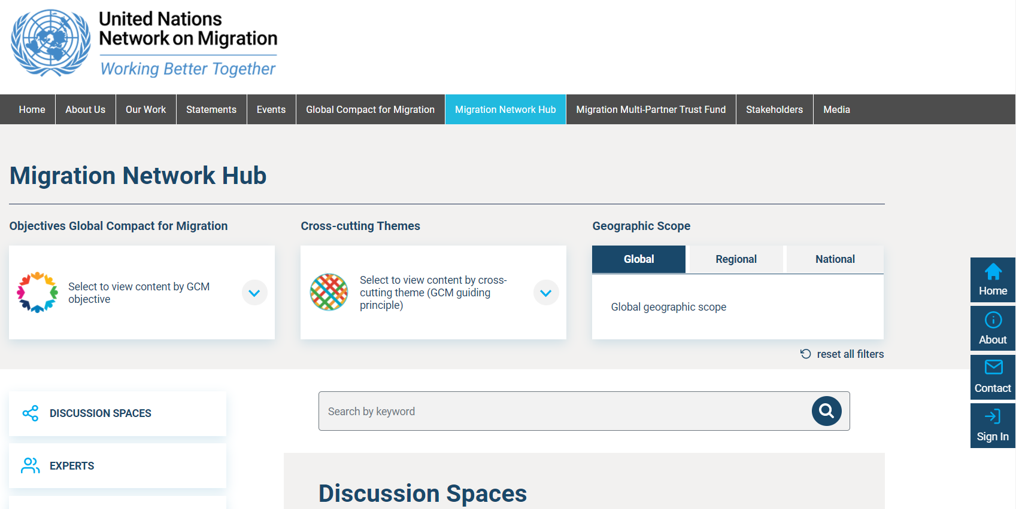
Migration Network Hub
https://migrationnetwork.un.org/hub

Slide 14
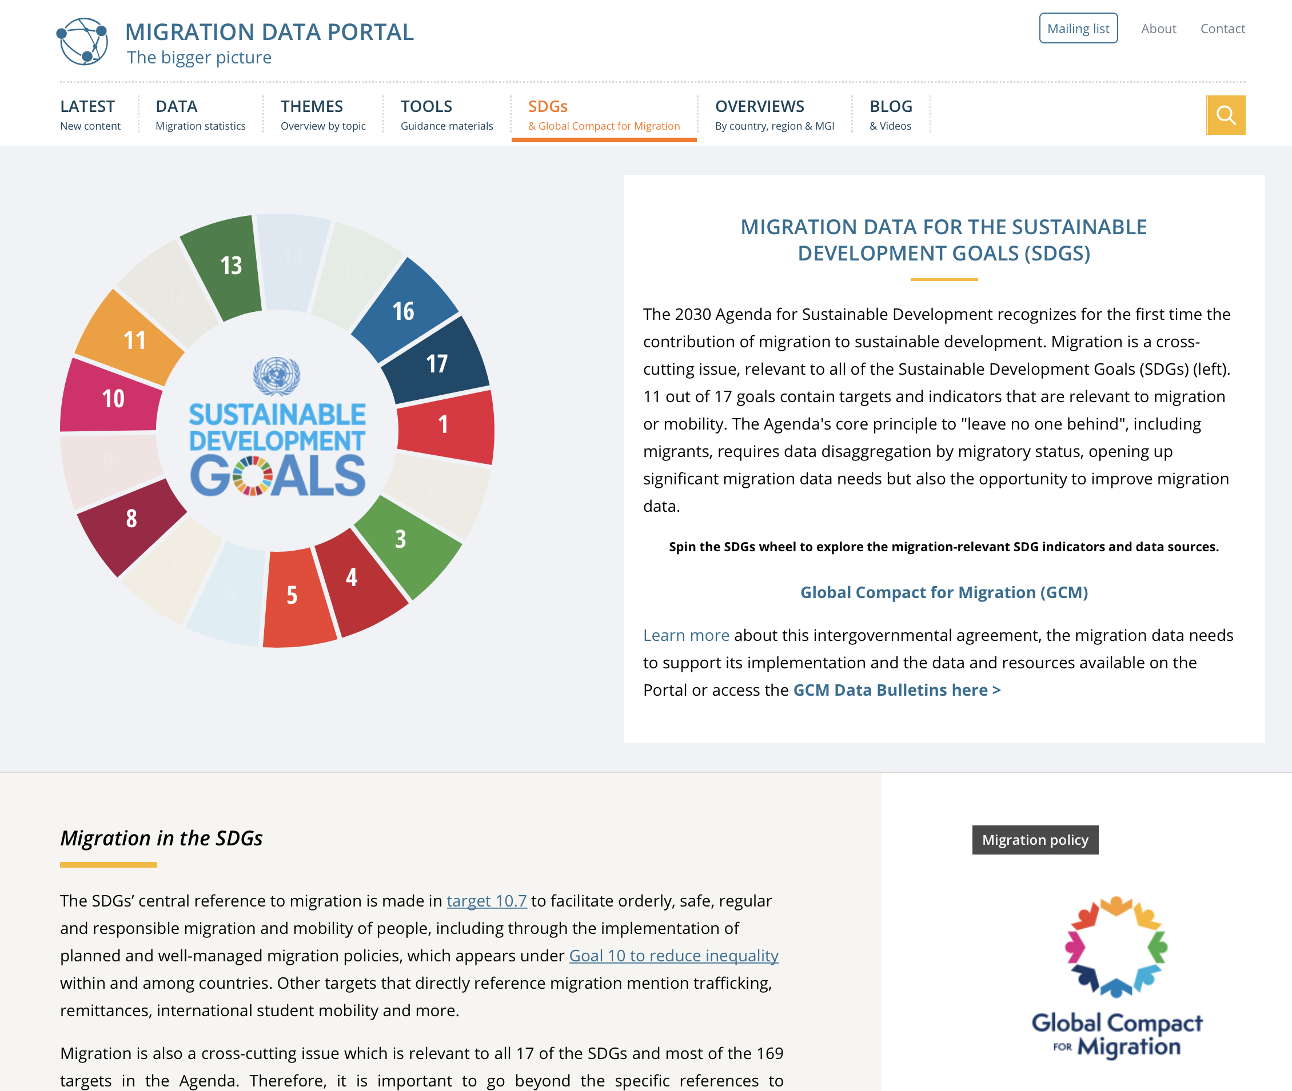
Additional data sources
SDG Indicators
Migration Data Portal
Leave No Migrant Behind
The 2030 Agenda and data dissaggregation
https://unstats.un.org/sdgs/metadata/
https://migrationdataportal.org/sdgs#0
https://publications.iom.int/books/leave-no-migrant-behind-2030-agenda-and-data-disaggregation

Slide 15
United Nations Network on Migration
17 Route des Morillons, P.O. Box 17
1218 Grand-Saconnex, Switzerland
+41 22 717 91 11
unmignet@iom.int
www.migrationnetwork.un.org

