Slide 1
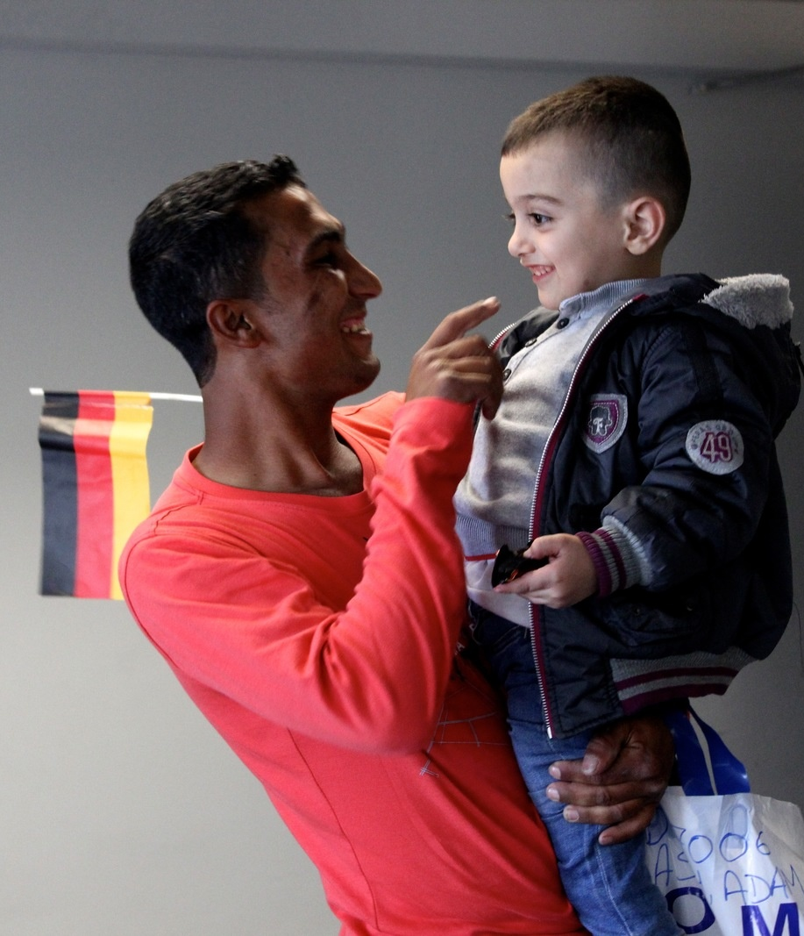
Welcome back! In the chat, please share with us 1 key takeaway from the training thus far.

Slide 2
Recap of DAY 1
Migration governance, the GCM and the 2030 Agenda
– The concept of migration governance
– An introduction to the GCM
– The core linkages between migration and the 2030 Agenda
– The importance of policy coherence
Migration and the CCA
– Migration considerations across the CCA
– Statistical invisibility
– The importance of migration data
– Migration data sources
Notes:
n.b. This welcome-back and recap session should be adjusted, depending on the structure of the training. For example, if the training is to be conducted over two-days then the welcome back can be tailored as a recap of Day 1, and overview of Day 2. Alternatively, it can simply be a recap of the prior session.

Slide 3
Overview of DAY 2
(adjust slide in line with the specifics of the training)
Session​ | Title​
Session 3​ | Migration and the Cooperation Framework (75 mins)​
Session 4​ | Migration Governance in Practice: partnership, financing, monitoring and evaluation (60 mins)​
Closing session​ | Wrap up, way forward and official close (20 mins)​

Slide 4
Session 3 – Migration and the Cooperation Framework (CF)
Session Objectives: by the end of this session participants should be able to: - Understand the importance of integrating migration into CFs for achieving the SDGs
- Understand how to integrate migration into CFs

Slide 5
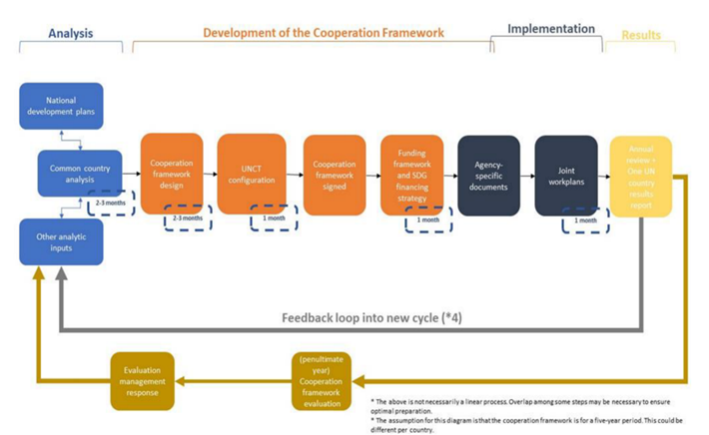
The Cooperation Framework (a recap)
Stages:
Analysis (includes the CCA)
Development of CF (includes designing, signing & funding the CF & reviewing UNCT configuration)
Implementation
Monitoring & evaluation

Slide 6
Integrating migration into the CF
Design phase:
The CCA will provide a basis for the integration of migration into CF
Development of CF includes the following basic elements:
Determining strategic priorities (and for our purposes, linkage to migration)
Identifying the high-level change(s) the UN system intends to contribute during through the CF
Identifying the solutions needed for high-level change to happen (how can migrants/ migration support this)
Identifying partners and stakeholders necessary for change
Identify and make explicit the key assumptions underpinning the identified solutions, and major risks that may affect whether the solutions will be effective

Slide 7
Strategic prioritization
Focuses on:
Examining the most pressing national development priorities, bottlenecks and entry points
Matching potential solutions to these priorities with the UN system's various mandates and sectoral priorities
Looking at the UN system's comparative advantage and complementarity with other stakeholders
Identifying ways that migrants and migration can contribute to the achievement of desired results
Recalling national development priorities (insert details for country x):
xxx
xxx
xxx

Slide 8
Migration: an opportunity to accelerate SDGs
When engaged & empowered, migrants can support positive development outcomes in their countries of origin, transit and destination, as recognized in the GCM
Using the GCM as a framework for effective migration governance, the UN system is encouraged to integrate migration into CFs to harness important elements of and opportunities for sustainable development (e.g., diaspora engagement for development)
Integrating migrants and migration into CFs helps support principle of LNOB and allows for increased understanding of how development interventions affect migration dynamics
Integrating migration into CFs also supports policy coherence, connecting with other aspects across the HDPN including environmental degradation and climate change, natural disasters, conflict, violence, and displacement
Well governed migration
can contribute to positive development outcomes and accelerate the achievement of the 2030 Agenda
Notes:
To change photo, just right click photo and choose ”Change Picture”

Slide 9
Questions?
Notes:
Key points
- Pause in the session to find out of there are any questions from participants on what has been covered in this part of the session
Interactive element:
- Prompt participants to highlight the connections between the frameworks in connection to the national context (depending on time)

Slide 10
Group Activity
Integrating migration into the Cooperation Framework
Objective: to review/explore alignment between the UN’s migration-related priorities in country x (i.e. UNNM) and the CF priorities, with the aim of strengthening alignment for coherent UN support for national development priorities.
Instructions
Breakout groups (30 minutes)
[Placeholder: Facilitator selects one from three activity options based on the status of the UNSDCF and adds text of option 1/2/3 here]
Divide into XX groups
Discuss the associated guiding questions
Question 1: Facilitator adds guiding question from option selected
Question 2: Facilitator adds guiding question from option selected
Plenary exchange (20 min)
Return to plenary
One speaker from each group highlights and 2 suggested actions for the group’s further review/discussion

Slide 11
Group Activity – Overarching Context:
Choose an Activity Option (1, 2, or 3). Delete the options that were not selected. Update the slide with the required text.
Option 1 – Hypothetical (No CF priorities nor a UNNM workplan/written priorities: Facilitator(s) draft(s) list of hypothetical CF priorities according to national context
A hypothetical Cooperation Framework might outline the following strategic priorities:
List hypothetical strategic priorities drafted by facilitator(s) during training preparation
Option 2 – CF priorities: Outline the strategic priorities/outcomes that most relevant to discussion
The Cooperation Framework (CF) outlines the following strategic priorities (drafted in Month Year):
List all strategic priorities or those selected by facilitator for discussion
Option 3 – CF priorities and national UNNM workplan/priorities:
[Text box 1] The Cooperation Framework (CF) outlines the following strategic priorities (drafted in Month Year)
[Text box 2] The National UNNM YYYY-YYYY workplan focuses on the following thematic priorities:

Slide 12
Group Activity – Context: National UNNM YYYY-YYYY workplan priorities [replace title and text (as needed) for Options 1 & 2]:
If Option 1 was selected, provide details on selected hypothetical priorities drafted by facilitator(s), including:
Why priority was selected
Relevance to migration
If Option 2 was selected, provide details on CF strategic priorities. Example:
High-value added and green economy
Support inclusive and sustainable economic growth based on the Government's bio-circular model.
Enable and strengthen capacities for low carbon society, resilience, and and disaster recovery with capability to adapt to and reduce the risks of disasters.
If Option 3 was selected, provide detailed outline of national UNNM workplan priorities. Example:
Promoting inclusion with particular focus on ensuring migrants are part of the COVID-19 Response & Recovery effort in Thailand.
Migrants have increased access to health care and essential services (including testing, treatment and vaccination against COVID‐19) regardless of migrant status and access social protection.
Migrants, regardless of status, are integrated in their communities and workplaces and recognized as vital contributors to Thailand’s economy and society.
RTG include migrants in their COVID‐19 plans.

Slide 13
Integrating migration into the CF:
The speaker from each group will present [add more groups as needed]
Group 1: (3-5 min)
Insert group theme
Group 2: (3-5 min)
Insert group theme
Open floor for further reactions and discussion
Presentations and Discussion
Notes:
Facilitator

Slide 14
United Nations Network on Migration
17 Route des Morillons, P.O. Box 17
1218 Grand-Saconnex, Switzerland
+41 22 717 91 11
unmignet@iom.int
www.migrationnetwork.un.org

