Slide 1
Session 4: Migration Governance in Practice: partnership, financing, monitoring and reporting
25th June
Session Objectives: by the end of this session participants should - Have a foundational understanding of how to effectively foster partnerships for effective integration of migration - Have a preliminary understanding of the linkages between migration governance & the two most prominent monitoring & reporting mechanisms for the 2030 Agenda & the GCM: the VNR & the IMRF
- Be familiar with the Migration Multi-Partner Trust Fund

Slide 2
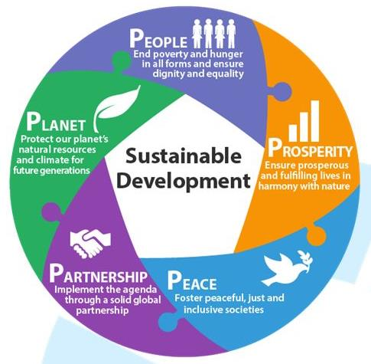
Partnerships: A key element of the GCM & the 2030 Agenda
- The GCM follows a ‘whole of society approach’ and promotes broad, multi-stakeholder partnership to address migration in all its dimensions.
- The 2030 Agenda’s 5 Ps:
People
Prosperity
Planet
Peace
Partnership
“No country can address the challenges and opportunities of this global phenomenon on its own.”
~ GCM para 11
Notes:
To change photo, just right click photo and choose ”Change Picture”

Slide 3
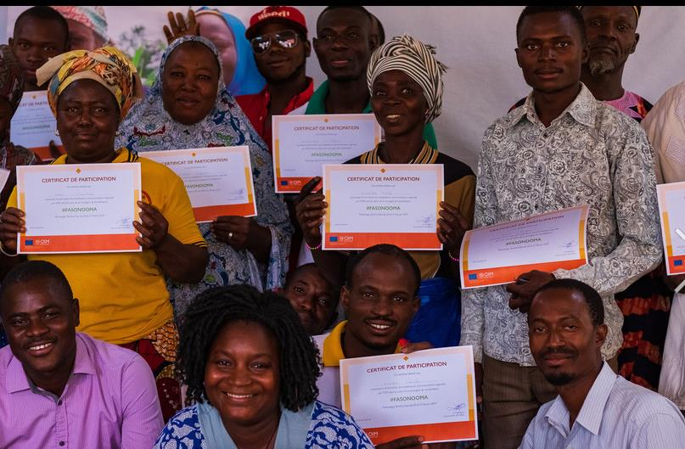
Partnerships the 2030 Agenda & the GCM Implementation of the GCM is dependent on partnership between/ among:
Migrants
Civil society
Migrant and diaspora organizations
Local authorities and communities
The private sector
Parliamentarians
National Human Rights Institutions
International Red Cross and Red Crescent Movement
Academia
Media
Other relevant stakeholders
Innovative and non-traditional partnerships are
central to success
Notes:
To change photo, just right click photo and choose ”Change Picture”

Slide 4
Multi-directional partnerships
VERTICAL PARTNERSHIPS
between different levels of government (national and sub-national)
HORIZONTAL PARTNERSHIPS
across different ministries and policy sectors

Slide 5
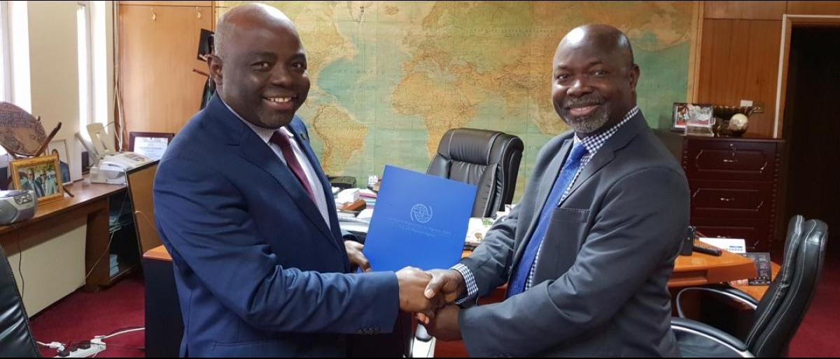
Cross-border partnerships
The GCM makes reference to the importance of cross-border partnerships.
The GCM:
Obj. 7, action (e): Accounting for migrant children in cross-border cooperation frameworks
Obj. 7, action (c): Facilitating cross-border law enforcement to counter migrant smuggling
Obj. 11, action (g): Improving cross-border collaboration relating to treatment of persons crossing international borders
Notes:
To change photo, just right click photo and choose ”Change Picture”

Slide 6
Strengthening partnership
in accordance with the vision and guiding principles of the GCM
What existing partnerships are critical to effective GCM implementation within your country?
What partnerships are lacking and/or could be strengthened to ensure effective GCM implementation in your country?
Insert EasyRetro or other online brainstorming tool Link
Group reflection
Notes:
Insert Link here
ADDITIONAL GUIDING QUESTIONS FOR CONSIDERATION
In the past, what have been some challenges to partnership in the area of migration? How can these challenges be overcome?

Slide 7
Questions?
Notes:
Key points
- Pause in the session to find out of there are any questions from participants on what has been covered in this part of the session

Slide 8
Monitoring, Evaluation and Reporting
Notes:
Key points
- Pause in the session to find out of there are any questions from participants on what has been covered in this part of the session

Slide 9
Voluntary National Reviews (VNRs)
A recap:
Regular reviews of progress on 2030 Agenda implementation: country-led & country-driven
Presented by governments during the annual High-level Political Forum on Sustainable Development (HLPF) in New York
Sharing of experiences, challenges & lessons learned
Strengthen governments' policies & institutions
Mobilize multi-stakeholder support for SDG implementation

Slide 10
VNRs & migration
VNRs can:
Help draw attention to the situation of migrants
Emphasise the link between migration and the SDGs
Highlight areas where migration has affected SDG progress
Ensure that migration-related indicators are reflected in VNR
Identify other areas of progress towards SDGs linked to migration

Slide 11
GCM: monitoring & review
“We will review the progress made at local, national, regional and global levels in implementing the Global Compact in the framework of the United Nations through a State-led approach and with the participation of all relevant stakeholders” – GMC, para. 48
Regional reviews
Beginning 2020
Global review: International Migration Review Forum (IMRF)
Beginning 2022
National reviews of GCM implementation
Regular, voluntary reviews the status of implementation of the GCM at national level are encouraged and should inform Regional Reviews and the IMRF.

Slide 12
International Migration Review Forum (IMRF)
Primary inter-governmental platform for Member States to discuss & share on GCM progress, including as it relates to the 2030 Agenda for Sustainable Development
Will convene every four years, starting in 2022
Includes interaction with and participation of all relevant stakeholders
Each IMRF to result in a Progress Declaration agreed upon by governments
Post-IMRF in 2022, this slide should be updated with core outcomes
The GCM review (IMRF) is complimentary to the VNR (and HLPF)
Recall: GCM is rooted in the 2030 Agenda & supports SDG acceleration & attainment

Slide 13
International Migration Review Forum (IMRF)
National and Regional Reviews
Each IMRF should be meaningfully informed by both national and regional reviews
National reviews conducted by governments should regularly and inclusively examine progress on GCM implementation and inform future planning and activities
Regional reviews, take place every four years, alternating with the IMRF
Update here according to country context - i.e. preparation for, or outcomes or, national or regional reviews
Visit the UN Network on Migration website for guidance, templates and related documents to support the preparation of national and regional reviews, as well as the IMRF: https://migrationnetwork.un.org/

Slide 14
Monitoring and Reporting
Building synergies between GCM monitoring and reporting and SDG monitoring and reporting
How can your country's VNRs feed into the IMRF and vice-versa?
Identify concrete actions that will support strengthening synergies between these processes. Think about:
Timing (when are national VNRs and GCM reviews conducted)
Development (what agencies or authorities lead in the process? Do they engage in both processes?)
Sources (what data sources and/or other processes should inform both, ex: UPRs, national strategy monitoring, etc.
Other actions?
Insert EasyRetro link
Group reflection

Slide 15
Questions?
Notes:
Key points
- Pause in the session to find out of there are any questions from participants on what has been covered in this part of the session
Interactive element:
- Prompt participants ….

Slide 16
Funding, Financing and Fundraising
Notes:
Key points
- Pause in the session to find out of there are any questions from participants on what has been covered in this part of the session

Slide 17
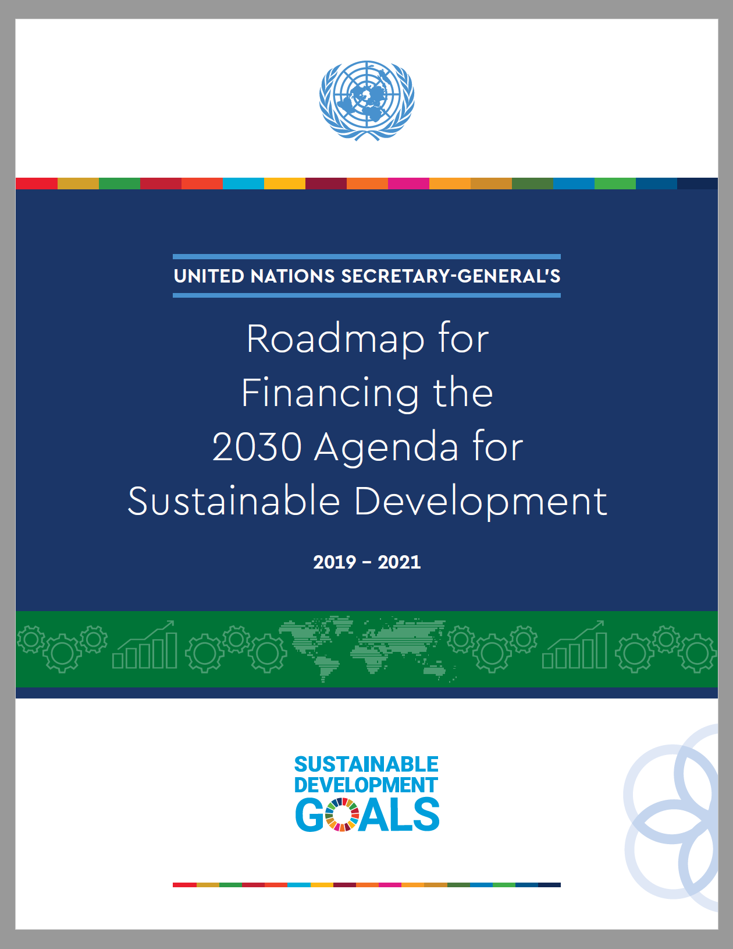
SDGs funding & financing - recap
Parallel streams:
FUNDING
…is about transferring money from a financial contributor to a recipient (e.g. donor country to UN).
The UN will increasingly be involved in both
…structuring & unlocking different financial flows to achieve a common result (e.g. helping governments develop a national financing strategy), including:
Domestic public resources
Domestic & international private business & finance
International development cooperation
FINANCING
Notes:
To change photo, just right click photo and choose ”Change Picture”

Slide 18
Migration & SDG Financing
Migrants as agents of change
Migrants’ economic & financial contributions
Individual/ community level contributions
Aggregate contributions
Addis Ababa Action Agenda (financing for development):
Reduced remittance costs
Improved diaspora engagement
Financing and building entrepreneurship systems and opportunities
Public-Private-Partnerships engaging with migrants entrepreneurs or migrant-related private business entities to support development objectives

Slide 19
Migration Multi-Partner Trust Fund (Migration MPTF)
“Start-up” fund of the capacity building mechanism of the GCM
First UN inter-agency pooled funding instrument focusing on migration
Has its own steering committee with representatives of Member States, donors, stakeholders & UN entities
Dedicated to jumpstarting collective action around well-managed migration policies
Learn more here: https://migrationnetwork.un.org/mptf

Slide 20
Migration MPTF Key Features
A partnership tool owned by national governments
Alignment with GCM 360-degree approach & guiding principles
People centered, whole-of-government and whole-of-society approaches emphasized throughout programme cycle
Gender Marker and innovative Human Rights Marker in place
Performance measured at Fund level through the Results Framework
Support to UN reform
Aligned with Funding compact
Key role for UN Resident Coordinators
Contribution to UN coherence
Strengthening linkages between GCM and SDG frameworks
Synergies with UN Network on Migration at country/regional/global levels

Slide 21
Migration MPTF Thematic Areas
GCM objectives are clustered into the 5 Thematic Areas (TA):
TA 1: Promoting fact-based, data-driven migration discourse, policy & planning
TA2: Protecting the human rights, safety & wellbeing of migration
TA3: Addressing irregular migration, including through border management & combatting transnational crime
TA4: Facilitating regular migration, decent work & positive development benefits of human mobility
TA5: Improving social inclusion & integration of migrants

Slide 22
Migration MPTF Projects
Nine funded projects
32 projects in the pipeline for funding
(n.b. these should be updated in advance of the training)
Summaries of the funded projects, as well as those included in the pipeline, can be found on the Network’s website (here)
Concept notes accepted on a rolling basis
The Operations Manual (available here) includes all instructions as well as the concept note template
https://migrationnetwork.un.org/mptf

Slide 23
Questions?
Notes:
Key points
- Pause in the session to find out of there are any questions from participants on what has been covered in this part of the session
Interactive element:
- Prompt participants to highlight the connections between the frameworks in connection to the national context (depending on time)

Slide 24
Fundraising
Migration MPTF concept note: lightning round review
Brainstorm on two elements of the Migration MPTF Concept Note:
Complementarity:
How might a joint programme build on what has been done or is currently being done by the UN and other actors in county/region?
Innovation:
What could make a project innovative?
Connections to national or regional strategies:
What key national or regional strategies should be evaluated/considered to inform potential M-MPTF concept notes?
Partnerships:
How do new or existing partnerships set this M-MPTF concept note apart?
Insert EasyRetro or other online brainstorming tool link
Group reflection
Notes:
Insert link here:

Slide 25
Questions, wrap-up and way forward
Wrap up:
This training has been intended to support UNCTs to:
1. Understand how to systematically integrate migration into Cooperation Frameworks and accompanying Common Country Analyses
2. Understand how the integration of migration into CF contributes to the implementation of the Global Compact for Safe, Orderly and Regular Migration (GCM) and the realization of the Sustainable Development Goals (SDGs)
Way forward:
Update with key thematic priorities and or suggested actions identified throughout the training which are recommended to help take the training forward
Articulate available support and or synergies for future action (global, regional, national)
Over to you...!
Notes:
Link to post-training questionnaire: https://forms.office.com/r/nTkSCuDVEE

Slide 26
OFFICIAL CLOSING
Notes:
Link to post-training questionnaire:

Slide 27
United Nations Network on Migration
17 Route des Morillons, P.O. Box 17
1218 Grand-Saconnex, Switzerland
+41 22 717 91 11
unmignet@iom.int
www.migrationnetwork.un.org

